Slide 1
Deep learning can accelerate grasp-optimized motion planning
Jeffrey Ichnowski, Yahav Avigal, Vishal Satish, Ken Goldberg
Presenter: Shashank Gupta

Slide 2

About Author
Jeff Ichnowski is currently assistant professor at Carnegie Mellon University (CMU).
Before that, Post-doctoral researcher at UC Berkeley.
PhD from University of North Carolina.
Research: Robot grasp, Motion Planning, Optimization, Deep Learning.
@jeff_ichnowski

Slide 3
Content
Motivation
Problem Statement
Background
Author Solution
Results
Discussion

Slide 4
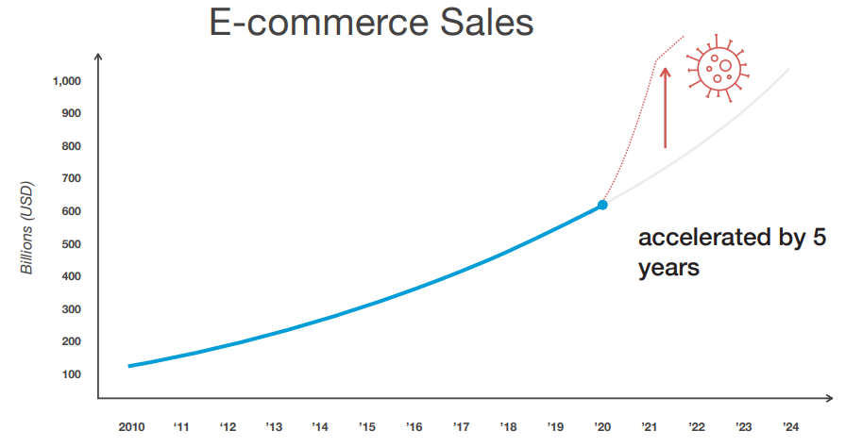
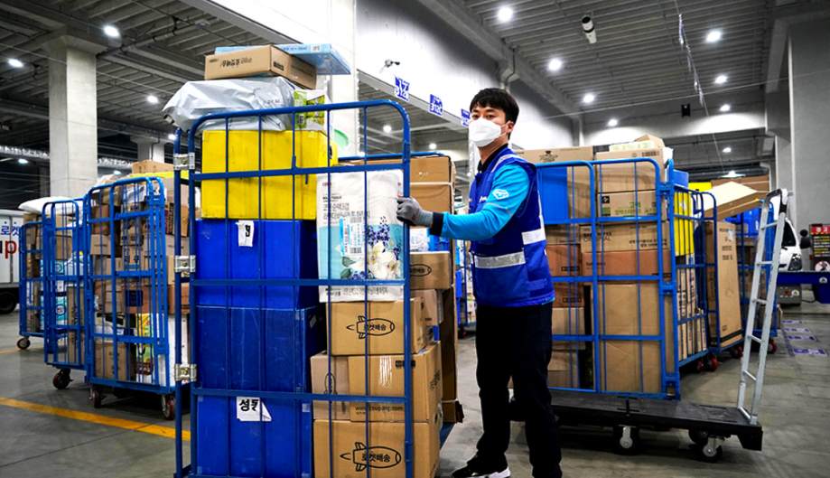
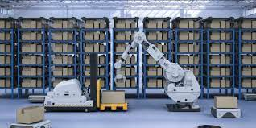
Motivation
Grasp arbitrary object application in factories, warehouses, and home.
Running time v/s Accuracy tradeoff

Slide 5
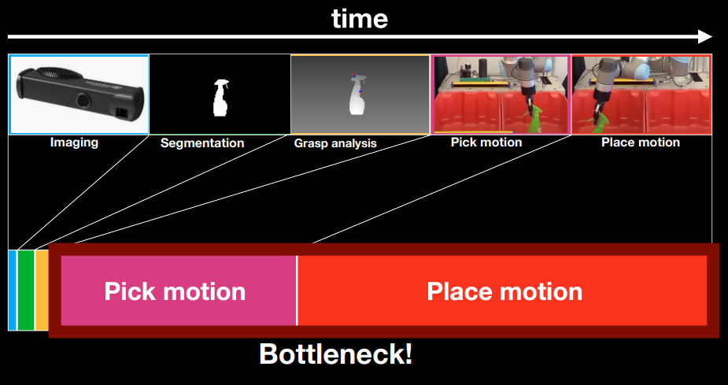
Credit: https://www.nvidia.com/en-us/on-demand/session/gtcspring21-s31905/

Slide 6
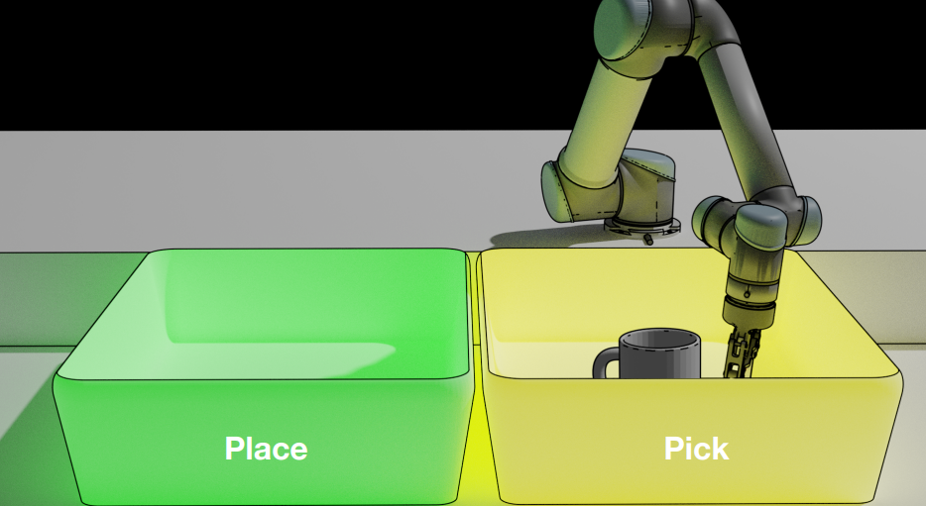
Problem Statement
Scenario: Pick up and Place object
Given: Initial(g_o) and Final Grasp Position(g_h)
Task: Optimal trajectory
Constraint: Faster pick-and-place with fast and smooth trajectory

Slide 7
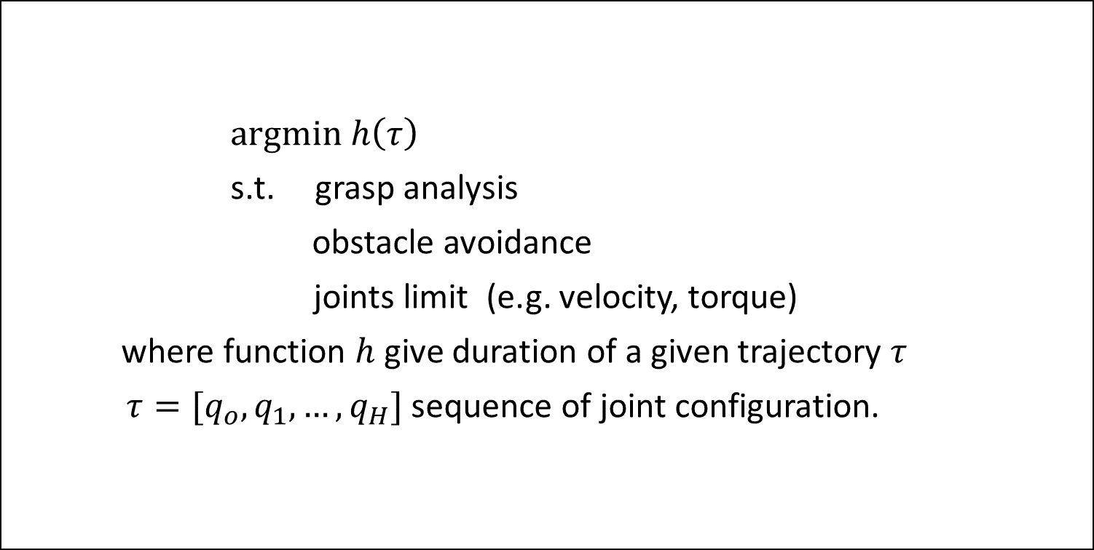
Mathematical Formulation
$argmin h\left(τ\right)$
s.t. grasp analysis
obstacle avoidance
joints limit (e.g. velocity, torque)
where function $h$ give duration of a given trajectory $τ$
$τ=[q_{o}, q_{1},…, q_{H}]$ sequence of joint configuration.

Slide 8
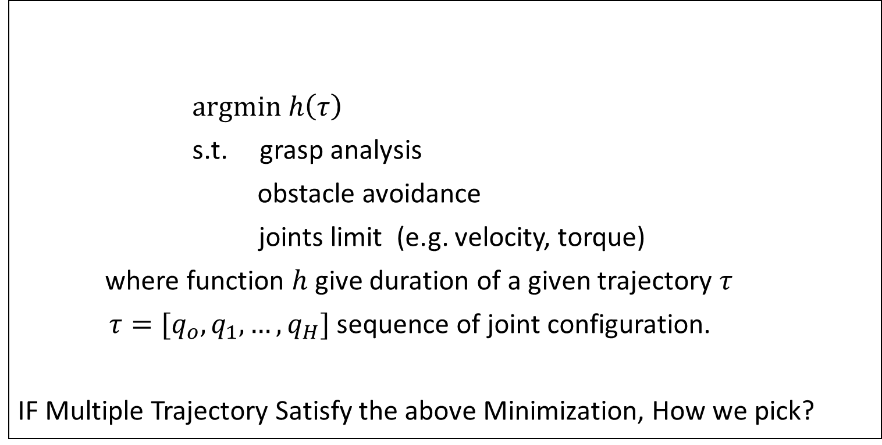
Mathematical Formulation
$argmin h\left(τ\right)$
s.t. grasp analysis
obstacle avoidance
joints limit (e.g. velocity, torque)
where function $h$ give duration of a given trajectory $τ$
$τ=[q_{o}, q_{1},…, q_{H}]$ sequence of joint configuration.
IF Multiple Trajectory Satisfy the above Minimization, How we pick?
Not Convex!

Slide 9
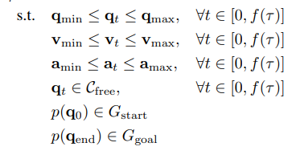
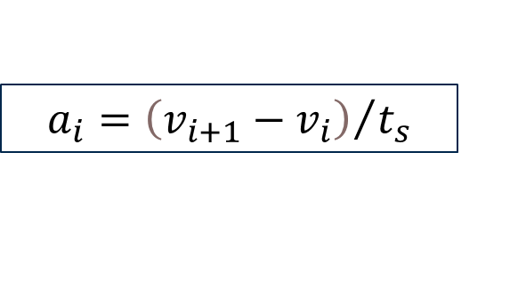


GOMP (Author Pre work)
$$\arg{\min_{τ}\sum_{i=0}^{H−1}{a_{i}^{T}Pa_{i}}}$$
$$τ=\left[τ_{0},τ_{1},τ_{2},…,τ_{H}\right]$$
$$τ_{k}=\left[\begin{matrix}q_{k} \\ v_{k} \\ a_{k}\end{matrix}\right]$$
Application Specific diagonal weighted matrix
$$a_{i}={\left(v_{i+1}−v_{i}\right)}/{t_{s}}$$
Discretization Horizon
Discretization time-step

Slide 10
Two Step Solution
Minimize sum-of-square acceleration. (Sequential Quadratic Program)
Then minimize time Horizon (Binary Search Tree)

Slide 11
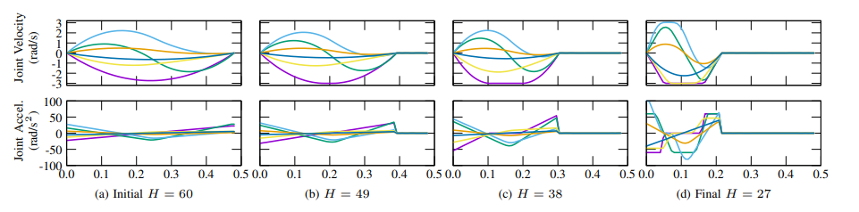
GOMP Cont.

Slide 12
GOMP Cont.
JERK!

Slide 13
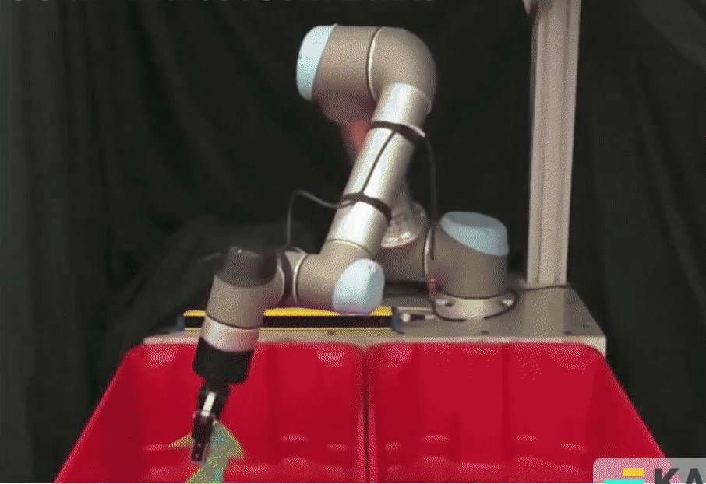
Video
Wear on joint
Imprecise Trajectory
Overshoot at the end
Credit: https://www.nvidia.com/en-us/on-demand/session/gtcspring21-s31905/

Slide 14
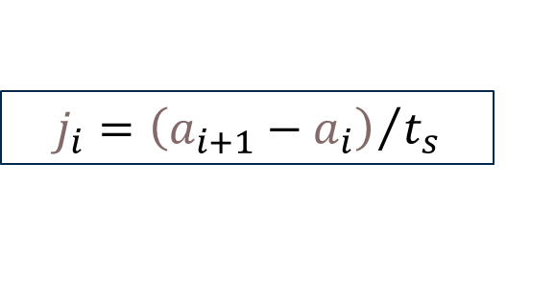


J-GOMP
$$\arg{\min_{τ}\sum_{i=0}^{H−1}{j_{i}^{T}Pj_{i}}}$$
$$τ=\left[τ_{0},τ_{1},τ_{2},…,τ_{H}\right]$$
$$τ_{k}=\left(\begin{matrix}q_{k} \\ v_{k} \\ q_{k} \\ j_{k}\end{matrix}\right)$$
Application Specific diagonal weighted matrix
$$j_{i}={\left(a_{i+1}−a_{i}\right)}/{t_{s}}$$
Discretization Horizon
Discretization time-step

Slide 15
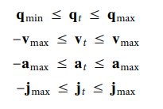
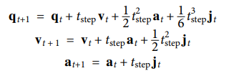
J-GOMP
$$\arg{\min_{τ}\sum_{i=0}^{H−1}{j_{i}^{T}Pj_{i}}}$$

Slide 16
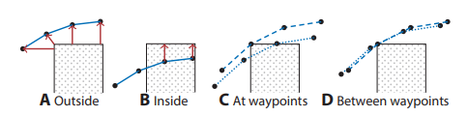
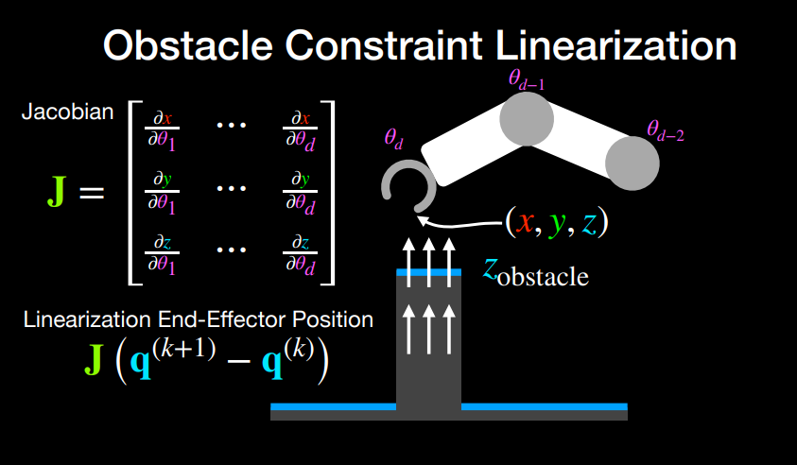
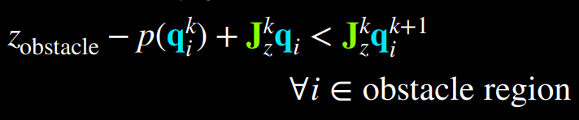
Additional Constraint
Obstacle Constraint on a Depth map are nonconvex, and it is handled by linearizing and creating trust region.
Credit: https://www.nvidia.com/en-us/on-demand/session/gtcspring21-s31905/

Slide 17
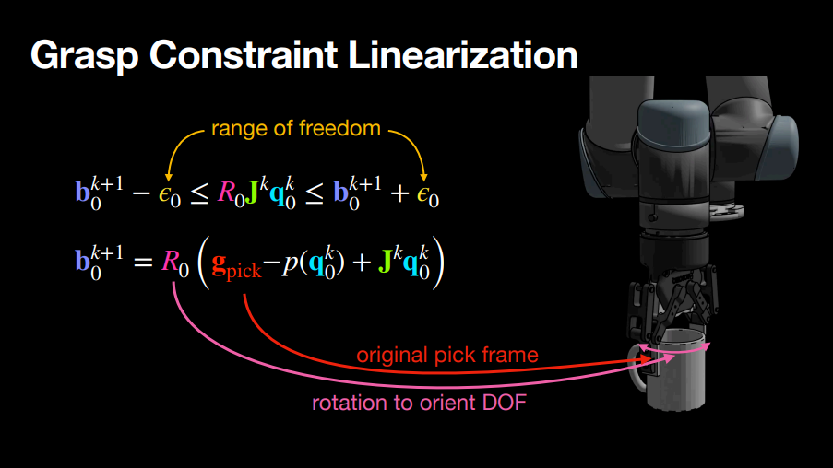
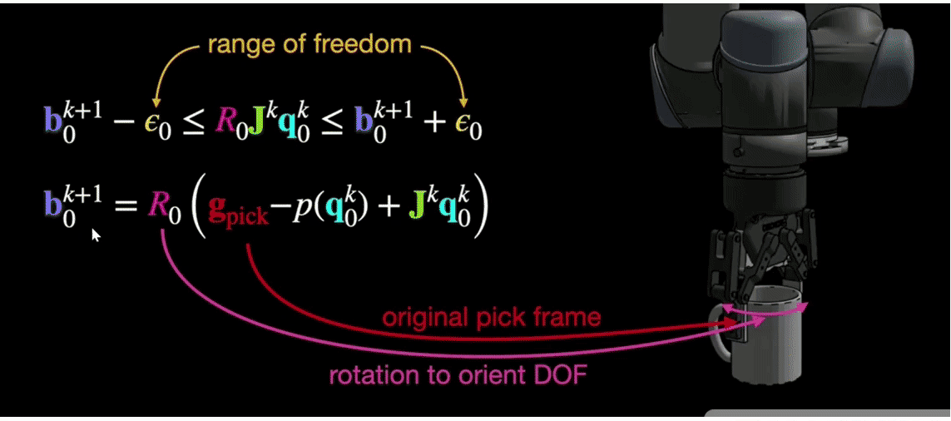
Additional Constraint
Grasp Constraint is also non-convex, and it is handled by Linearization

Slide 18
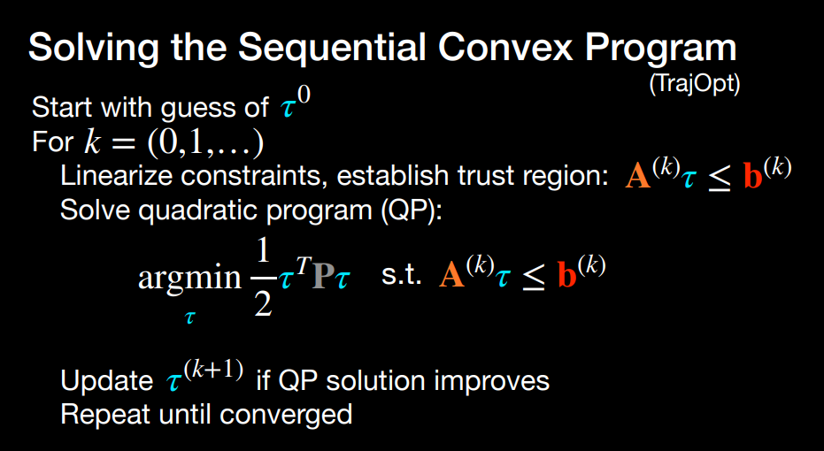
Credit: https://www.nvidia.com/en-us/on-demand/session/gtcspring21-s31905/

Slide 19
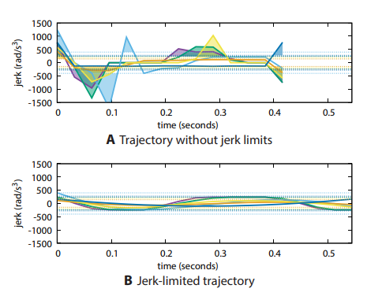
J-GOMP
☺
Reduced wear
Improved trajectory
Avoid Overshoot 
☹
Slightly Slower Motion
Much Slower Computation

Slide 20
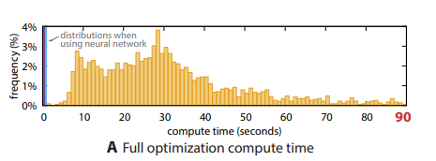
Shortcoming with J-GOMP
Median Compute Time: 29 Sec

Slide 21

Pipeline Before

Slide 22
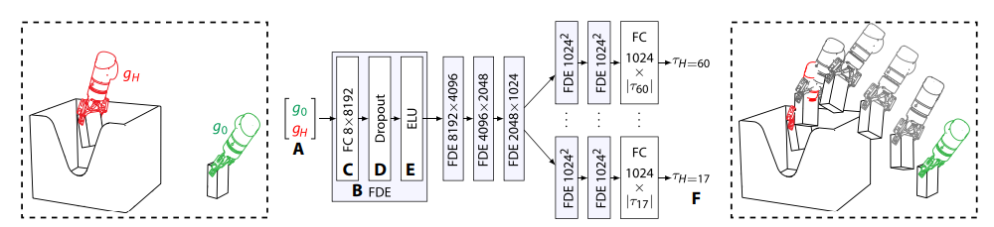
Deep Learning Pipeline

Slide 23
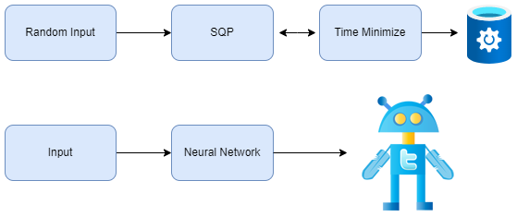
Deep Learning Pipeline
Data Generation
Phase
Train Offline
Deep Learning

Slide 24
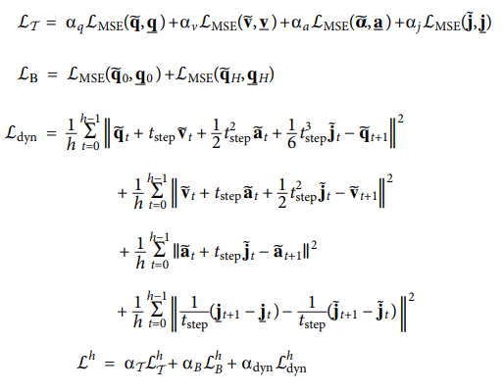
Loss Function

Slide 25
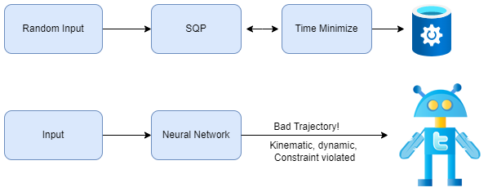
Deep Learning Pipeline
Train Offline

Slide 26
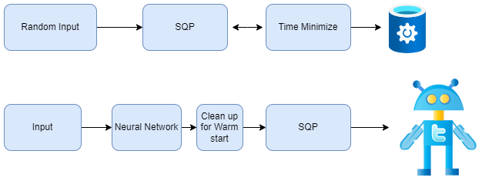
Deep Learning Pipeline
Same SQP

Slide 27
Network Architecture

Slide 28
Classifier Network
What Horizon time to select?
Which trajectory to select?

Slide 29

Classifier Network
What Horizon time to select?
Which trajectory to select?
Classification Network

Slide 30
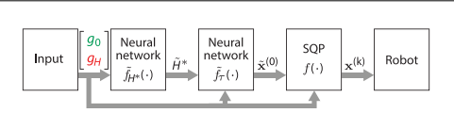
Finally

Slide 31
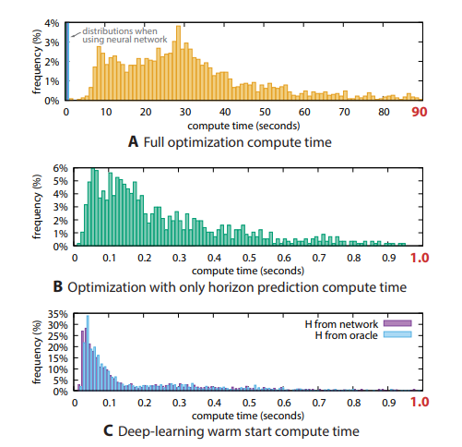
Result
Median Compute Time: 29 Sec
Median Compute Time: 80 ms

Slide 32
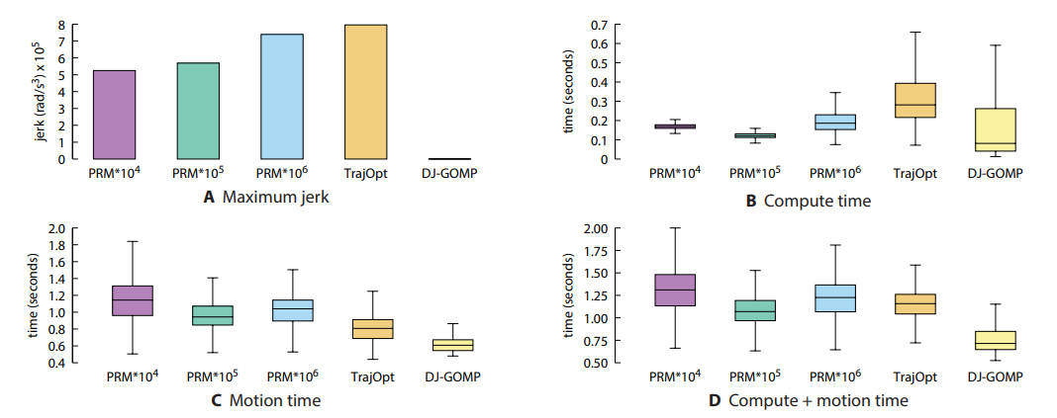
Comparison

Slide 33
Discussion - 1
Currently, the amount of training data needed is huge and the choice of network is also a bottleneck considering one must predict for every head, is their any better design choice?

Slide 34
Discussion 2
Can the deep learning approach be optimized in any way to reconsider for additional SQM iteration. Can deep learning give us Physics driven solution which satisfy the constraint in hand?
Neural ODE? PDE based modelling? Or some sort of other head in Neural network to account for correctness check of solution? How would you go about it?

Slide 35
Thank you

