Slide 1
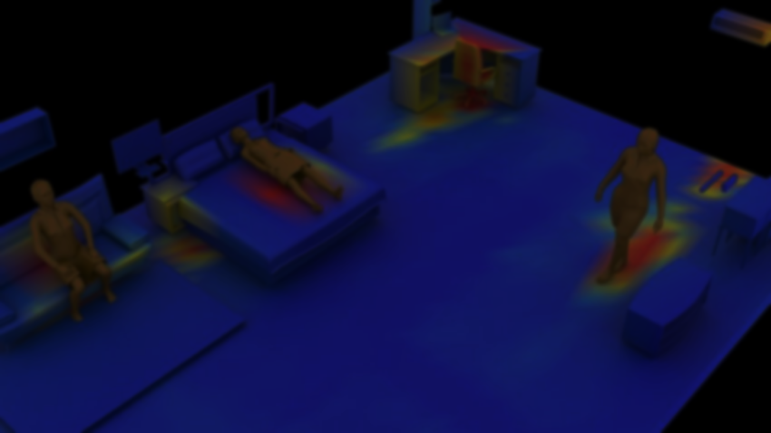
Duration: 30 min
University of Michigan
EECS 498
Action and Perception
Putting Humans in a Scene: Learning
Affordance in 3D Indoor Environments
Xueting Li, Sifei Liu, Kihwan Kim, Xiaolong Wang, Ming-Hsuan Yang, and Jan Kautz
PRESENTED BY:
HARIKRISHNAN SEETHARAMAN
MS Robotics, UMich
JEMUEL STANLEY PREMKUMAR
MS Robotics, UMich

Slide 2
OVERVIEW OF THE PRESENTATION
Interpretation of Affordances
Reasonable human pose
Fully automatic 3D pose synthesizer
3D Affordance Generative Model
Discussion

Slide 3
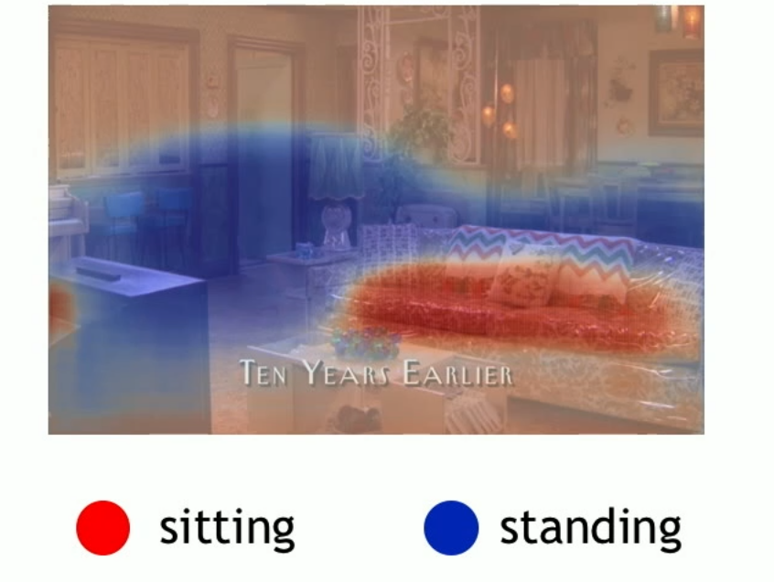
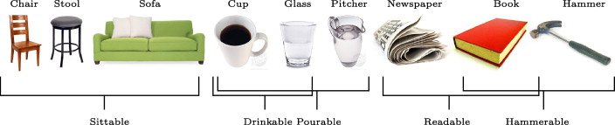
HOW TO INTERPRET AFFORDANCE?
Definition: Opportunities of interaction in the environment
What we care?
Functionalities
Example affordance an indoor environment offers
Notes:
What actions can the object be used for?
How to interact with objects properly
Focussed on the functionality of the medium, rather than the quality / category of medium

Slide 4
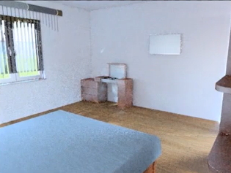
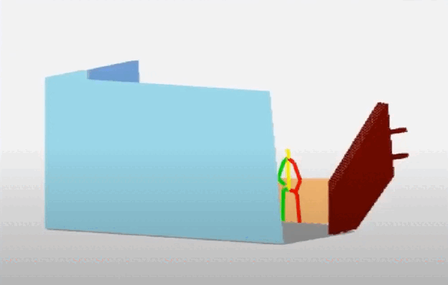
AFFORDANCE IN INDOOR ENVIRONMENT
OBJECTIVE: Generate reasonable human poses in 3D scenes given a single image
INPUT
OUTPUT
Notes:
Generate reasonable human poses in 3D scenes from a 2D scene image. This scene image: Single RGB or RGB-D

Slide 5
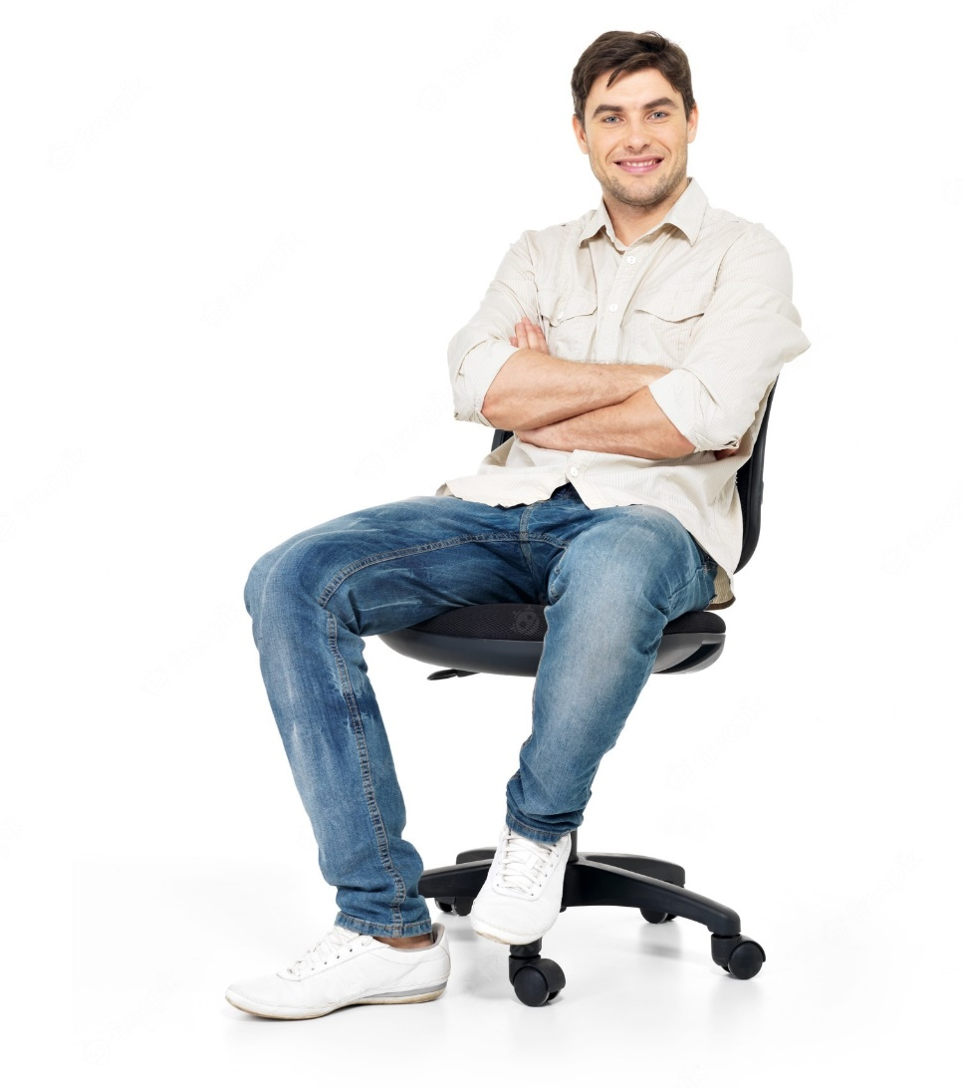
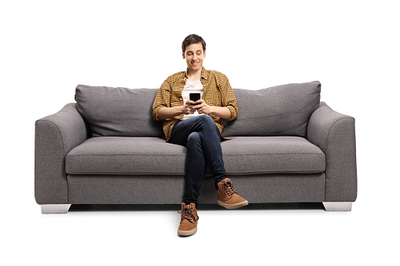
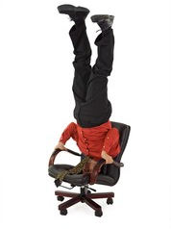
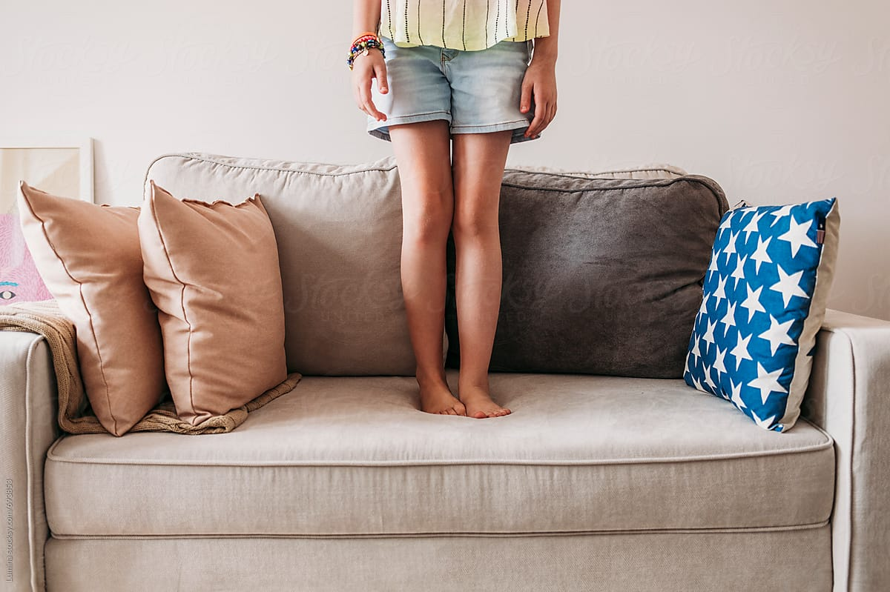

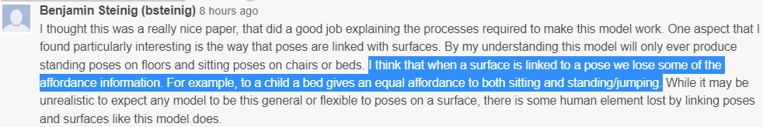
WHAT IS A REASONABLE HUMAN POSE?
SEMANTICALLY PLAUSIBLE: Common actions in indoor environment
Notes:
What does a pose mean to be reasonable in indoor scenes?
Semantically plausible: Common actions in indoor environment

Slide 6
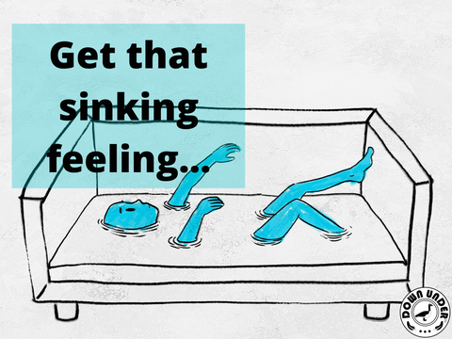

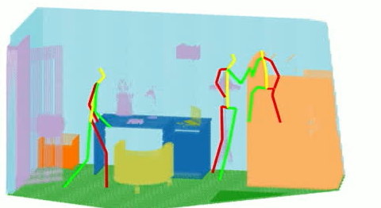
WHAT IS A REASONABLE HUMAN POSE?
PHYSICALLY STABLE: Human pose supported by surroundings
Notes:
Well supported by surrounding objects
Standing human supported by : Floor
Sitting human supported by : chair/bed
Shouldn’t be mistook with rigidity

Slide 7
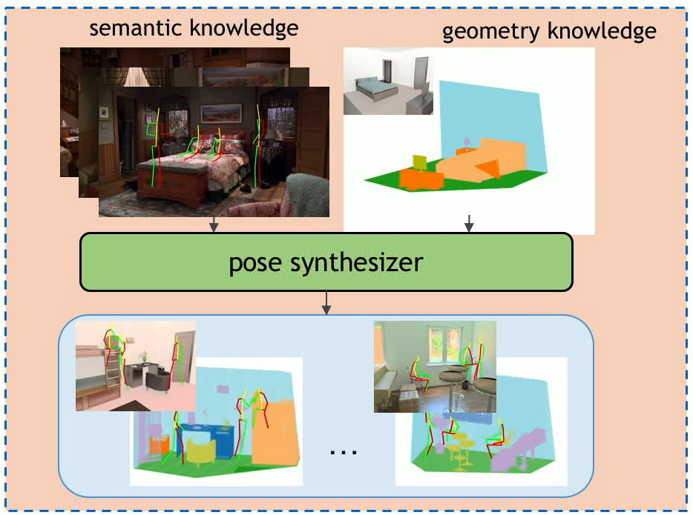
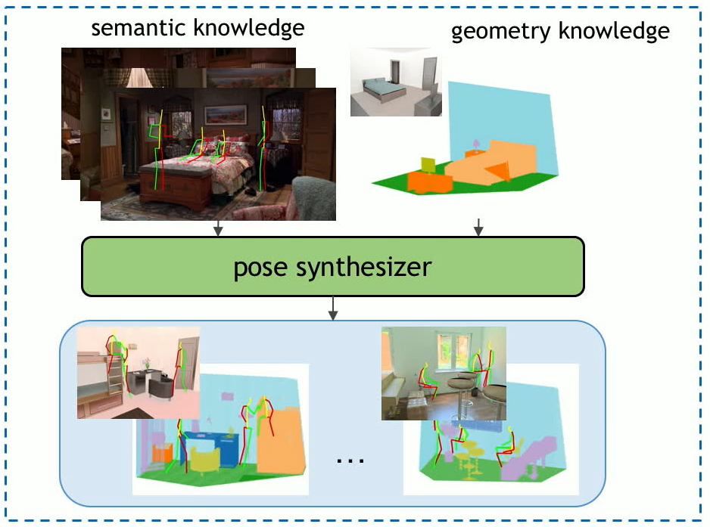
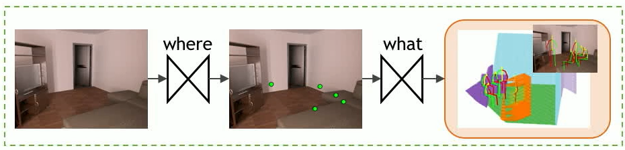
LEARNING 3D AFFORDANCE
STAGE-I: Build a fully automatic 3D pose synthesizer
STAGE-II: Using the dataset, train a data-driven and end-to-end 3D pose prediction model
Notes:
Two stages

Slide 8
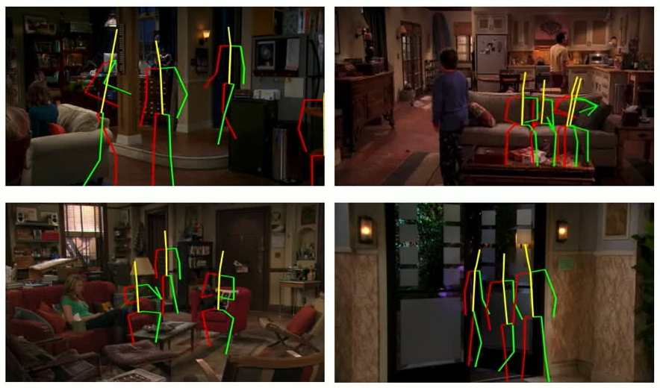
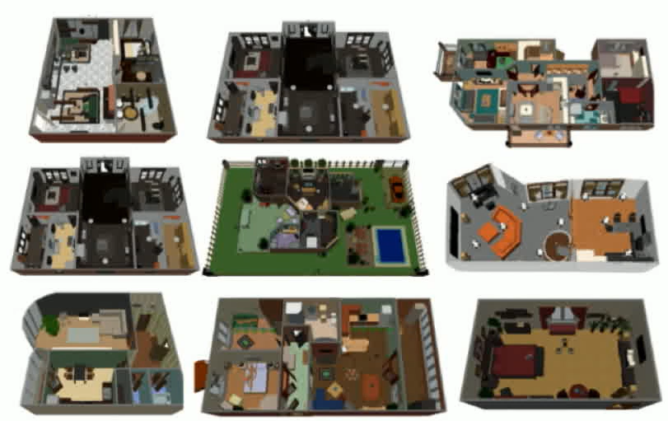
STAGE - I
Available datasets
Semantic knowledge
Geometric knowledge
The Sitcom dataset [1]
The SUNCG dataset [2]
SOMEHOW COMBINE?
[1] Wang X, Girdhar R, Gupta A. Binge Watching: Scaling affordance learning from sitcoms CVPR, 2017
[2] Song S, Yu F, Zeng A, et. al,. Semantic scene completion from as single depth. CVPR 2017
Notes:
Sitcom: 2D human poses in 2D images (No 3D annotations)
SUNCG: All 3D information (no human poses)
Combine to synthesize 3D poses for ground truths

Slide 9
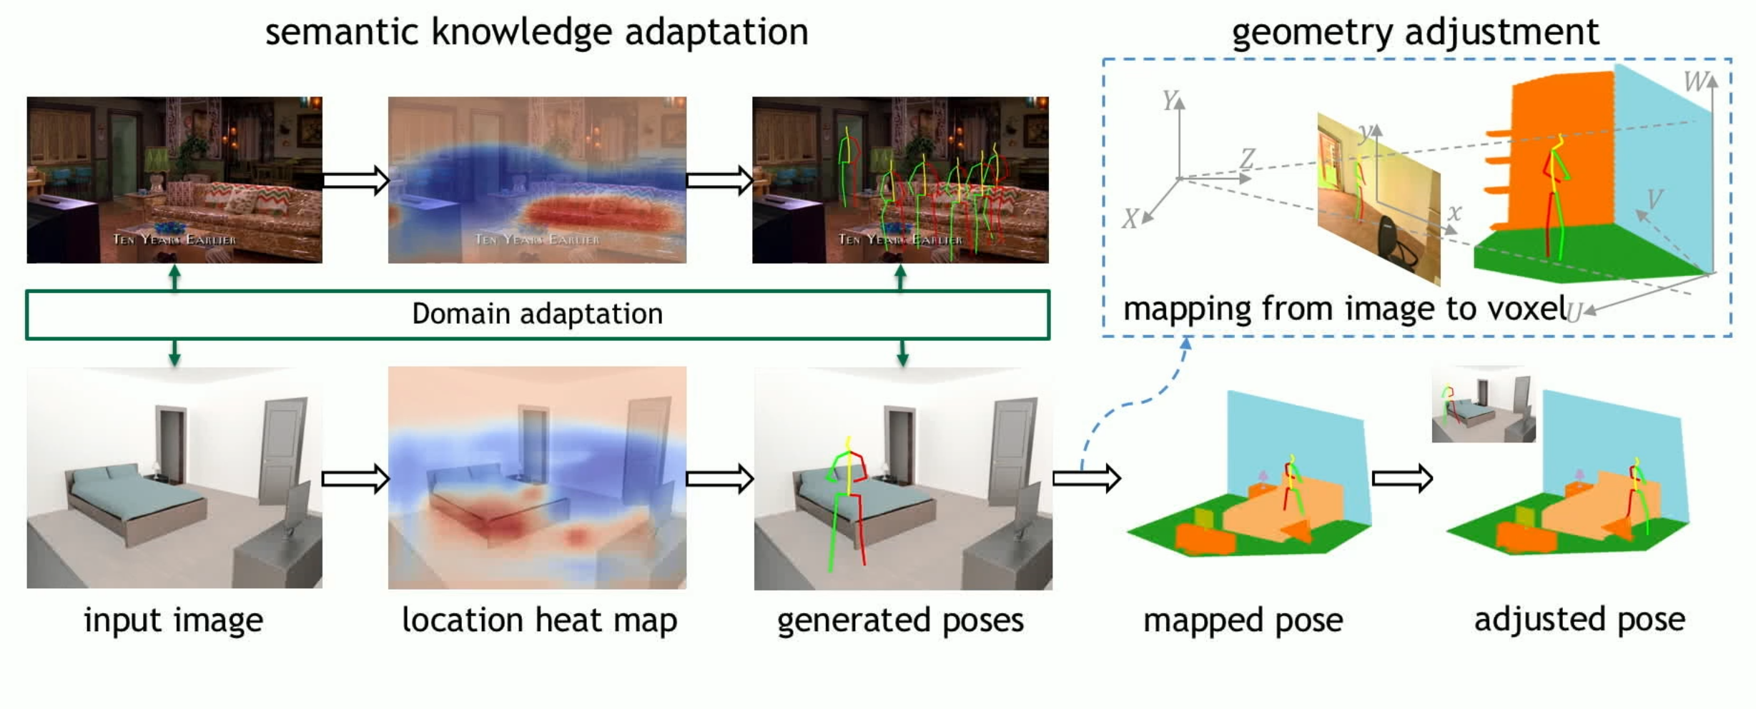
STAGE – I: FULLY AUTOMATIC 3D POSE SYNTHESIZER
Fusing semantic & geometric knowledge
1
2
Notes:
Problem: : Large domain-gap between the datasets. Domain-adaptation is performed using feature statistic mapping (used in style transfer)

Slide 10
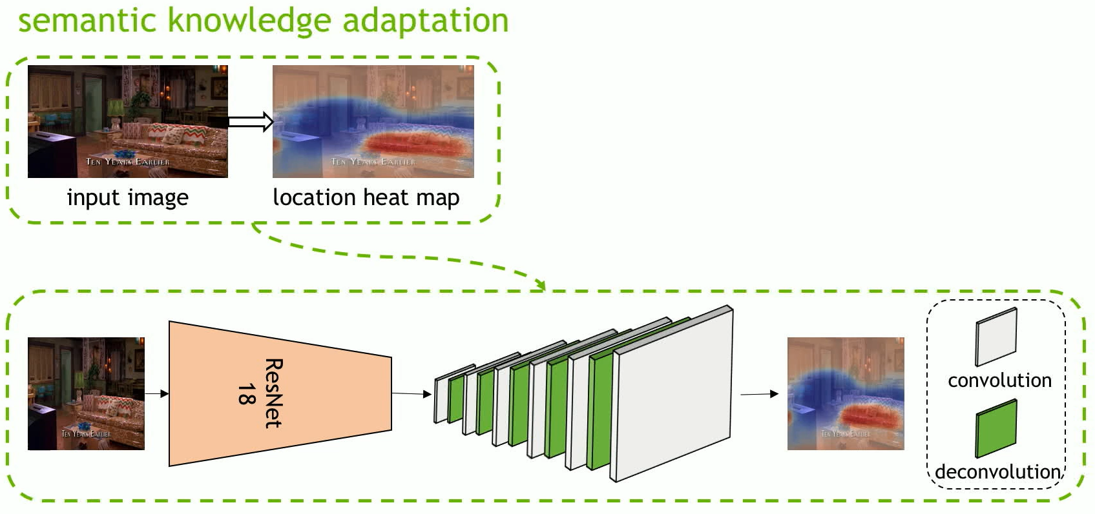
STAGE – I: FULLY AUTOMATIC 3D POSE SYNTHESIZER
Generating location heat map
Train a ResNet18 model : Heatmap
Sample positions for humans
Generate poses
Notes:
How to generate 2D poses?
1) Map 2D pose annotations in the sitcom dataset to 3D poses in Human 3.6M dataset
2) Train the pose generative model [2] to generate 3D poses (which we’ll discuss in Stage-II)
To satisfy the constraints: a 2D human pose generative model is learnt that encodes the natural human pose distributions from existing 2D examples. Then using the camera parameters, these generated poses are mapped into 3D world.

Slide 11
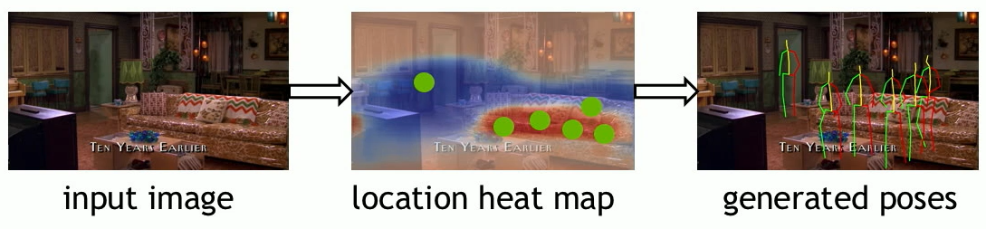
STAGE – I: FULLY AUTOMATIC 3D POSE SYNTHESIZER
Generating poses in 2D images:
Wang X, Girdhar R, Gupta A. Binge Watching: Scaling affordance learning from sitcoms CVPR, 2017
Notes:
How to generate 2D poses?
1) Map 2D pose annotations in the sitcom dataset to 3D poses in Human 3.6M dataset
2) Train the pose generative model [2] to generate 3D poses (which we’ll discuss in Stage-II)
To satisfy the constraints: a 2D human pose generative model is learnt that encodes the natural human pose distributions from existing 2D examples. Then using the camera parameters, these generated poses are mapped into 3D world.

Slide 12
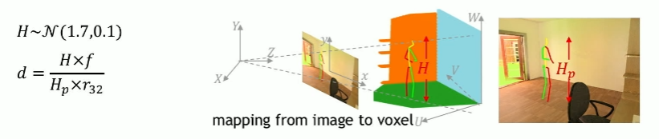
STAGE – I: FULLY AUTOMATIC 3D POSE SYNTHESIZER
Mapping from 2D image to 3D voxel
ALTERNATIVE APPROACH?
Notes:
Take the resulting pose depth as the depth of the pelvis joint and calculate the depth of other joints by their offsets w.r.t to the pelvis joint.
NAÏVE approach……think alternative ways

Slide 13
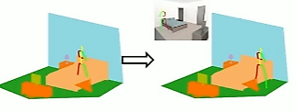
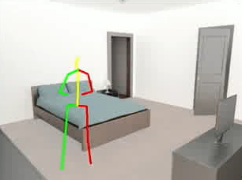
STAGE – I: FULLY AUTOMATIC 3D POSE SYNTHESIZER
3D pose adjustments
Notes:
Since the pose prediction model is trained with only 2D information, a plausible generated pose may not be physically feasible. Hence, this calls for adjusting to locations to avoid collisions

Slide 14

STAGE – I: FULLY AUTOMATIC 3D POSE SYNTHESIZER
Constraints [3]:
Free space constraint: No human body part can intersect with any object in the scene
3D correlation between pose and a voxel representation of the scene
Correlation score
Note: Necessary contacts between humans and objects (for sitting or standing) should be considered – Mask specific body parts
[3] A. Gupta et al. From 3D scene geometry to human workspace
Notes:
Free space: 0
Pose voxels and occupied spaces: 1
The free space constraint is satisfied in the locations where the correlation score below a threshold Tf
Necessary contacts between human and objects (e.g., a human touches
the chair when sitting, or the floor when standing) should be
considered. Thus we mask out these body parts that have to contact with objects, including thigh and pelvis for sitting
poses and feet for standing poses, when performing the 3D
correlation.

Slide 15
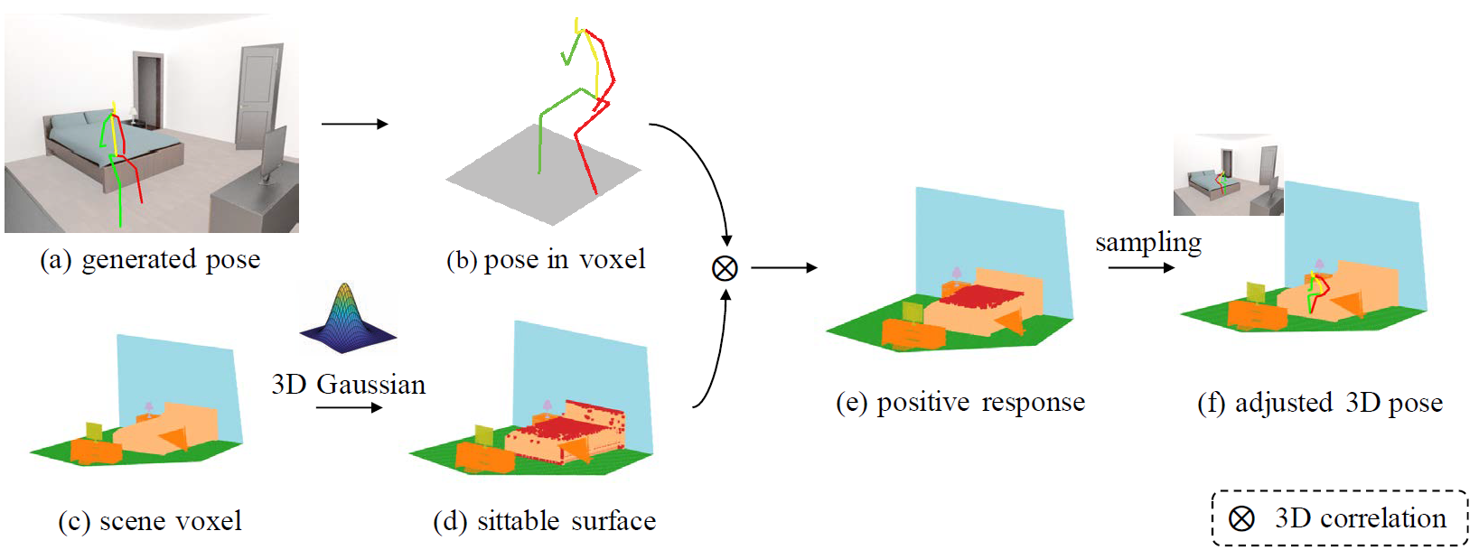
STAGE – I: FULLY AUTOMATIC 3D POSE SYNTHESIZER
Constraints:
Support constraint: Human pose should be supported by a surface
Between the scene voxels and 3D gaussian kernel: Detect all affordable surfaces in the room
Between 3D pose and all affordable surfaces
Notes:
The support constraint states that the
human pose should be supported by a surface of surrounding
objects (e.g., floor, bed). We search locations that satisfy
this constraint by performing two 3D correlations.
The first correlation is performed between scene voxels Vs and
a 3D Gaussian kernel to detect voxel cells on the surfaces
of affordable objects.
After this first correlation, all voxels except on the boundaries would be either zero or one. Masking them out would leave us only affordable surface boundaries. Boundary voxels without upward surface normal is eliminated.

Slide 16
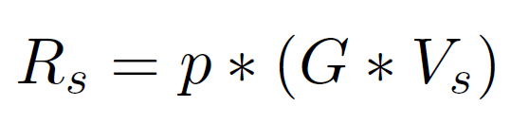
STAGE – I: FULLY AUTOMATIC 3D POSE SYNTHESIZER
Constraints:
Support constraint: Human pose should be supported by a surface
Between 3D pose and all affordable surfaces
- Adjust to the “best location”
Location obtained by localizing point with maximum correlation score (R_{s})
Notes:
Next, we perform another 3D correlation between poses
and the object surfaces and take the location with the maximum correlation score as the optimal location for putting the pose.
Note that poses are adjusted in a local region to preserve the semantic
information. Poses that do not find a valid location are discarded, i.e., the support constraint is satisfied in the locations where max (Rs) is above a threshold Ts.

Slide 17
STAGE – I: FULLY AUTOMATIC 3D POSE SYNTHESIZER
Constraints:
Affordable surface

Slide 18

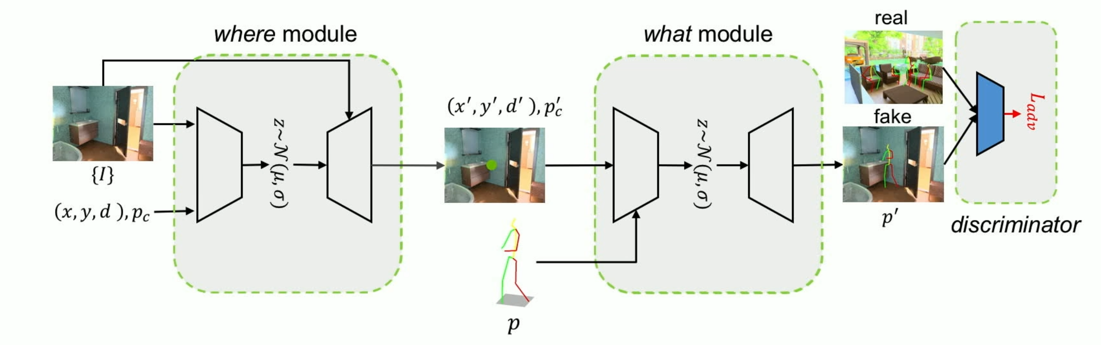
STAGE – II: 3D Affordance Generative Model
Objective: Using the dataset, train a data-driven and end-to-end 3D pose prediction model
Human Pose Modeling Parameters:
Scale
Pose
Location
Interactions
Challenging
Proposed approach: Two jointly-learned sub-tasks
Where (localization) module
What (pose gesture) module
Comparatively easier
Notes:
Generating human poses
in 3D scenes requires modeling the joint distribution of human
scale, pose, location and interactions with objects in
3D, which is very challenging. A typical solution is to use
a single network to model the joint distribution of pose locations
and gestures. This approach, however, will result
in a huge solution space and poor performance.
In contrast, we break it down to two jointly
learned sub-tasks, where the generative model for each subtask
is much easier to learn, To be specific, we first predict
the plausible locations in a scene and then predict the suitable human poses that are aligned with their surrounding context. Both modules are jointly trained using the pose location as a differentiable link, which allows the two modules to mutually benefit from each other, as well as from the
Discriminator.

Slide 19
STAGE – II: 3D Affordance Generative Model
Distribution model:
Location
Gesture
Conditioned Variational Auto-Encoders
Design considerations:
Semantically plausible
Physically feasible
Geometry-aware discriminator
Notes:
We take two factors into consideration when designing
both the where and the what modules. First, both modules
should be able to understand the semantics of scene
context to generate poses that follow natural human behaviors
(e.g., sit rather than stand on a sofa). To this end, we
model the distributions of pose locations and gestures by
two VAEs conditioned on the scene context.
Introduce a geometry-aware discriminator that further
regularizes the two modules to generate physically correct
Poses (regularizes two modules)

Slide 20
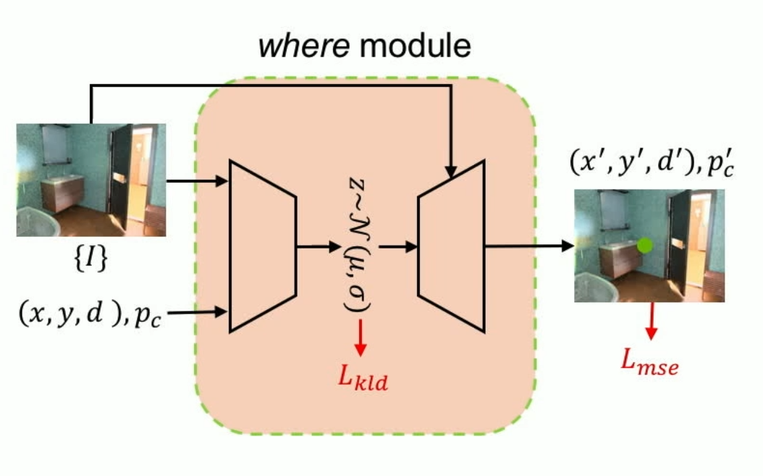
STAGE – II: 3D Affordance Generative Model
Where Module (Location prediction)
Considerations:
Ability to sample during inference (due to multiple possible poses)
Condition on scene image
Given: {I}
Task: Simultaneously re-construct pose pelvis joint coordinates and depth + most likely pose class
Notes:
Given a scene image I, we build a where VAE to encode
pose location in the 3D scene, by simultaneously reconstructing
pose pelvis joint coordinates (x; y) and depth
d, as well as the most likely pose class pc at the predicted
location.
The pose class pc provides a clue for the likely pose appearance
(e.g., sitting or standing), which can be obtained

Slide 21
STAGE – II: 3D Affordance Generative Model
Where Module (Location prediction)
Structure
Encoder extracts image features using ResNet18 and concatenates them with the location features and pose class features extracted by two fully connected layers.
The final concatenated feature is then fed into four fully connected layers to predict the mean and covariance for distribution Q
DSNT used to convert heat map to pose location coordinates
Notes:
18 layer ResNet
The decoder takes a latent variable z sampled
from Q and the scene context features shared with the encoder
to predict x; y; d; p. Because it is challenging for
the model to associate numerical coordinates with the exact
location in the image, we predict a heat map in the decoder
to indicate possible locations for a pose and adopt one
Differentiable Spatial to Numerical Transform (DSNT) [20]
layer to convert the heat map to pose location coordinates.

Slide 22

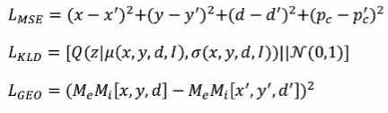
STAGE – II: 3D Affordance Generative Model
Where Module (Location prediction)
Losses:
Notes:
18 layer ResNet
The decoder takes a latent variable z sampled
from Q and the scene context features shared with the encoder
to predict x; y; d; p. Because it is challenging for
the model to associate numerical coordinates with the exact
location in the image, we predict a heat map in the decoder
to indicate possible locations for a pose and adopt one
Differentiable Spatial to Numerical Transform (DSNT) [20]
layer to convert the heat map to pose location coordinates.

Slide 23
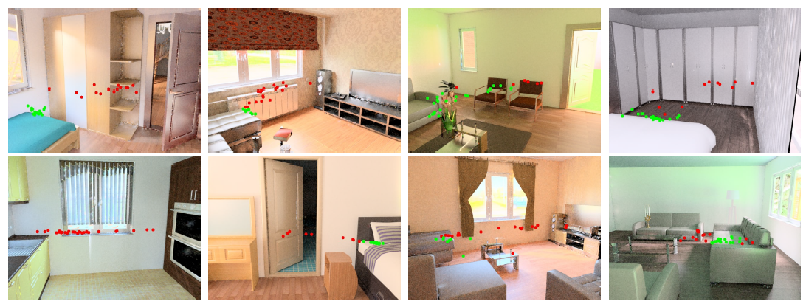
STAGE – II: 3D Affordance Generative Model
Where Module (Location prediction)
Sample outputs:
Pelvis joint locations marked in Red: Standing and Green: Sitting
Notes:
18 layer ResNet
The decoder takes a latent variable z sampled
from Q and the scene context features shared with the encoder
to predict x; y; d; p. Because it is challenging for
the model to associate numerical coordinates with the exact
location in the image, we predict a heat map in the decoder
to indicate possible locations for a pose and adopt one
Differentiable Spatial to Numerical Transform (DSNT) [20]
layer to convert the heat map to pose location coordinates.

Slide 24
STAGE – II: 3D Affordance Generative Model
What Module (gesture prediction)
Input: Pelvis joint coordinates and pose class, {I}
Task: Understand the scene context, and be able to sample poses conditioned on it.
Output: Coordinates and depth for each joint
Notes:
Our what module shares similar structure as the where module except that the inputs are pose location, scene context and pose class, and the outputs are the coordinates and depth for each joint.

Slide 25
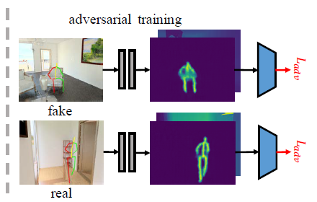
STAGE – II: 3D Affordance Generative Model
Geometry-aware Discriminator
Input: Coordinates and depth for each joint
Task: Further regularizes the
where and what module simultaneously to generate poses that obey geometry rules in the scene.
Note: We note that both the geometry-aware discriminator as well as the geometrically feasible/unfeasible labels are utilized only during training.
Notes:
In this work, we aim to generate poses in 3D scenes that follow physical rules in the scene, which requires our model. to properly hallucinate the 3D scene geometry merely from
a 2D image. To this end, in addition to including the
depth value of each pose during training, we introduce a
geometry-aware discriminator that further regularizes the
where and what module simultaneously to generate poses
that obey geometry rules in the scene.
As shown in Fig. 4(b), the discriminator takes generated
poses and scene depth images as inputs and learns to discriminate
between geometrically feasible (real) vs. unfeasible
(fake) pairs. However, it is challenging for the discriminator
to associate the discrete depth value of each joint to a
scene depth map (i.e., the depth of each point between two
connected joints is not modeled). Thus we first train a network
which converts coordinates and depth of each joint to
a “depth heat map” (Fig. 4(b)), where each pixel is either
the depth of a point between two joints or -1 for background
pixels.

Slide 26
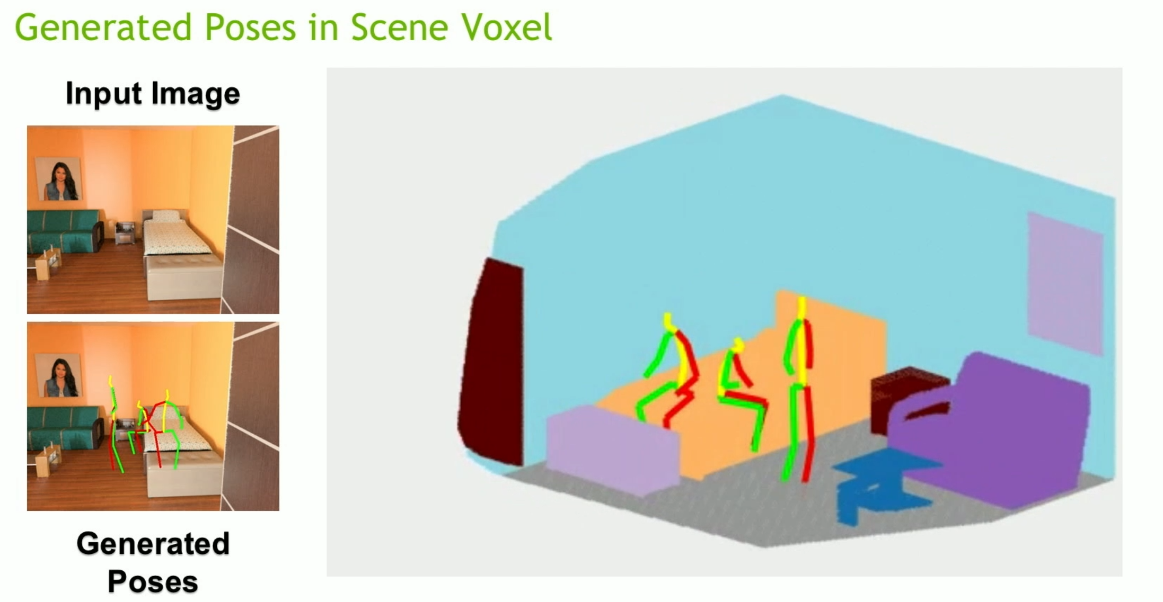

Slide 27
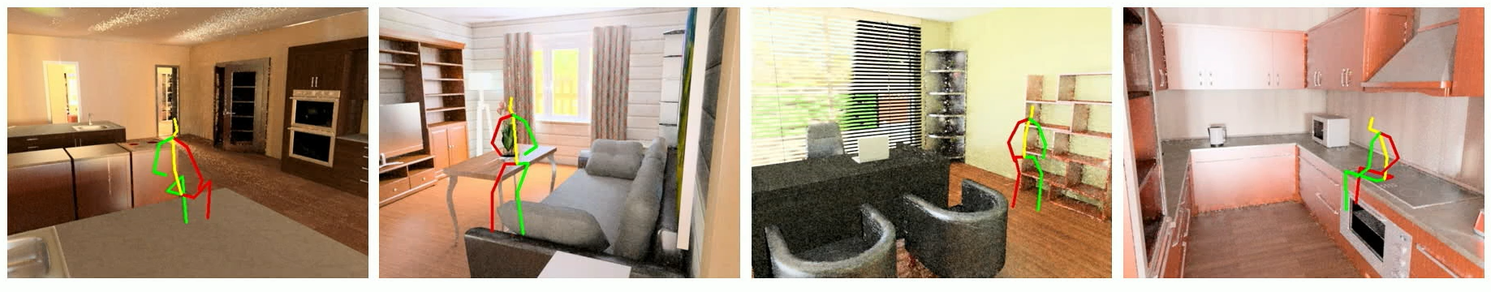
FAILURE CASES
Not semantically possible

Slide 28
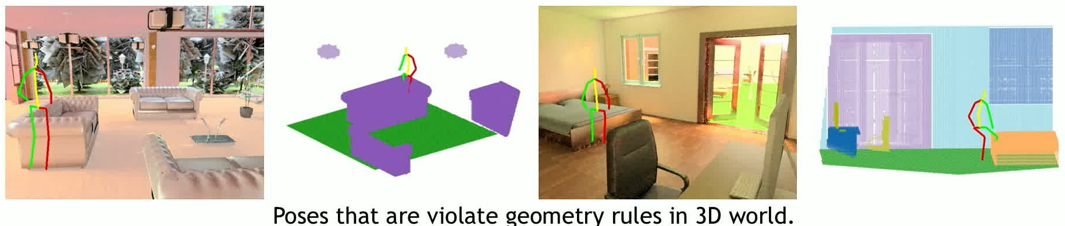
FAILURE CASES
Geometrically infeasible

Slide 29
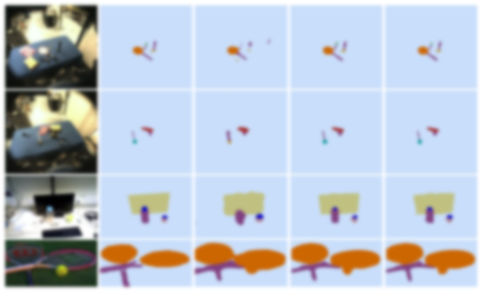
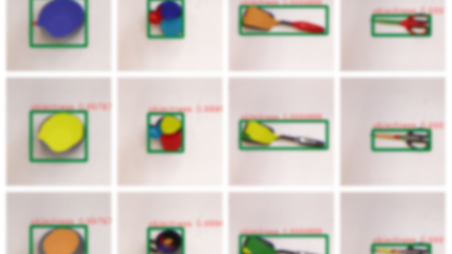
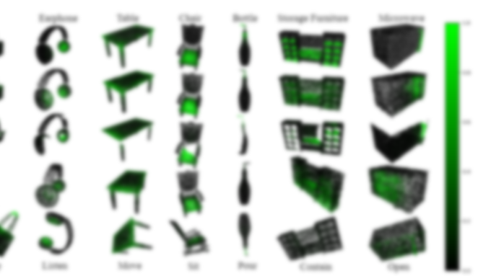
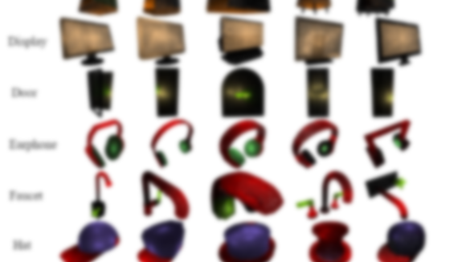
PREVIOUS WORK

Slide 30
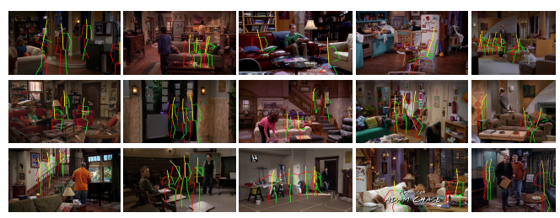
PREVIOUS WORK
Scene Understanding
Objective: Understanding of visual scenes
Example images from sitcom affordance dataset
Notes:
Scene understanding holds a great position in computer vision due to its real time perceiving, analyzing and elaborating an interpretation of dynamic scene which leads to new discoveries. The visual information can be given with many features such as Colors, Luminance and contours or in the form of Shapes, Parts and Textures or through semantic context. The goal of scene understanding is to make machines look like humans, to have a complete understanding of visual scenes.

Slide 31
PREVIOUS WORK
Binge Watching: Scaling Affordance Learning from Sitcoms
Example images from sitcom affordance dataset
Example images from sitcom affordance dataset

Slide 32
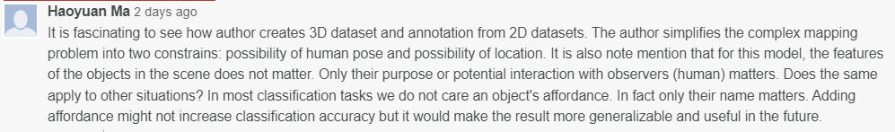
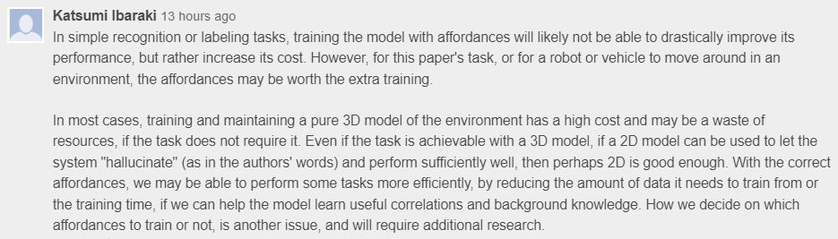
DISCUSSION

Slide 33
DISCUSSION
This was a topic brought up again and again during discussion , i.e., babies see the world very differently from what a grown human sees , hence biasing affordances based on an individual like say a chair offers “sit-ability” and floor offers “walk-ability” should not be the means to go ahead about the field. Thus the only hope is to see if the model can learn affordances by itself to do the tasks we humans do.

Slide 34
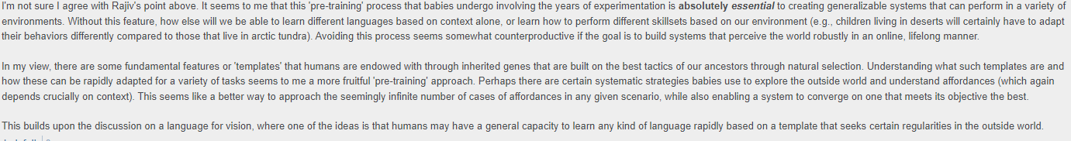
This argument provides a valid yet another perspective on how to go about for the earlier side which I find really insightful.

Slide 35
CONTRIBUTIONS
Fully automatic 3D human pose synthesizer for creating pose data in 3D scenes
Novel generative model for 3D affordance prediction that generates plausible human poses from a single scene image
A new benchmark for human affordance prediction built on top if SUNCG dataset and 3D pose synthesizer
Notes:
What actions can the object be used for?
How to interact with objects properly

Slide 36
DISCUSSION Post Presentation
Things that were discussed is to find the application for affordance modelling in real life:
The discussion went on about criticizing on pre defined affordance for training the model and eventually concluded with the following points
If affordance is to be taken as an approach instead of predefining certain affordances in a particular environment based off on generalized adult vision , a system/model should be defined in such a way to learn new affordances instead of mimicking one.
Affordance learning can be really useful if the task space or configuration environment is fixed . (i.e.,) instead of dealing with infinite affordances if the task is to do robot grasping (manipulator) then the affordance to grasp a arbitrary object is a constricted problem.
RL approach to be used to learn affordances instead of giving it inputs explicitly.

