Slide 1
Learning to Grasp by Extending the Peri-Personal Space Graph
(Published: 2018 IEEE/RSJ International Conference on Intelligent Robots and Systems (IROS))
Jonathan Juett and Benjamin Kuipers
Presented by: Upasana Thakuria

Slide 2
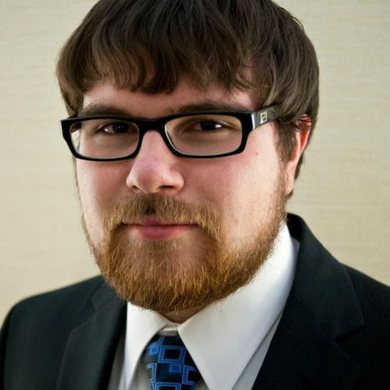
About Author
Jonathan Juett, currently Proff. of CS at Kirkwood Community College, Iowa
2021 Ph.D. & Masters in Computer Science at UofM (paper part of thesis “Towards Learning the Foundations of Manipulation Actions from Unguided Exploration.”)
Research Areas: Robot grasp, ungrasp, pick and place

Slide 3
Content
Introduction
  Motivation
  What is Peri-Personal Space (PPS)?
Problem Statement
Background (previous paper)
  Representation of PPS
  Learning to Reach (unusual bump event)
Methodology
  Planning a Reach (flowchart req.)
    Better Reach: Local Jacobian, Inverse Jacobian
  Learning to Grasp (Palmer Reflex included)
    Selecting penultimate node: successful grasp
    Cosine similarity: Predict favorable alignments
4. Results
  Experiment 1
  Experiment 2
5. Conclusion
6. Discussion
7. References

Slide 4
Motivation
Reach, Grasp learning without prior knowledge (geometry, kinematics, dynamics of the arm) (infant-learning inspired)
Self-built spatial representation (of body and environment)
Traditional robotic models rely on prior data (forward and inverse kinematics models)
Notes:
Hence, basic intuition is to come out with a completely autonomous approach/computational model for a robot learning agent to reach and grasp a target object, basically learning from unguided experience, and being intrinsically motivated

Slide 5
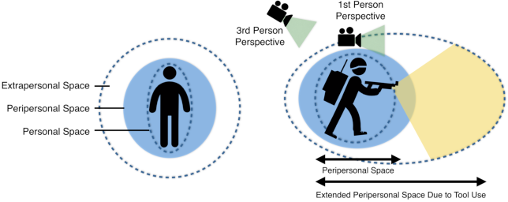
What is Peri-Personal Space (PPS)
Space surrounding an agent and in reach of its manipulators (in this case, also the visual perception)
Notes:
This paper is an extension to the previous paper by the same authors, the PPS graph generation being a part of the previous paper

Slide 6
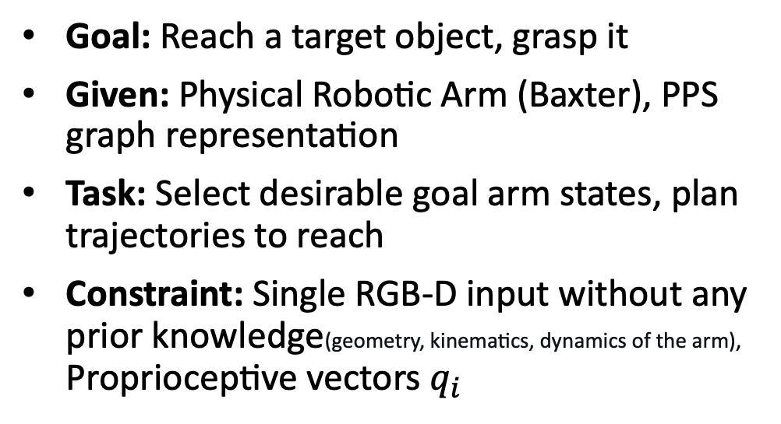
Problem Statement
Goal: Reach a target object, grasp it
Given: Physical Robotic Arm (Baxter), PPS graph representation
Task: Select desirable goal arm states, plan trajectories to reach
Constraint: Single RGB-D input without any prior knowledge(geometry, kinematics, dynamics of the arm), Proprioceptive vectors $q_{i}$

Slide 7
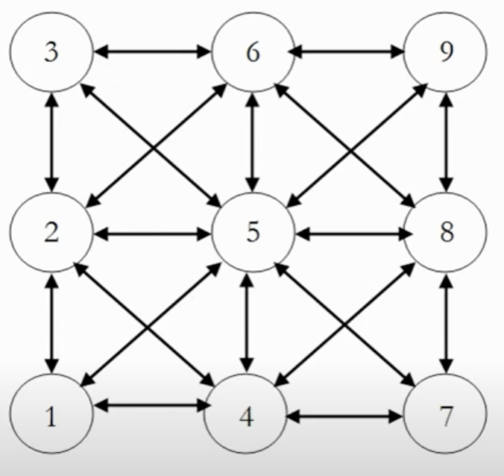

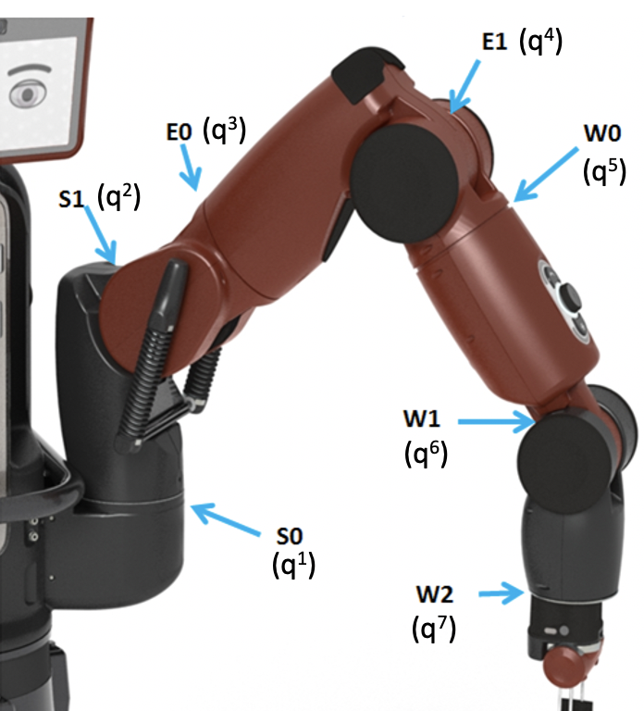

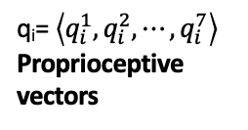
Background: Representation of PPS
3000 Nodes ($n_{i})$ -> poses during motor babbling PPS graph -> maps q_{i} to visual percepts p_{i}
Each $n_{i}$ stores $q_{i}, p_{i} \&$ edge e($n_{i}−n_{j}$) connects i,j (if Euclidian dist. || $q_{i}$- $q_{j}$|| between them is sufficiently small)
q_{i}= $\left\langle q_{i}^{1},q_{i}^{2},⋯,q_{i}^{7}\right\rangle$
Proprioceptive vectors
p_{i}=(160 × 120) RGB-D images
Visual Percepts
Image credit: https://sdk.rethinkrobotics.com/wiki/Hardware_Specifications

Slide 8
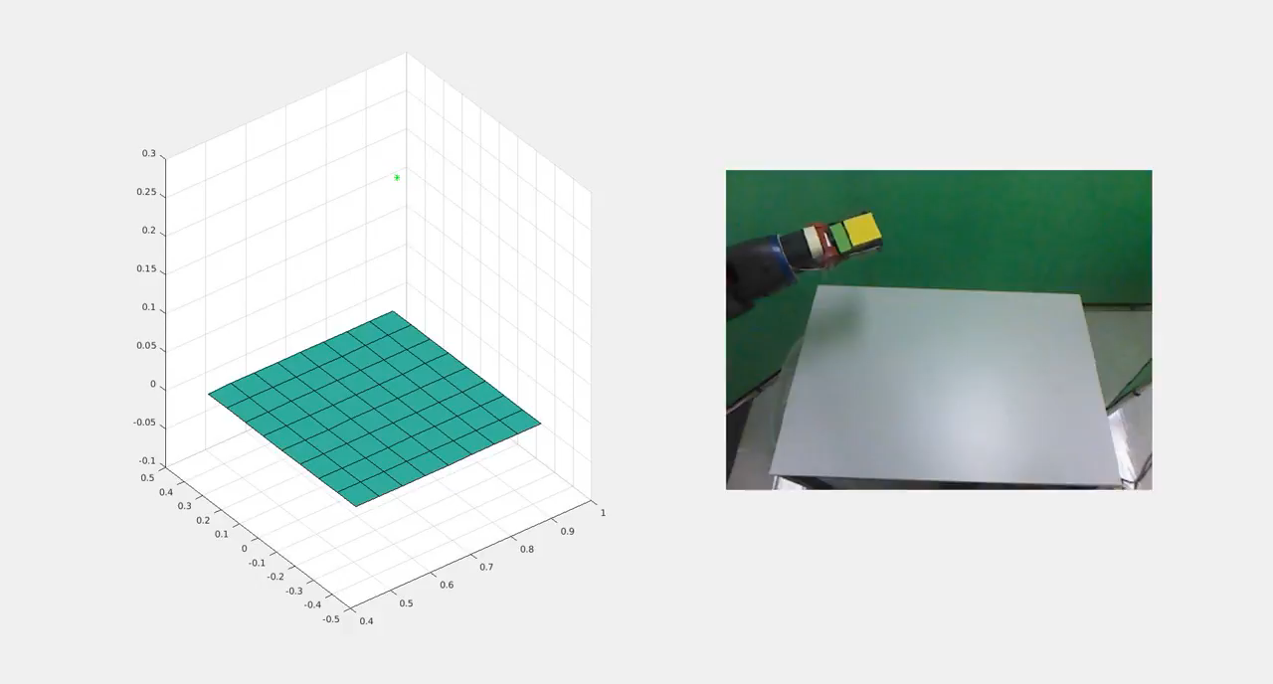
Background: Representation of PPS
Generating PPS during motor babbling (video)

Slide 9
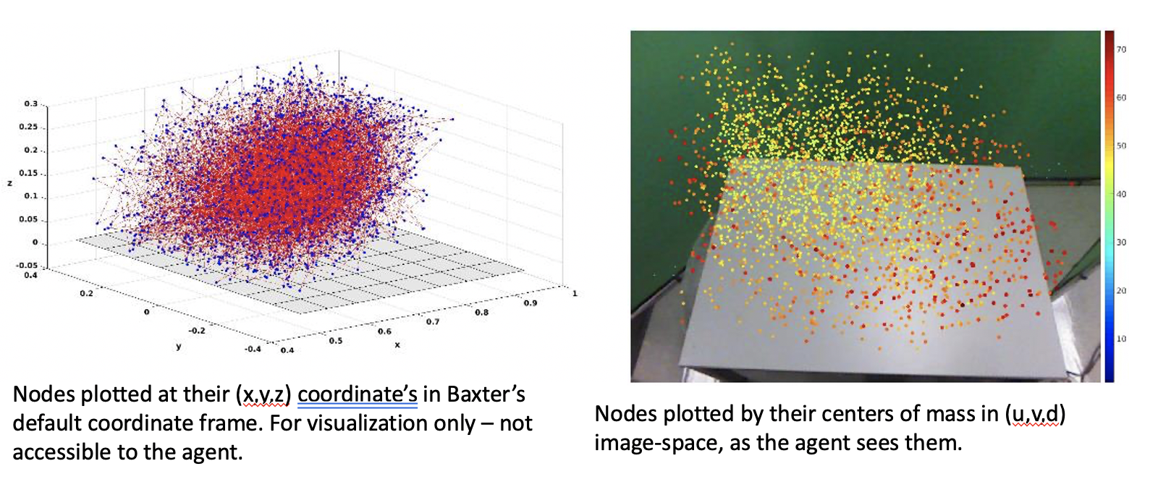
Background: Representation of PPS
Visualization of PPS

Slide 10
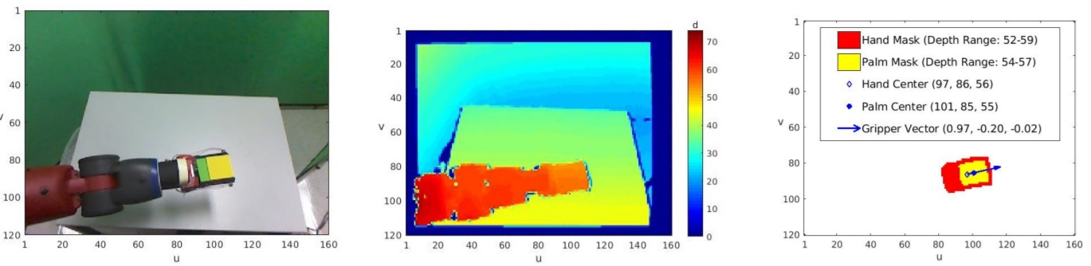
Vision of the robot
Single RGB-D camera with a fixed perspective
Simple representations -> arm, other objects can be identified (Binary image masks, centers, depth ranges, and orientations)
Image credit: https://web.eecs.umich.edu/~kuipers/research/pubs/Juett-PhD-21.html

Slide 11
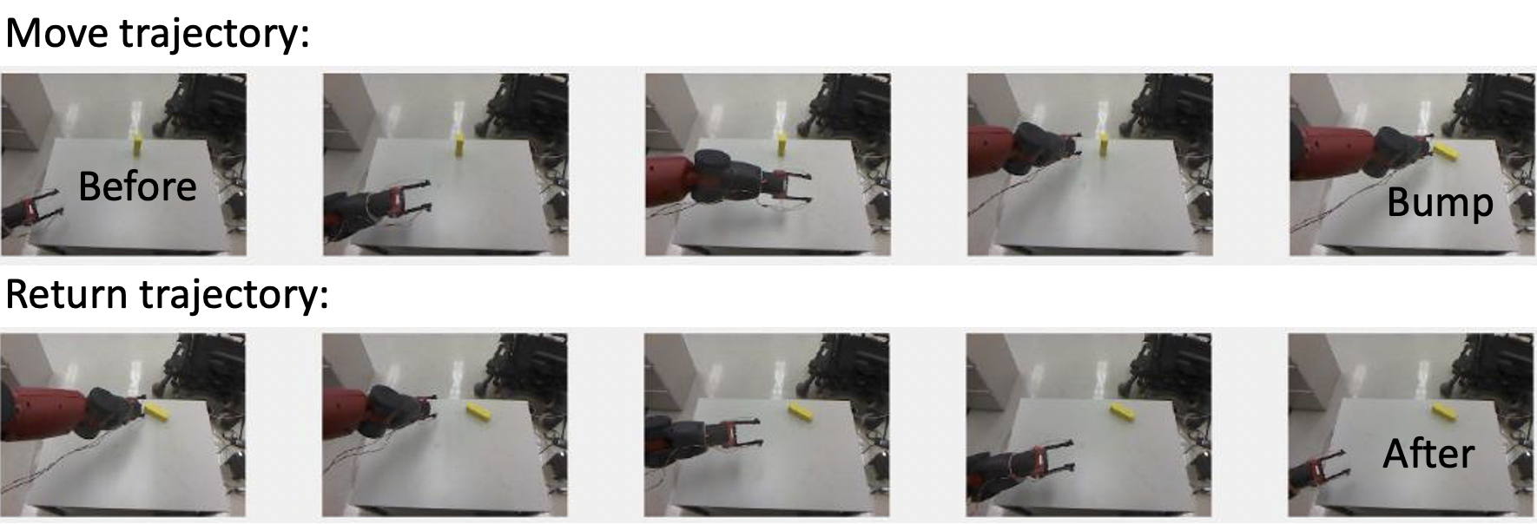
Background: Using target binary mask
Agent moves to random nodes
Compares the “before” & “after” appearances of the object.
The typical result -> no change to the object’s appearance.
Atypical results: Rare cases: “bumps” object, using
Image credit: https://sdk.rethinkrobotics.com/wiki/Hardware_Specifications
Notes:
The agent can observe a mask for the object in the image taken before beginning the trajectory and after returning to the home node (this simplifies the image processing and rules out a difference in appearance because of an occlusion)

Slide 12
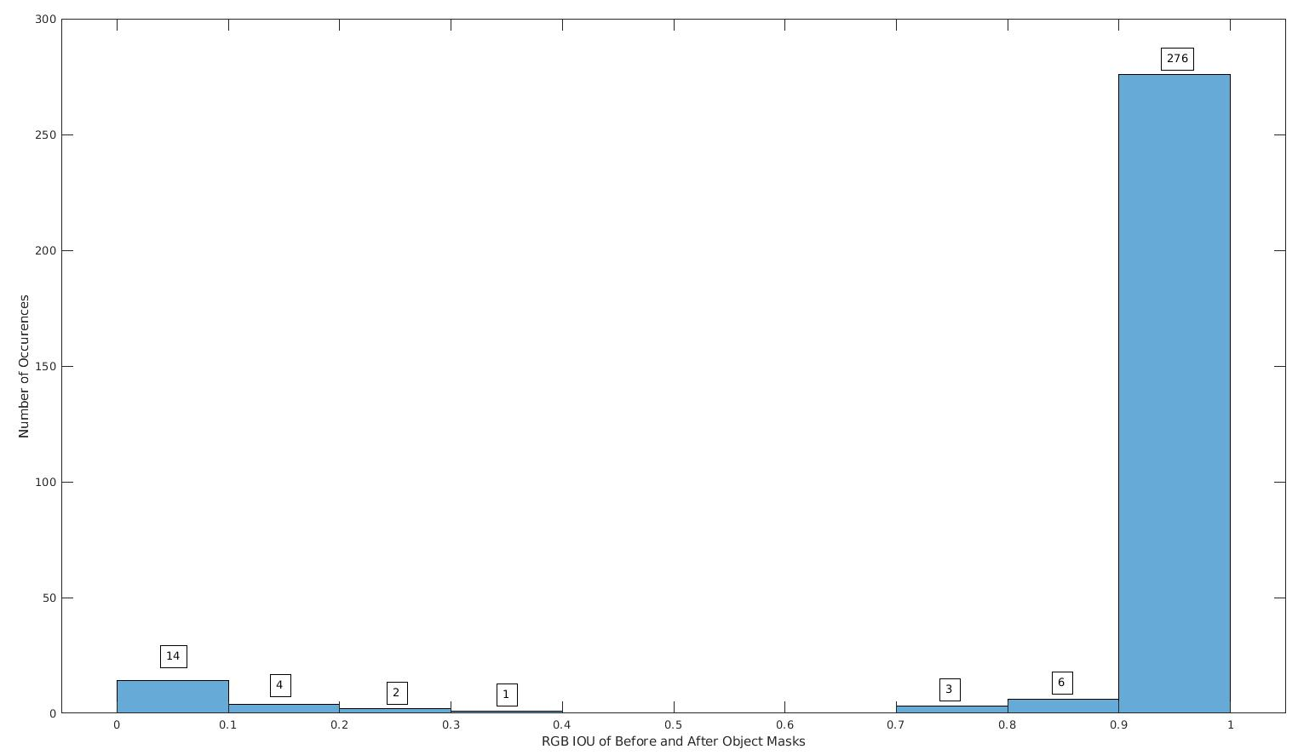

Background: Using target binary mask
”Bumps” vs usual(typical) result
Condition:
IOU ≈ 1 → No change
IOU << 1 → Bump
($IOU\left(A,B\right)= \frac{\left|A ∩ B\right|}{\left|A ∪ B\right|}$)
Image credit: https://sdk.rethinkrobotics.com/wiki/Hardware_Specifications
Notes:
For each trajectory, the agent calculates the Intersection over Union (IOU) between the before and after masks. The size of the intersection and union are the number of pixels in each.

Slide 13
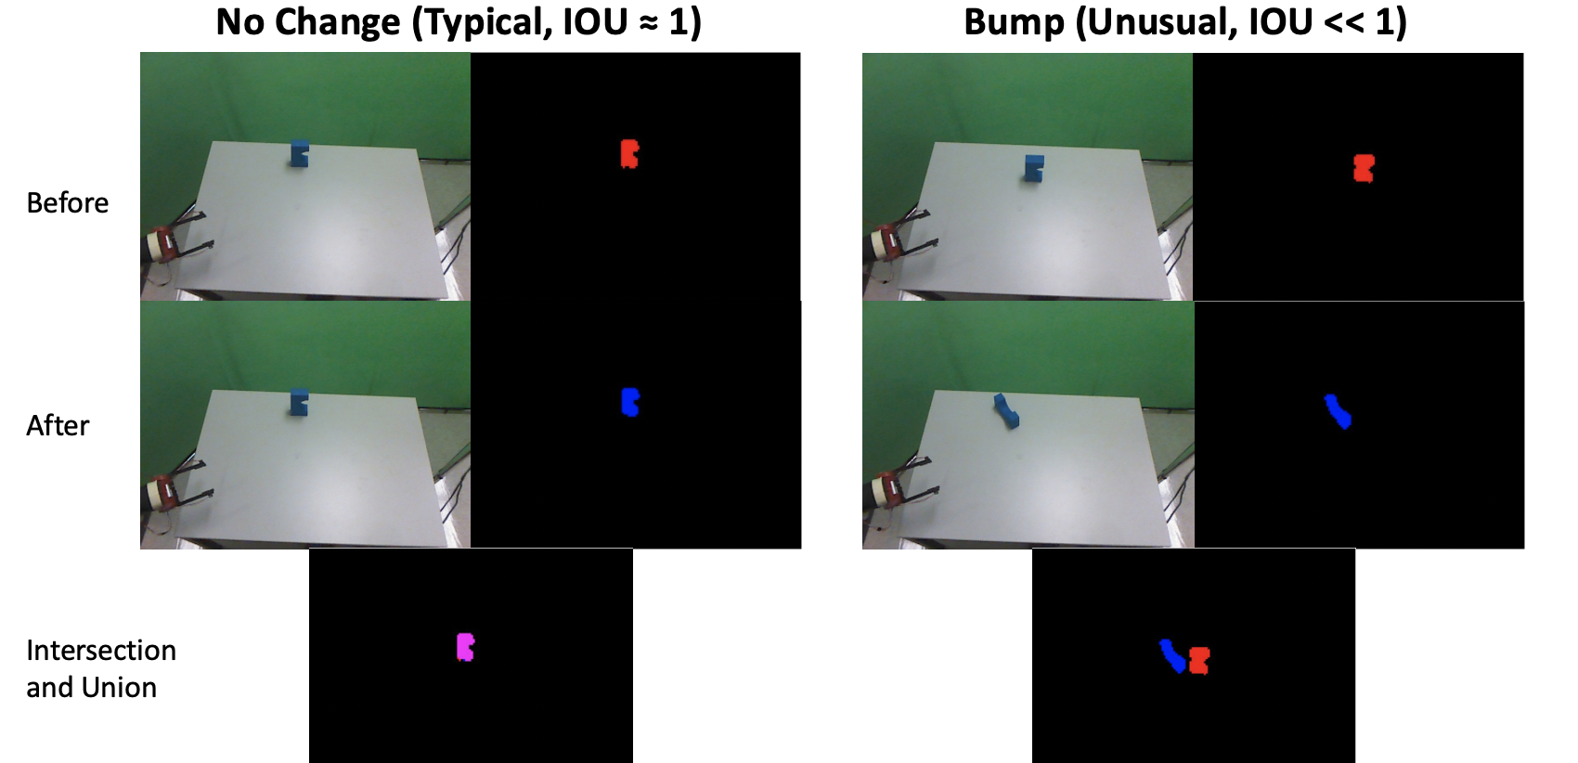
Background: Learning to Reach
Example scenarios of bumps and usual events:
Image credit: https://sdk.rethinkrobotics.com/wiki/Hardware_Specifications
Notes:
For each trajectory, the agent calculates the Intersection over Union (IOU) between the before and after masks. The size of the intersection and union are the number of pixels in each.

Slide 14
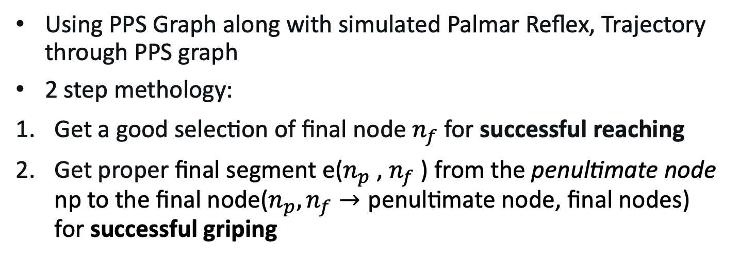
Methodology of the solution:
Planning a Reach and Grasp
Using PPS Graph along with simulated Palmar Reflex, Trajectory through PPS graph
2 step methology:
Get a good selection of final node $n_{f}$ for successful reaching
Get proper final segment e($n_{p}$ , $n_{f}$ ) from the penultimate node np to the final node($n_{p}, n_{f}→\text{penultimate} \text{node}\text{,}$ final nodes) for successful griping

Slide 15
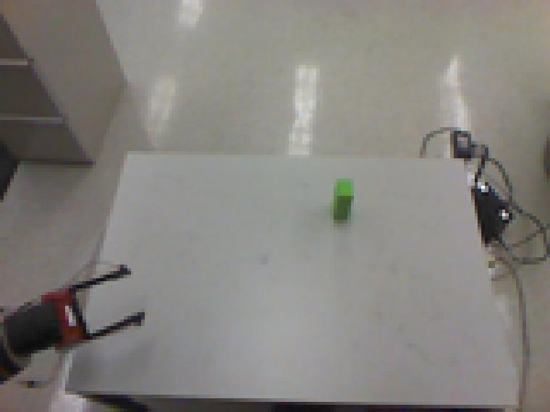
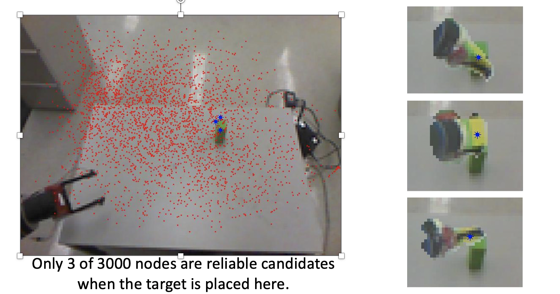
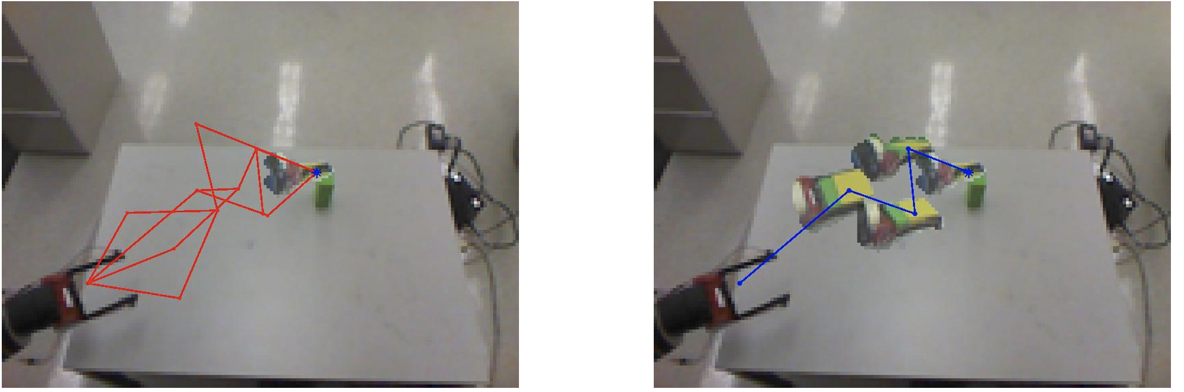
Methodology: Planning a Reach
Step 1: Observe Target with the Arm at the Home Node (The target object’s mask and depth range are extracted from the current visual percepts.)
Step 2: Determine the Set of Final Node Candidates
Step 3: Find the Shortest Graph Path Trajectory to the Final Node from the Candidates (randomly selected) (52.5% of reaches planned in this way successfully bumped the object)
Step 1
Step 2
Step 3

Slide 16
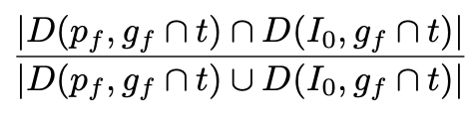
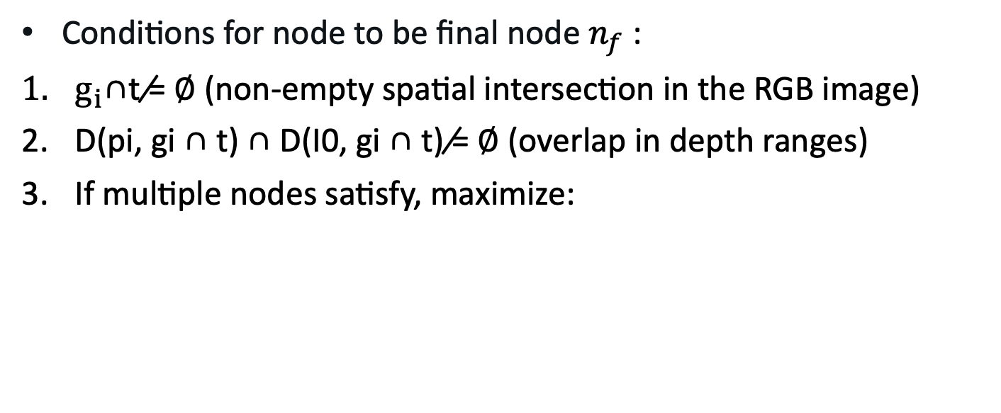
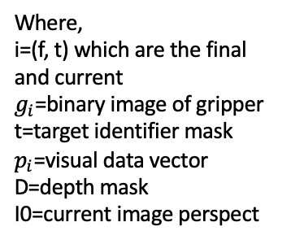
Planning a Reach: Mathematical formulation
Conditions for node to be final node $n_{f}$ :
$g_{i}$∩t ̸= ∅ (non-empty spatial intersection in the RGB image)
D(pi, gi ∩ t) ∩ D(I0, gi ∩ t) ̸= ∅ (overlap in depth ranges)
If multiple nodes satisfy, maximize:
Where,
i=(f, t) which are the final and current
$g_{i}$=binary image of gripper
t=target identifier mask
$p_{i}$=visual data vector
D=depth mask
I0=current image perspect

Slide 17
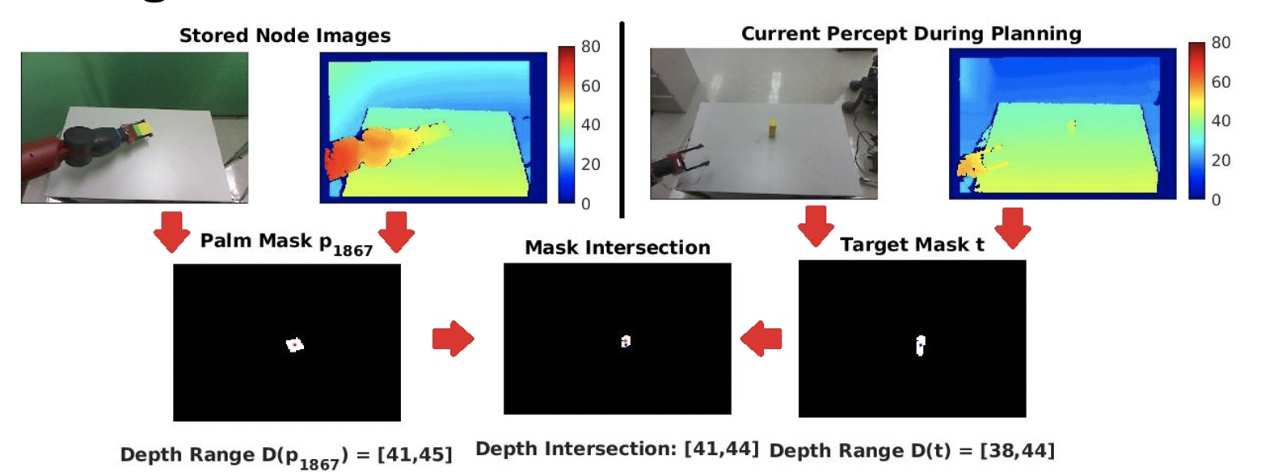
Planning a Reach: Visualization
This node has the most reliable type of intersection features. Both its mask and depth range intersect with the target’s. It will be included in the set of final node candidates.

Slide 18
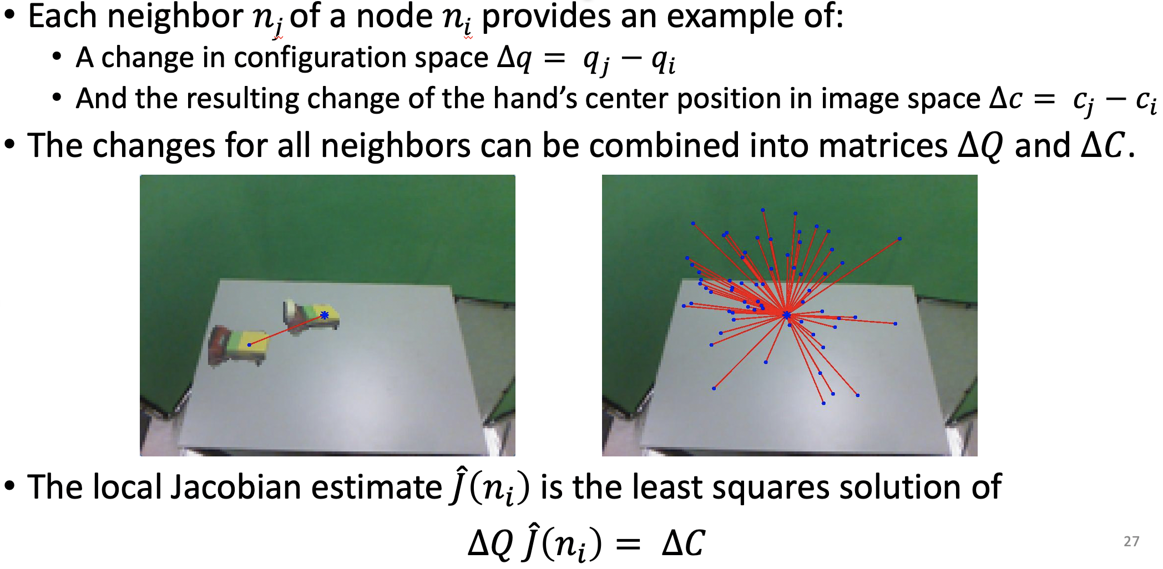
Planning a Reach: To improve
Can the agent reach closer than the nearest node?
Using Local Jacobian for the Neighborhood of a PPS Graph Node

Slide 19
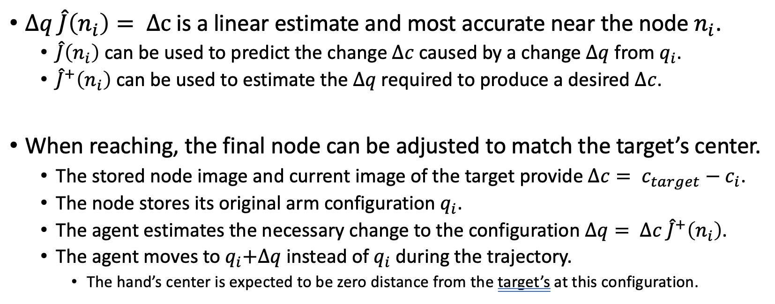
Planning a Reach: Jacobian
Notes:
In this case it will be a 7x3 matrix of partial derivatives that describe the change in each image-space coordinate for a unit change in each joint angle.

Slide 20
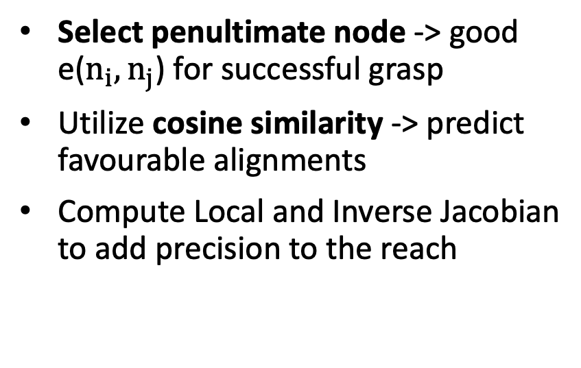
Learning to Grasp: Steps
Select penultimate node -> good e($n_{i},n_{j}$) for successful grasp
Utilize cosine similarity -> predict favourable alignments
Compute Local and Inverse Jacobian to add precision to the reach
Notes:
An accidental grasp requires two low-probability events:
The grippers must surround the object during the trajectory.
The grippers must be closed at the correct time to firmly grip the object.
The agent must observe multiple grasp examples to begin learning.
The co-occurrence of these events by chance is prohibitively rare.

Slide 21
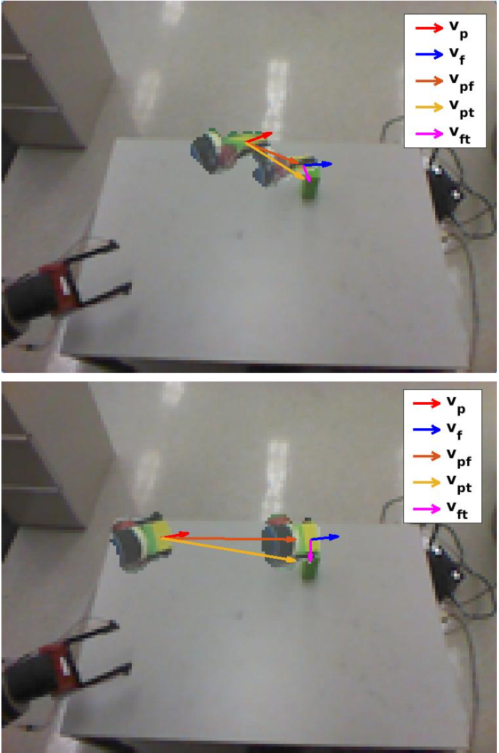
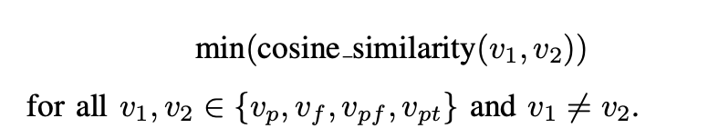
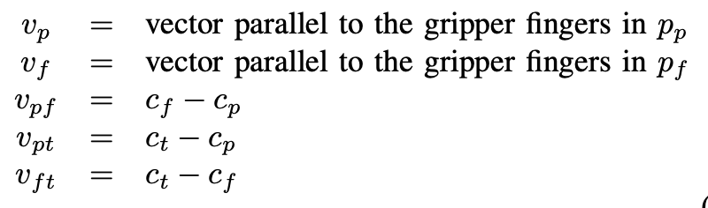
Learning to Grasp: Cosine Similarity
Use cosine similarity to get successful grasp:
where,
ci = (ui, vi, di)

Slide 22

Learning to Grasp:
High cosine similarity between -> successful grasps
Cosine similarities with 5th vector vft not informative
(makes sense!!)
Notes:
This is because these vectors being similar implies that there is minimal rotation of the gripper opening during the motion, and the gripper opening will lead the motion when they also align with vpf. If vpf agrees with vpt, motion along the edge will move directly toward the target. Thus, all four vectors being aligned leads to a higher chance of success.

Slide 23
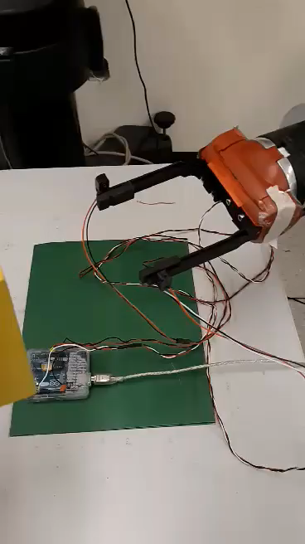
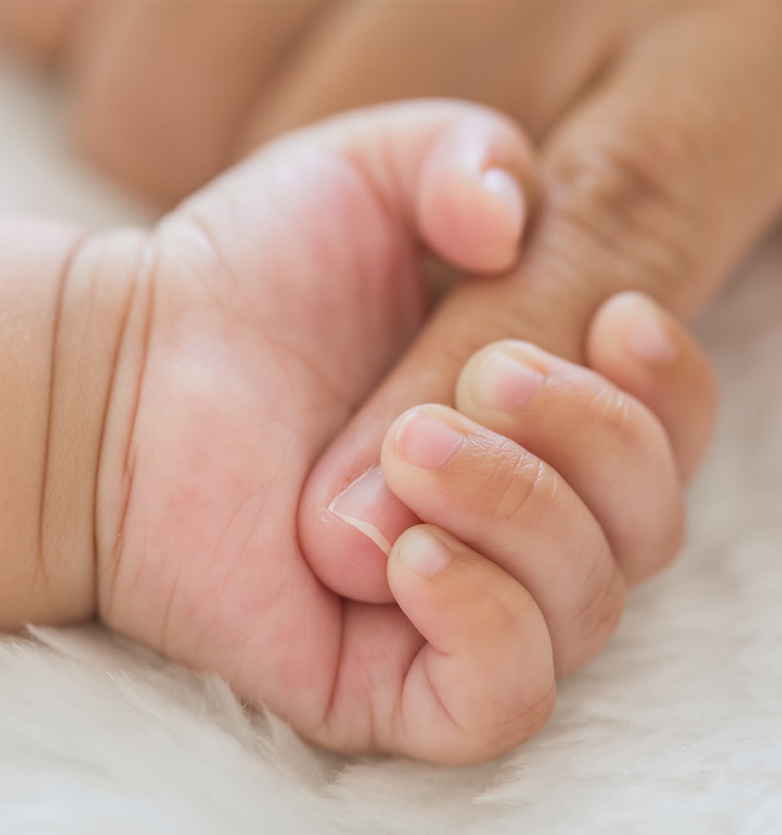

Learning to Grasp: Jacobian and inverse
Implementation of Palmer Grasp
Same as before, qf -> final configuration is changed to:
Palmer Grasp

Slide 24
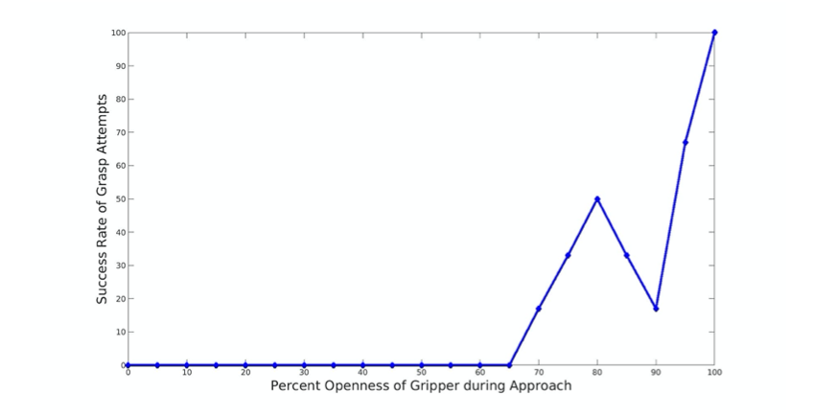
Experiment 1:
Learning the Gripper Open Requirement

Slide 25
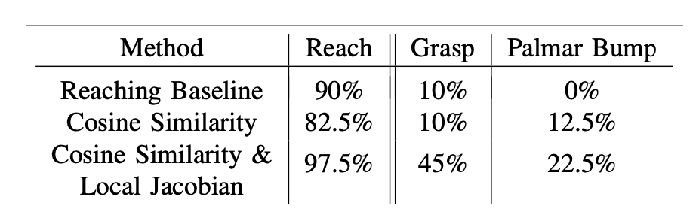
Experiment 2
cosine similarity and local Jacobian and inverse -> better success rate

Slide 26
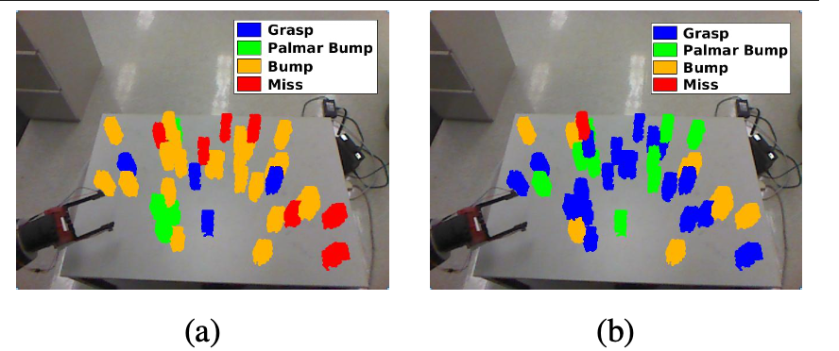
Experiment 2
Cosine similarity vs cosine sim + Jacobian

Slide 27
Conclusion
Self-built spatial representation
Using just PPS graph + Single RGB-d camera
Physically implemented using a Baxter robot

Slide 28
Discussion
More informative if all graphs and observations had # of trials success not success rate

Slide 29
Discussion
@93_f2: Piazza
From what I understand from the paper, the 3000 graph nodes are generated by randomly searching the peri-personal space from "unguided motor babbling". The paper also talks about some sort of intrinsic motivation that is present to encourage it to focus on rare events. But I'm not sure if this is part of the exploration process to generate the graph nodes, or if it is used when learning to reach?

Slide 30
References
J. Juett and B. Kuipers. Learning to reach by building a representation of peri-personal space. In IEEE/RSJ Int. Conf. Humanoid Robots, 2016.
https://web.eecs.umich.edu/~kuipers/research/pubs/Juett-PhD-21.html
https://web.eecs.umich.edu/~kuipers/papers/Juett-PhD-21.pdf
https://www.youtube.com/@jonjuett1533
https://www.youtube.com/watch?v=1U-R_xT1eNw

Slide 31


