Slide 1
Body Schema in Robotics: A Review
Authors: Matej Hoffmann, Hugo Gravato Marques, Alejandro Hernandez Arieta, Hidenobu Sumioka, Max Lungarella, and Rolf Pfeifer
Presenter: Ruohua Li

Slide 2
Outline
Body representations in biology
Body representations in robotics
Body representations in robotics →biology

Slide 3
In Biology
Definitions in biology (disorders → definitions)
Plasticity
Coordinate transformations
Forward model

Slide 4
Definitions & Differentiations
Functional axis – action vs perception
Body schema: sensorimotor representation for movements/actions
Body image: body structural description & body semantics
Grounding – two streams in visual nervous system
Disorders – proof for differentiation

Slide 5
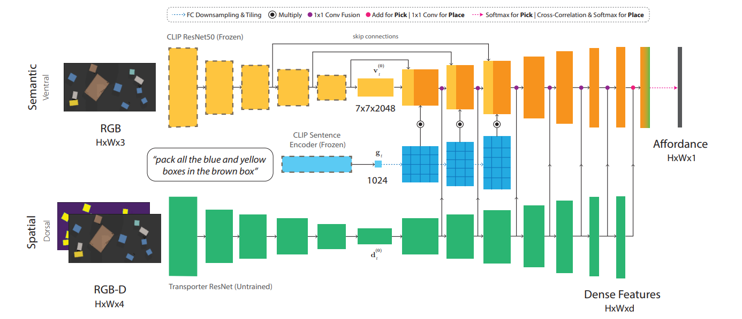
Two Streams in Visual Nervous System
Dorsal vs ventral pathways

Slide 6
Plasticity
Plasticity in development
Visual–proprioceptive calibration: body ownership & agency
Plasticity in short time
Fluid body image: rubber hand illusion
Plasticity in tool use
Extendable body schema: peripersonal space

Slide 7
Coordinate Transformation
Spatial sensing
LIP (lateral intraparietal area), VIP (ventral intraparietal area), premotor areas, PRR (parietal reach region), & anterior parietal area
Parallel transformation
Gain encoding & gain modulation

Slide 8
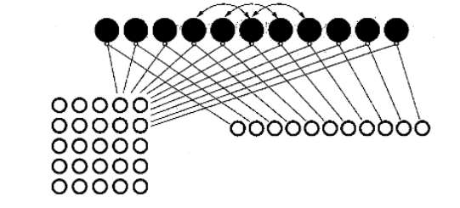
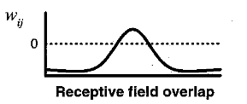
Gain Encoding & Gain Modulation
$$R_{i}={\left[h_{i}^{G}\left(y\right)+h_{V}\left(x\right)+\sum{w_{i,j}r_{j}}−θ\right]}_{+}$$

Slide 9
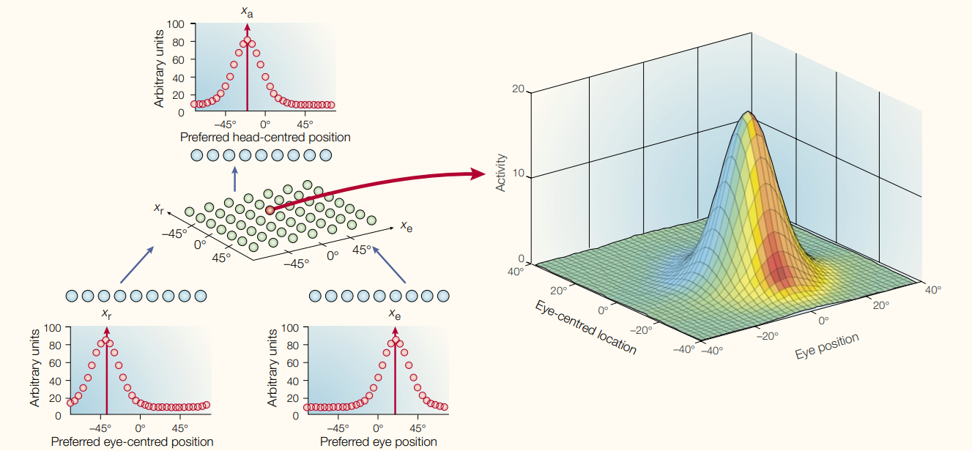
Gain Encoding & Gain Modulation
$F_{i,j}=h_{i}^{r}\left(x\right)h_{j}^{e}(y)$ or $F=h_{r}h_{e}^{T}$
$$R_{k}=\sum_{i+j=k}{F_{i,j}}$$

Slide 10
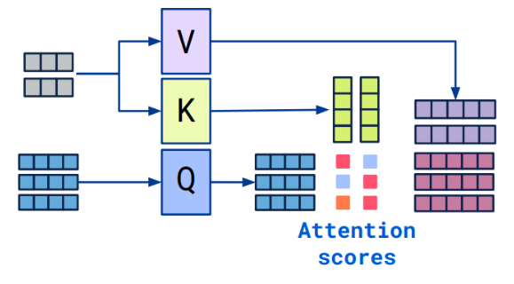
Similarities – Cross Attention
$F\left[i,j\right]=Q\left(q_{i}\right)·K (k_{j})$ or $F=QK^{T}$

Slide 11
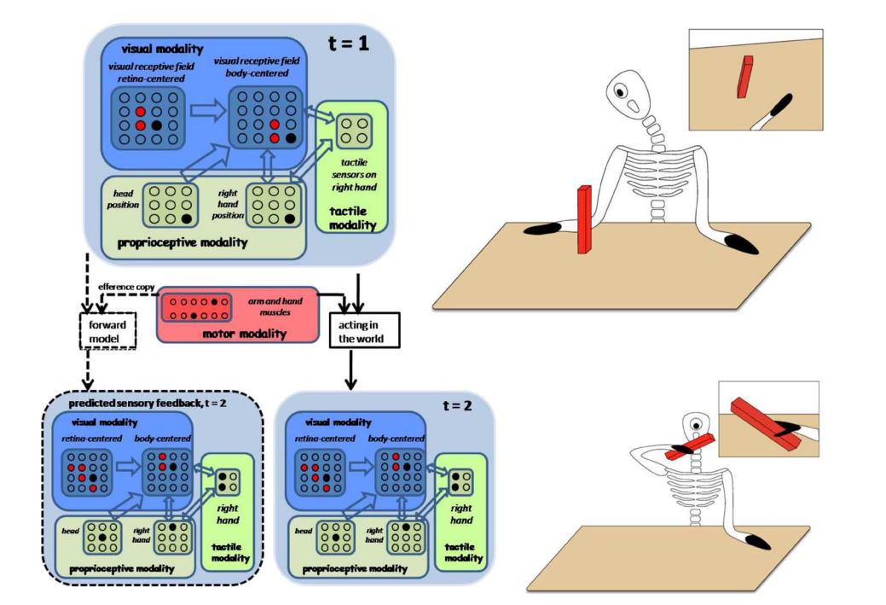
Forward Model

Slide 12
In Robotics
Necessity
Explicit model
Implicit model

Slide 13
Pros vs Cons
Pros
Required for precise control
Required for state estimation
Cons
Considerable costs for development
Inability to bear changeable conditions

Slide 14
Explicit Models
Fixed kinematic models
$x=F\left(q\right)$
Rigid body kinematics only
Not adaptive
Self-calibration of kinematic models
Only possible when system receives info from more than one source
Preferably to be incremental & online

Slide 15
Self-Calibration
Online learning of kinematic parameters

Slide 16
Explicit Models
Automatic Model Synthesis
Robotic manipulator can synthesize and adapt its kinematic model from self-observation
Hyperparameters like the number of joints and body parts are prior knowledge
The signals from the robots’ own sensors are used to validate the model
There is a population of candidate models involved

Slide 17
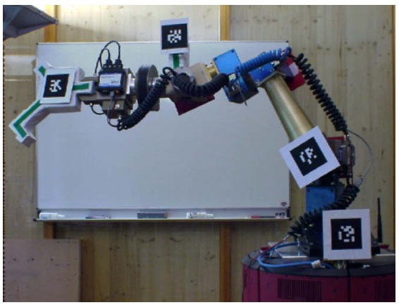
Automatic Model Synthesis
Online learning of kinematic parameters

Slide 18
Implicit Models
Take forms of an NN or look-up table
Provide mappings mainly in parameters
Can handle non-linearities
Self-recognition
Learn to separate signals from its own body with counterparts from the environment
Takes advantages of invariances & correlations in sensorimotor perceptions
Visual input → motor input
Arms fixed in vision
Hands moves periodically in vision

Slide 19
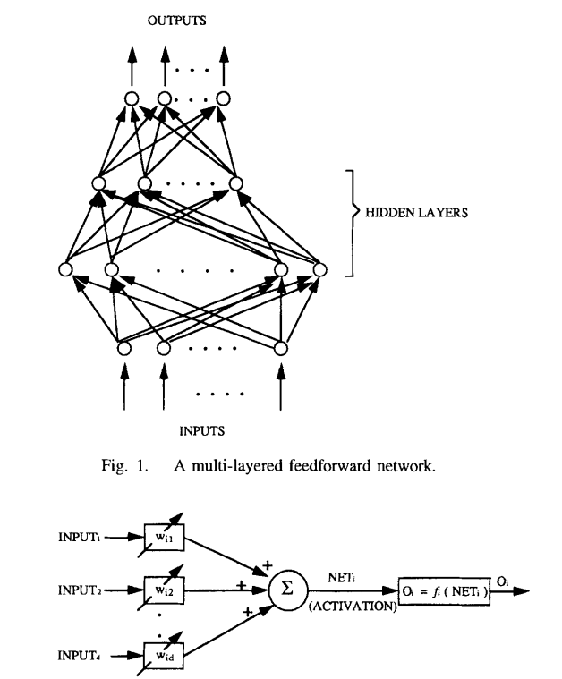
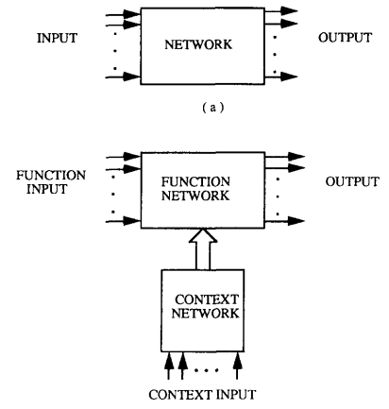
Neural Network for Representations
MLP for inverse kinematics approximation

Slide 20
Robots as Models of Biological Representation
Nonaction-oriented body representation
Body image
Explore body representation when multi-modal signals are available
Action-oriented body representation
Body schema
Explore body representation changes when actions are in motion

Slide 21
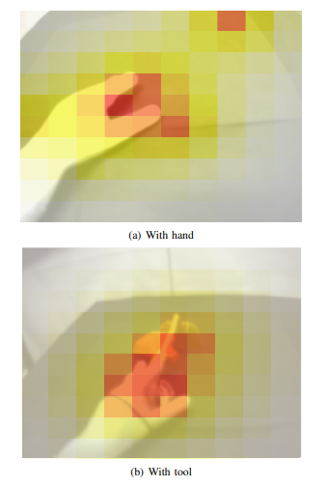
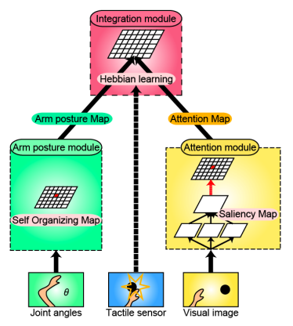
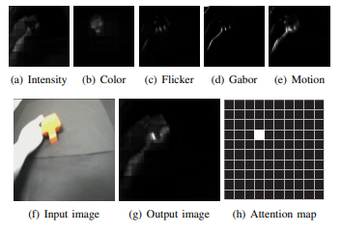
Cross-modal Body Representations w/ Attention

Slide 22
Multi-Modal Map Correlations for SSL
Audio & vision co-train for SSL

Slide 23
References
M. Hoffmann, H. Marques, A. Arieta, H. Sumioka, M. Lungarella and R. Pfeifer, "Body Schema in Robotics: A Review," in IEEE Transactions on Autonomous Mental Development, vol. 2, no. 4, pp. 304-324, Dec. 2010, doi: 10.1109/TAMD.2010.2086454.
A. Pouget, S. Deneve, and J.-R. Duhamel, “A computational perspective on the neural basis of multisensory spatial representations,” Nature Rev. Neurosci., vol. 3, pp. 741–747, 2002.
M. Hikita, S. Fuke, M. Ogino, T. Minato, and M. Asada, “Visual attention by saliency leads cross-modal body representation,” in Proc. 7th Int. Conf. Develop. Learn. (ICDL), Shanghai, China, 2009.
S. M. Prabhu and D. P. Garg, “Artificial neural network based robot control: An overview,” J. Intell. Robot. Syst., vol. 15, pp. 333–365, 1996.
C. Gaskett and G. Cheng, “Online learning of a motor map for humanoid robot reaching,” in Proc. 2nd Int. Conf. Computat. Intell., Robot. Autonom. Syst. (CIRAS 2003), Singapore, 2003.

Slide 24
Thank you!

Slide 25
Discussion Piazza #1 Piazza @103_f5
To me, the most interesting part of this paper is the section on implicit representations. As this paper was written in 2010 just as deep learning was really starting to take off, the overall focus is still largely on models and hand-crafted systems with some learned components. I'd like to do more reading to see if there is some insight from biology that makes the CMAC specifically a good structure for motor control, or whether this is just similar to how CNNs are inspired by vision. Nowadays, it seems like the explosion in parameters and compute allows for the learning of much more complex implicit models (e.g. accurately predicting complex scene dynamics from images alone).

Slide 26
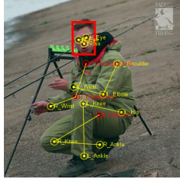
Discussion Piazza #2 Piazza @103_f7
People can often estimate other's abilities for motions like parents can guess what their babies should be able to do and athletes can evaluate their opponents' physical capabilities or even read their intentions. So is it a valid research problem to discover if learning others' body representations. How should we formulate the problem?

Slide 27
Discussion Class
Implicit model is generally preferred in today’s research community regarding robotic body representations since it offer more capacity for complex information storage and are able to adapt to changing scenarios.

