Slide 1
The Development of Embodied Cognition: Six Lessons from Babies
By Linda Smith and Michael Gasser
Published 2005 in Artificial Life, Vol. 11 Iss. 1-2
Presented by Adam Li
Notes:
View original slides at https://docs.google.com/presentation/d/12uAviOmsjO7zqgP7qMBz6ytjdewHkARYyVO-aO-O5N4/edit?usp=share_link

Slide 2
Six Lessons
Be Multimodal
Be Incremental
Be Physical
Explore
Be Social
Learn a Language

Slide 3
Be Multimodal
Vast array of sensory systems - vision, audition, touch, smell, proprioception, balance
  Degeneracy - which results in redundancies
    Example of being blind still having concept of space because we encounter space through sight, sound movement, toch, and even space. (so lacking one modality doesn’t break it)
    Also means systems can educate each other - reentry (time-locking and correlation of multimodal experiences)
    Big example idea is transparency
    Even for a purely visual, priming of sensors seems to help - pitcher task
Babies’ experience of the world is profoundly multimodal. We propose that multiple overlapping and time-locked sensor systems enable the developing system to educate itself - without defined external tasks or teachers - just by perceiving and acting in the world.

Slide 4
Lesson 1
Be Multimodal

Slide 5
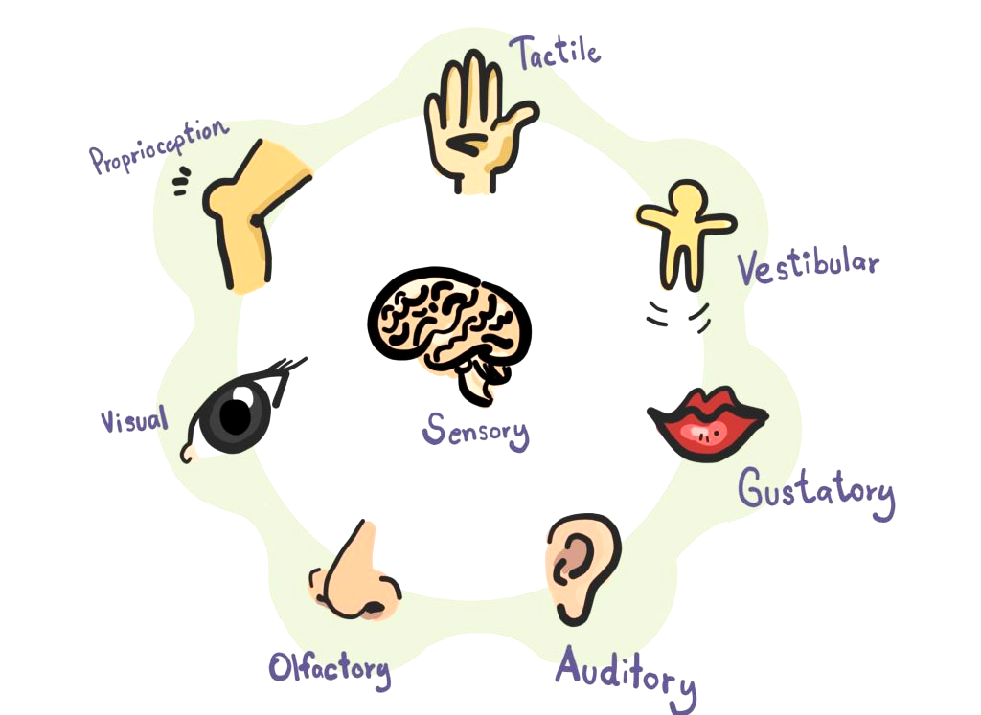
Many Senses
https://uplifttherapycenter.com/7-senses-of-the-sensory-system/
Notes:
Vast array of sensory systems - vision, audition, touch, smell, proprioception, balance (and gustatory included here)

Slide 6
Many Senses
https://uplifttherapycenter.com/7-senses-of-the-sensory-system/
Notes:
Vast array of sensory systems - vision, audition, touch, smell, proprioception, balance (and gustatory included here)

Slide 7
Many Senses
https://uplifttherapycenter.com/7-senses-of-the-sensory-system/
Notes:
Vast array of sensory systems - vision, audition, touch, smell, proprioception, balance (and gustatory included here)

Slide 8
Many Senses
https://uplifttherapycenter.com/7-senses-of-the-sensory-system/
Notes:
Vast array of sensory systems - vision, audition, touch, smell, proprioception, balance (and gustatory included here)

Slide 9
Many Senses
https://uplifttherapycenter.com/7-senses-of-the-sensory-system/
Notes:
Vast array of sensory systems - vision, audition, touch, smell, proprioception, balance (and gustatory included here)

Slide 10
Many Senses
https://uplifttherapycenter.com/7-senses-of-the-sensory-system/
Notes:
Vast array of sensory systems - vision, audition, touch, smell, proprioception, balance (and gustatory included here)

Slide 11
Many Senses
https://uplifttherapycenter.com/7-senses-of-the-sensory-system/
Notes:
Vast array of sensory systems - vision, audition, touch, smell, proprioception, balance (and gustatory included here)

Slide 12
Many Senses
https://uplifttherapycenter.com/7-senses-of-the-sensory-system/
Notes:
Vast array of sensory systems - vision, audition, touch, smell, proprioception, balance (and gustatory included here)

Slide 13
Many Senses - Degeneracy
Still have sense of space!
https://uplifttherapycenter.com/7-senses-of-the-sensory-system/
Notes:
Degeneracy means there are multiple pathways to achieve the same ideas
Even if born completely blind, children still grow up to have a sense of space despite lacking vision

Slide 14

Many Senses - Reentry
https://uplifttherapycenter.com/7-senses-of-the-sensory-system/
Notes:
Mapping between the smoother surface of the apple
Mapping between the red color of the apple
Mapping between the time-correlated signals of the two

Slide 15

Transparency
Notes:
Transparency experiment for 9mo babies. If we have a container, one transparent and one opaque, we can task the baby with obtaining the object in the container and see how it handles transparency.

Slide 16
Transparency
Notes:
In the case of the opaque box, the baby know to remove the box first, then access the object

Slide 17

Transparency
Notes:
In the case of the opaque box, the baby know to remove the box first, then access the object

Slide 18
Transparency - No Play
Notes:
For many babies that are 9mo and haven’t had many experiences with transparent objects, they will try to get to the object through the box, which doesn’t work.

Slide 19
Transparency - No Play
Notes:
For many babies that are 9mo and haven’t had many experiences with transparent objects, they will try to get to the object through the box, which doesn’t work.

Slide 20
Transparency - With Play
Notes:
In another group, parents were asked to leave a transparent container in the box of toys for their 8mo babies to play with

Slide 21
Transparency - With Play
Notes:
Now when faced with the same task at 9mo like the earlier control experiment, the babies this time know to remove the box to get to the object

Slide 22
Transparency - With Play
Notes:
Now when faced with the same task at 9mo like the earlier control experiment, the babies this time know to remove the box to get to the object
Through play, with reentrant self-informing senses, the babies were able to learn the subtle details that show the transparent container being present and learn how to interact with it.

Slide 23
Multiple overlapping and time-locked sensor systems enable the developing system to educate itself just by perceiving and acting in the world.
Multiple overlapping and time-locked sensor systems enable the developing system to
Multiple overlapping and
Multiple
Notes:
Multiple overlapping and timelocked sensor systems enable the developing system to educate itself just by perceiving and acting in the world.

Slide 24
Be Incremental
Experiences of a 3mo old is very different from (and much more constrained) than that of a 1yo, and likewise for a 2yo.
  Systematic changes to the input - in range and kind of experience - matter and determine developmental outcome
  First, audition and vision are available, but visual focus is driven by sound until correlations start becoming apparent
    4mo’s look at the ball in temporal synchrony with the sound if presented with pair
    Deaf children show altered and more disorganized visual attention
    This coordination is a form a reentrant mappings and multimodal learning from #1 - key change in #2 is that these do not stay the same over developmental time.
    After passive listening and vision, infants begin to reach for objects and these correlations change at 3-4mo. Now, they can provide themselves with new multimodal experiences involving vision, haptic exploration, proprioceptive input, and audition.
    After this, they get self-locomotion.
  Key task is A-not-B task, which seems to be tied to self-locomotion.
  Studies of comparative development also show this development ordering matters greatly. Reorderings dramatically alter developmental outcomes
Babies develop incrementally, and they are not smart at the start. We propose that their initial prematurity and the particular path they take to development are crucial to their eventual outpacing of the world’s smartest AI programs.

Slide 25
Lesson 2
Be Incremental
Notes:
Systematic changes to the input - in range and kind of experience - matter and determine developmental outcome

Slide 26


Temporal Synchrony of Vision and Audition
https://dribbble.com/shots/2327065-Bouncing-Balls
Notes:
First, audition and vision are available, but visual focus is driven by sound until correlations start becoming apparent
4mo’s look at the ball in temporal synchrony with the sound if presented with pair
Deaf children show altered and more disorganized visual attention - like us right now, do you focus on any one ball in this animation?
Click to play the audio after a flip. What do you focus on now?

Slide 27
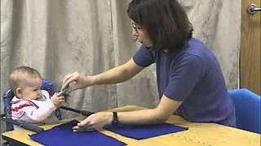
The A-not-B Error
Notes:
After passive listening and vision, infants begin to reach for objects and these correlations change at 3-4mo. Now, they can provide themselves with new multimodal experiences involving vision, haptic exploration, proprioceptive input, and audition.
But they don’t have self-locomotion, so in this a-not-b task, they still relate past locations to where an object should be. Self-locomotion appears to be a key change

Slide 28
Development occurs incrementally.
The initial prematurity and exploration path a baby takes is crucial to their development of intelligence.
Notes:
Development occurs incrementally.
The initial prematurity and exploration path a baby takes is crucial to their development of intelligence.

Slide 29
Be Physical
Some intelligence appears to reside in the interface between body and world
  Change blindness is often conceptualized this way - people don’t need to remember the details of what is right before their eyes because they do not need to remember what they can merely look at and see
  Ballard and colleagues [source 2] have shown that in tasks in which people are asked to rearrange arrays of squares, they offload their short-term memory to the world (when they can).
Offloading interface between body and world appears to be pervasive and may be critical to development
  Two object container task - “dax”
  Objects are linked to their relative spatial location. Even demonstrated with toys in two separate places
    Deictic pointers
  People routinely and unconsciously gesture with one hand when speaking of one protagonist and another when speaking of a different protagonist.
    Links separate events in a story to the same individual through hand gestures and direction of attention.
Babies live in a physical world, full of rich regularities that organize perception, action, and ultimately thought. The intelligence of babies resides not just inside themselves but is distributed across their interactions and experiences in the physical world. They physical world serves to bootstrap higher mental functions.

Slide 30
Lesson 3
Be Physical
Notes:
Some intelligence appears to reside in the interface between body and world

Slide 31

Change Blindness
https://en.wikipedia.org/wiki/Change_blindness
Notes:
Some intelligence appears to reside in the interface between body and world
Change blindness is often conceptualized this way - people don’t need to remember the details of what is right before their eyes because they do not need to remember what they can merely look at and see

Slide 32
Change Blindness
Notes:
Some intelligence appears to reside in the interface between body and world
Change blindness is often conceptualized this way - people don’t need to remember the details of what is right before their eyes because they do not need to remember what they can merely look at and see

Slide 33
Change Blindness
https://en.wikipedia.org/wiki/Change_blindness
Notes:
Some intelligence appears to reside in the interface between body and world
Change blindness is often conceptualized this way - people don’t need to remember the details of what is right before their eyes because they do not need to remember what they can merely look at and see
Did you catch the differences?

Slide 34

Change Blindness
https://en.wikipedia.org/wiki/Change_blindness
Notes:
Some intelligence appears to reside in the interface between body and world
Change blindness is often conceptualized this way - people don’t need to remember the details of what is right before their eyes because they do not need to remember what they can merely look at and see
Did you catch the differences?

Slide 35
Spatial Binding of Objects
There is a “dax” in here
Notes:
Offloading interface between body and world appears to be pervasive and may be critical to development
Two object container task - “dax”
Even beyond this task…
People routinely and unconsciously gesture with one hand when speaking of one protagonist and another when speaking of a different protagonist.
Links separate events in a story to the same individual through hand gestures and direction of attention - Deictic pointers.

Slide 36
The physical world is full of rich regularities that organize perception, action, and ultimately thought.
Intelligence is distributed across interactions and experiences in the physical world.
Notes:
The physical world is full of rich regularities that organize perception, action, and ultimately thought.
Intelligence is distributed across interactions and experiences in the physical world.

Slide 37
Explore
How can a learner who does not know what there is to learn manage to learn anyway?
Babies can discover both the tasks to be learned and the solution to those tasks through exploration / non-goal-directed action.
  Spontaneous movement creates both tasks and opportunities for learning.
  Course of learning appeared to be: arousal, exploration, then selection of solutions from that exploration space.
    Takes over weeks of this cycle, which over cycles becomes more stable.
    Lesson: A multimodal system that builds reentrant maps from time-locked correlations only needs to be set in motion, to move about broadly, even randomly, to learn and through such exploration to discover both tasks and solutions.
  Also illustrated by infant conjugate reinforcement.
    Infants on their backs with their angles attached by ribbon to a mobile quickly learn the link between a kick and the jiggling of the mobile.
    Children spend a lot of time in behavior with no apparent goal. This behavior, called play, is essential to building inventive forms of intelligence that are open to new solutions
Babies explore - they move and act in highly variable and playful ways that are not goal-oriented and are seemingly random. In doing so, they discover new problems and new solutions. Exploration makes intelligence open-ended and inventive.

Slide 38
Lesson 4
Explore

Slide 39

Exploration
Notes:
How can a learner who does not know what there is to learn manage to learn anyway?
Babies can discover both the tasks to be learned and the solution to those tasks through exploration / non-goal-directed action.
Spontaneous movement creates both tasks and opportunities for learning.
Here, we have the foot attached to a mobile with a ribbon, but as the control, nothing happens. We see the baby make a kick or two, but explore and find the mobile off to the side

Slide 40
Exploration and Infant Conjugate Reinforcement
Notes:
If the mobile is attached, the infant quickly learn the link between a kick and the jiggling of the mobile.
Children spend a lot of time in behavior with no apparent goal. This behavior, called play, is essential to building inventive forms of intelligence that are open to new solutions
This is also known as infant conjugate reinforcement.
A multimodal system that builds reentrant maps from time-locked correlations, such as a baby, only needs to be set in motion, to move about broadly, or even randomly, in order to learn. Through such exploration, this system discovers both tasks and solutions.

Slide 41
Babies move and act in highly variable and playful ways.
By exploring, they discover new problems and solutions.
Exploration makes intelligence open-ended and inventive.
Notes:
Babies move and act in highly variable and playful ways.
By exploring, they discover new problems and solutions.
Exploration makes intelligence open-ended and inventive.

Slide 42
Be Social
Reimagine the infant conjugate reinforcement paradigm, except this time the infant’s face is coupled to the face of a mature partner by mutual gaze.
  Mature social partners don’t just react conjugately to infants’ behavior; they build on it and provide scaffolding to support and transform it into conventionally shared patterns
  Parents don’t just respond to infant smiles and vocalizations; they imitated them, and parents naturally select those they take to be meaningful -> naturally learning and fine-tuning infant facial and vocal gestures to match the adult model
Mature social partners also provide multimodal supports to help ground early language learning
  When a parent introduces an object to a toddler and names it, the parent musters a whole array of sensorimotor supports to bring the child’s attention to the object and to bind that object to the word.
  They routinely couple action and sound when talking to young children
Babies act and learn in a social world in which more mature partners guide learning and add supporting structure to that learning.

Slide 43
Lesson 5
Be Social

Slide 44
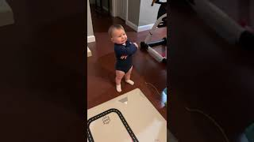
Baby Babbling and Mature Feedback
Notes:
Reimagine the infant conjugate reinforcement paradigm, except this time the infant’s face is coupled to a mature partner by mutual gaze.
Mature social partners don’t just react conjugately to infants’ behavior; they build on it and provide scaffolding to support and transform it into conventionally shared patterns
Here, babbling with mature feedback results in what almost appears to be like a conversation.
Parents don’t just respond to infant smiles and vocalizations; they imitated them, and parents naturally select those they take to be meaningful -> naturally learning and fine-tuning infant facial and vocal gestures to match the adult model

Slide 45

Multimodal Language Support
Notes:
Mature social partners also provide multimodal supports to help ground early language learning
When a parent introduces an object to a toddler and names it, the parent musters a whole array of sensorimotor supports to bring the child’s attention to the object and to bind that object to the word.
They routinely couple action and sound when talking to young children

Slide 46
Multimodal Language Support
Notes:
Mature social partners also provide multimodal supports to help ground early language learning
When a parent introduces an object to a toddler and names it, the parent musters a whole array of sensorimotor supports to bring the child’s attention to the object and to bind that object to the word.
They routinely couple action and sound when talking to young children

Slide 47
Babies act and learn in a social world where more mature partners guide learning and
add supporting structure to that learning.
Notes:
Babies act and learn in a social world where more mature partners guide learning and add supporting structure to that learning.

Slide 48
Learn a Language
Language is a very special form of regularity in the world and one that profoundly changes the learner
  1st - It is a shared communicative system
    It is very stable and continually constrained by many local communicative acts
    Emergent product of many individual communicative encounters - may be nearly perfectly adapted to the learning community
  2nd - It is a symbol system
    At the level of individual words (morphemes), the relation between events in the world and the linguistic forms that refer to them is mainly arbitrary (dig v dog)
      One might expect a more iconic language would be better due to multimodality, evidence suggests that they fail if there is too much iconicity - Scale model experiment by DeLoach [12]
    Given this mapping, the power of arbitrary symbols might lie in the property of orthogonality - they enable children to form second-order rule-like generalizations and pull apart overlapping regularities that create perceptual categories apart.
Paper then describes the learning progress / milestones
  First order generalizations about the structure of individual categories
  Then second-order generalizations over names and category structures
  Then there is potential for higher order generalizations
Language may have a special role in enabling the formation of second-order generalizations
  Arbitrariness and orthogonality of linguistic labels may be critical - NN that ready form second order generalizations do not do this if the labels are not orthogonal.
Language also enables systems with the domain of grammar.
  They are at least approximately compositional
  They permit structured representations - in particular those with embedding
Developing in a linguistic world makes children smarter in at least 3 ways:
Direct access to knowledge that other have
Explicit categorization of objects, attributes, and relations in the world
May be the key to becoming symbolic and by its nature chance the computational power of the learner.
Babies learn a language, a shared communicative system that is symbolic. And this changes everything, enabling children to form even higher-level and more abstract distinctions.

Slide 49
Lesson 6
Learn a Language
Notes:
Language is a very special form of regularity in the world and one that profoundly changes the learner

Slide 50
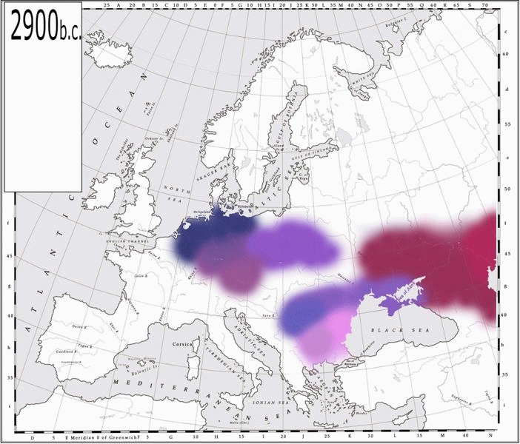
Language is Stable and Continually Constrained
http://capitan-mas-ideas.blogspot.com/2015/03/indo-european-migrations.html
Notes:
1st - It is a shared communicative system
It is very stable and continually constrained by many local communicative acts
Emergent product of many individual communicative encounters - may be nearly perfectly adapted to the learning community
This diagram shows indo-european migrations, but the colors also closely resemble cultural spreads. If we take this as an analog for shared language, it shows how relatively stable it is over the span of centuries and millenia.

Slide 51
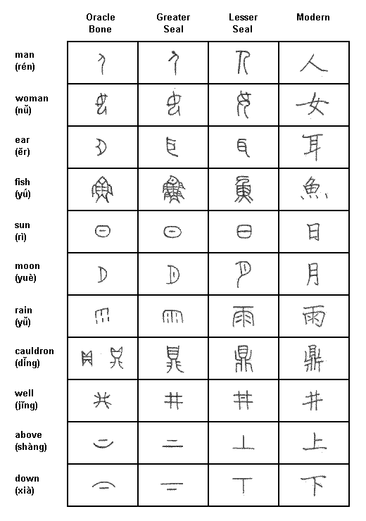
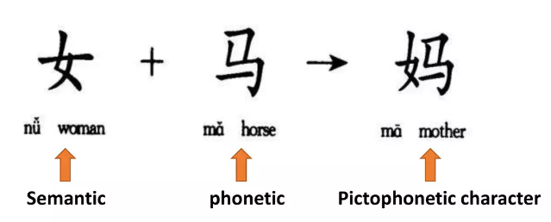
Language is Symbolic
https://www.ocf.berkeley.edu/~wwu/chinese/handout.html
https://www.slideshare.net/Haibiao/05-phonosemantic-compound-characters
Notes:
2nd - It is a symbol system
Chinese demonstrates this rather well. There are base symbols on the left, which aren’t perfect analogs, and as chinese developed, phono-semantic compounds develop to generate later characters
But even spoken, like english, at the level of individual words (morphemes), the relation between events in the world and the linguistic forms that refer to them is mainly arbitrary (dig v dog)
—(drop) One might expect a more iconic language would be better due to multimodality, evidence suggests that they fail if there is too much iconicity - Scale model experiment by DeLoach [12]

Slide 52
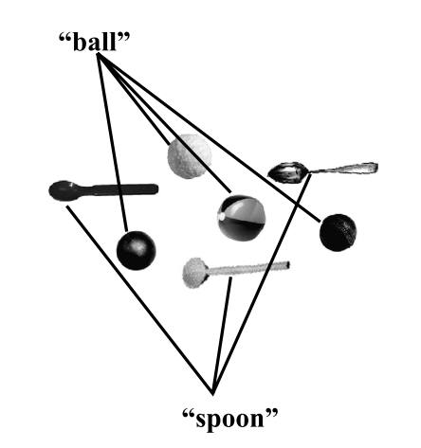
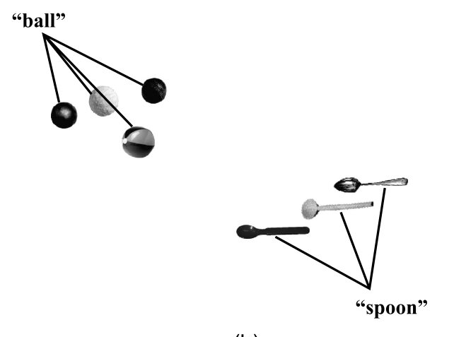
Orthogonality of Words
Notes:
Given this mapping, the power of arbitrary symbols might lie in the property of orthogonality - they enable children to form second-order rule-like generalizations and pull apart overlapping regularities that create perceptual categories apart.
for the most part, individual words pick out or point to unique categories. At the very least, this is true in the lexicons of 2- to 3-year-olds [42]. We also know that young children act as if it were true, a phenomenon sometimes referred to as the mutual exclusivity constraint [8, 28]. More specifically, children act as if each object in the world received one and only one name. For example, shown two novel objects and told the name of one (e.g., ‘‘This is a dax’’), children will assume that any new name (e.g., ‘‘wug’’) refers to the second previously unnamed object.

Slide 53
Orthogonality of Words - New Categories
“wug”?
“dax”
“wug”
Notes:
for the most part, individual words pick out or point to unique categories. At the very least, this is true in the lexicons of 2- to 3-year-olds [42]. We also know that young children act as if it were true, a phenomenon sometimes referred to as the mutual exclusivity constraint [8, 28]. More specifically, children act as if each object in the world received one and only one name. For example, shown two novel objects and told the name of one (e.g., ‘‘This is a dax’’), children will assume that any new name (e.g., ‘‘wug’’) refers to the second previously unnamed object.

Slide 54
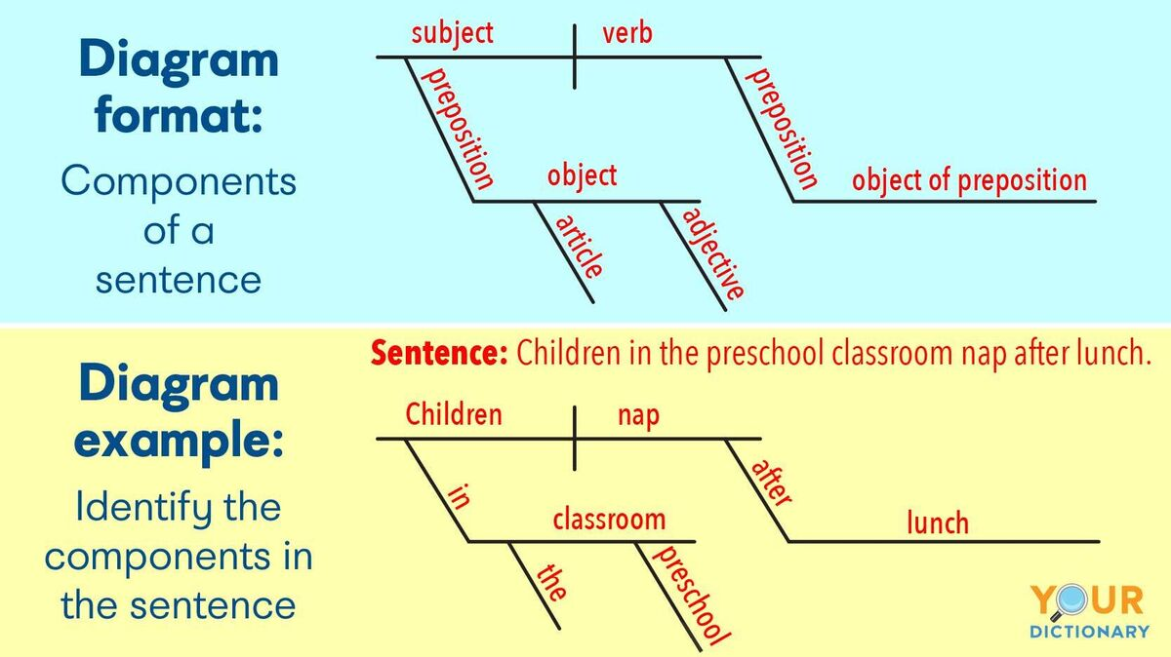
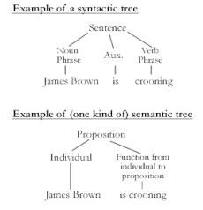
Adding Grammar
https://grammar.yourdictionary.com/sentences/diagramming-sentences.html
https://en.wikipedia.org/wiki/Philosophy_of_language
Notes:
Language also enables systems with the domain of grammar.
They are at least approximately compositional
They permit structured representations - in particular those with embedding
English has many ways to structure like this.

Slide 55
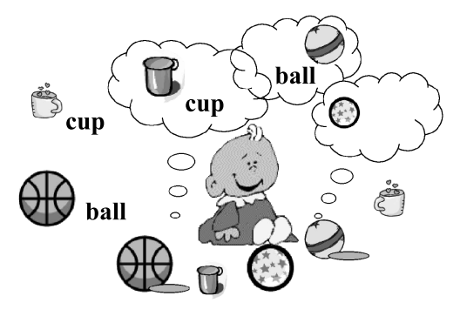
Language Enables Learning of Generalizations
Notes:
Paper then describes the learning progress / milestones
First individual items
Then, First order generalizations about the structure of individual categories

Slide 56
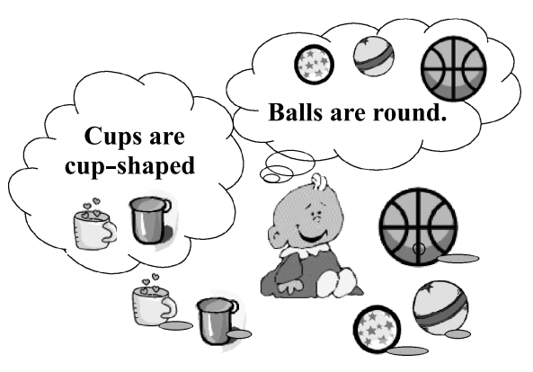
Language Enables Learning of Generalizations
Notes:
First order generalizations about the structure of individual categories
Then second-order generalizations over names and category structures
Then there is potential for higher order generalizations

Slide 57
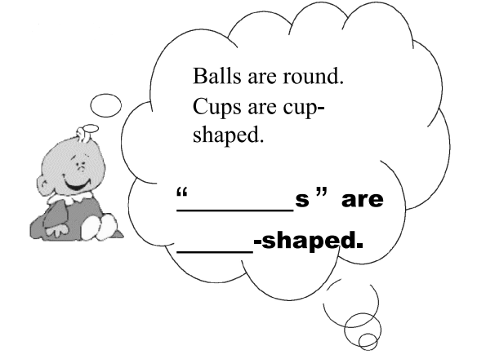
Language Enables Learning of Generalizations
Notes:
Then there is potential for higher order generalizations, extending off the second order generalization

Slide 58
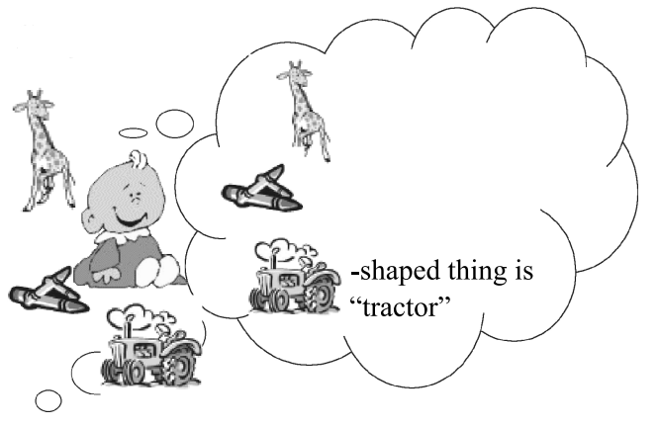
Language Enables Learning of Generalizations
Notes:
Then there is potential for higher order generalizations, extending off the second order generalization
Such as here where the bably learns general shaped things are specific items / categories

Slide 59
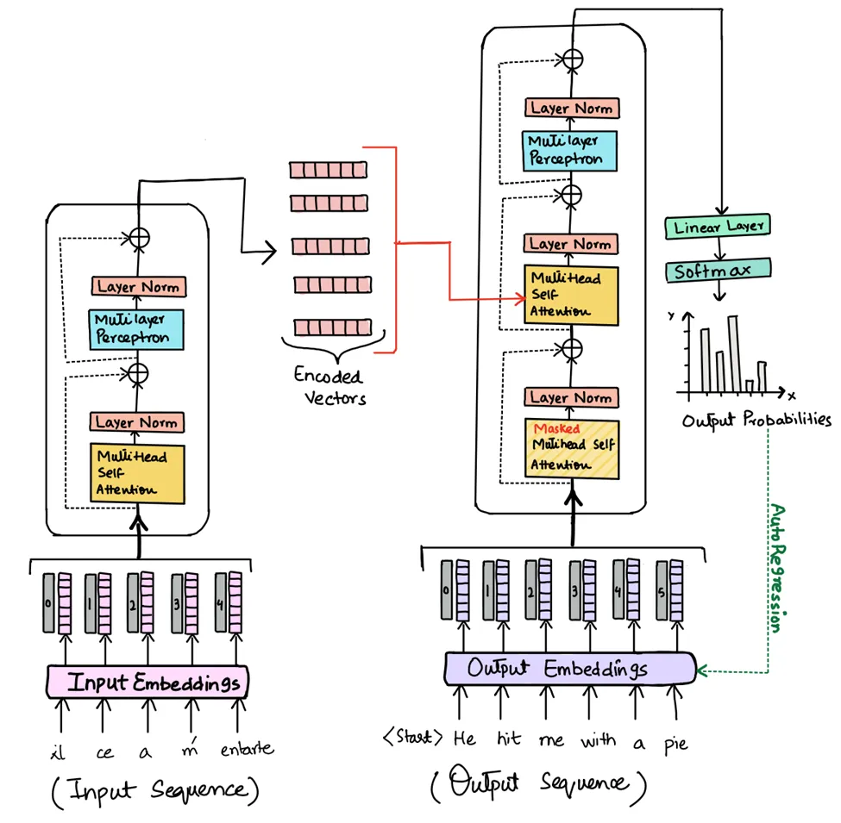
GPT - How Does it Relate?
https://medium.com/machine-intelligence-and-deep-learning-lab/transformer-the-self-attention-mechanism-d7d853c2c621
Notes:
Generative pretrained transformer - we can see the symbolic aspect of language, along with in the transformer architecture how it creates “attention” over the “symbols” or words of the sentence
Language may have a special role in enabling the formation of second-order generalizations

Slide 60
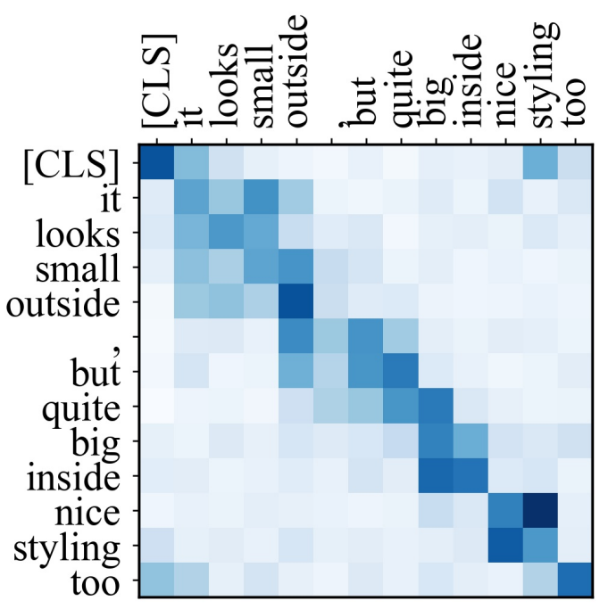
BERT - Self Attention Generalizations
http://aclanthology.lst.uni-saarland.de/D19-1361.pdf
Notes:
Bidirectional Encoder Representations from Transformers
While not the same, this demonstrates the broad generalizations that language also enables by showing how different words in a sentence may be more or less related to other words in the same sentence.

Slide 61
Direct access to knowledge from others
Explicit categorization of objects, attributes, and relations in the world
Key to becoming symbolic and by nature change the computational power of the learner
Notes:
Why Language Matters
Developing in a linguistic world makes children smarter in at least 3 ways:
Direct access to knowledge that other have
Explicit categorization of objects, attributes, and relations in the world
May be the key to becoming symbolic and by its nature change the computational power of the learner

Slide 62
Conclusions

Slide 63
Six Lessons, Again
Be Multimodal
Be Incremental
Be Physical
Explore
Be Social
Learn a Language
Notes:
Artificial life attempts to model living biological systems through complex algorithms (this publication)
The article suggests that developmental psychology offers usable lessons for creating the intelligence that lives in the real world, is connected to it, and knows about that world.

Slide 64
Key Takeaway
The authors argue that embodied intelligence develops and emerges as a child explores the world.
Intelligence isn’t just embodied, it becomes embodied.

Slide 65
Discussions

Slide 66
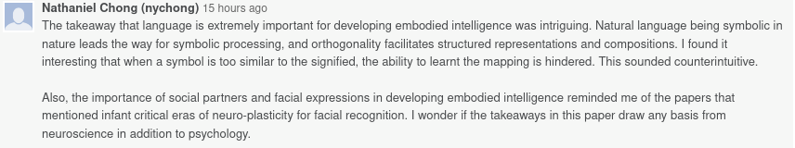
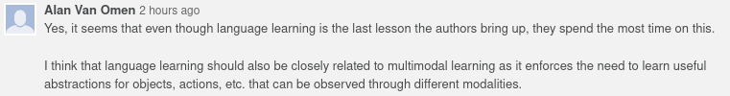
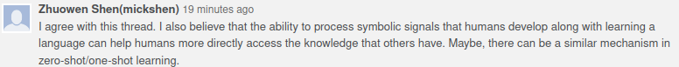
Language as a Basis for Intelligence
https://www.technologyreview.com/2016/10/14/156968/context-language-and-reasoning-in-ai-three-key-challenges/
https://analyticsindiamag.com/openai-language-models-vision-gpt-neural-networks/

Slide 67
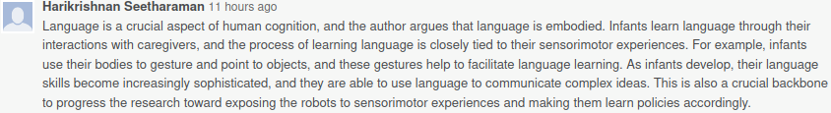
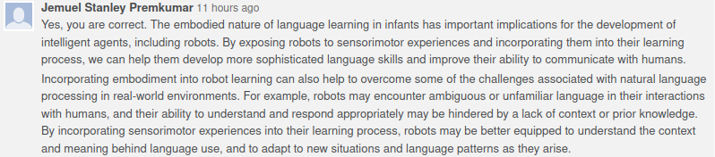
Language as a Basis for Intelligence -> Embodiment?
https://medium.com/machinevision/overview-of-embodied-artificial-intelligence-b7f19d18022

Slide 68

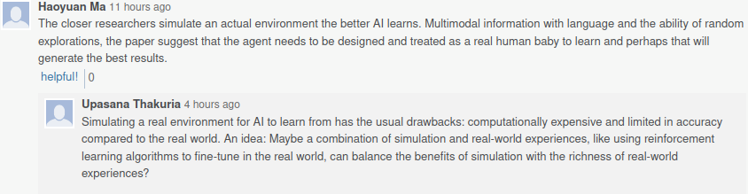
Multimodality is Key… But Simulation is Expensive
Simulations are models in the end, so adding real world data in an embodied manner may be best

Slide 69
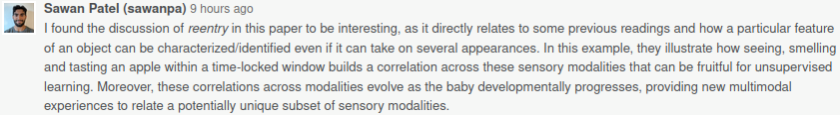
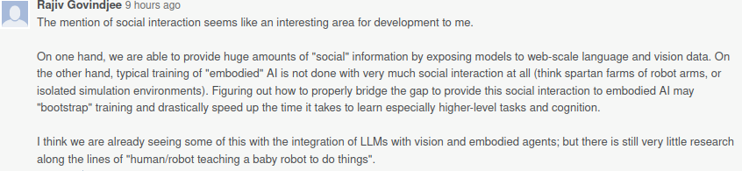
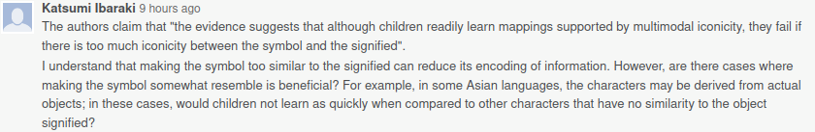
Reentrant Behavior, Social Interaction, Symbolics
Notes:
Reentry was a key topic in this paper. It discusses how mappings between senses can be made. Social interaction can help an embodied agent further create this mapping, and symbolics might be useful not being as iconic because to more iconic they are, perhaps the harder they are to distinguish from reality?

Slide 70
In-class discussion
Differences between cultures where there is more or less interaction between caretaker and child?
Unsure, but a somewhat related but tangential topic is https://en.wikipedia.org/wiki/Feral_child
  Notably, the raised in confinement section
  See https://en.wikipedia.org/wiki/Anna_(feral_child)
This may be relevant: https://www.aacap.org/App_Themes/AACAP/Docs/resource_centers/cultural_diversity/competency_curriculum%20_cap_training/cases_supporting_materials/clinics/Pumariega_Joshi-culture_and_development_in_children_and_youth.pdf
Are transformers universal function approximators? https://arxiv.org/abs/2103.05247

Slide 71
My YouTube feed is now filled with baby videos.

