Slide 1
Big Book of Concepts (Chapter 3) Gregory L. Murphy
Presenter: Ken Shao
1/23/2022

Slide 2
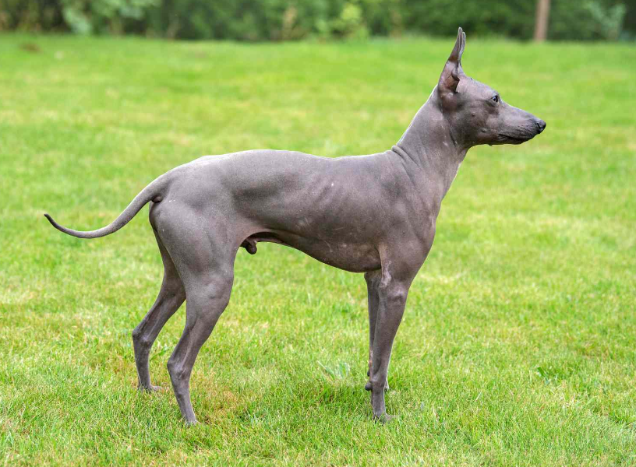
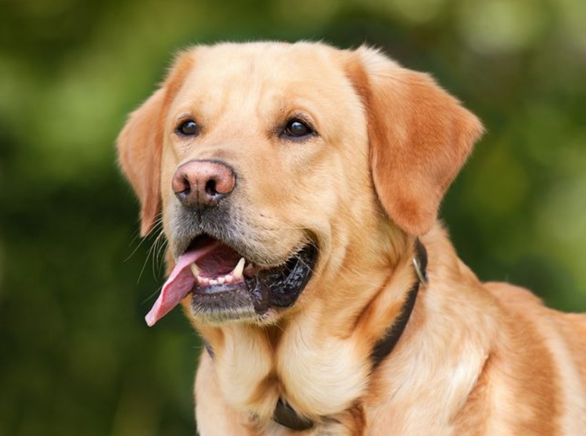
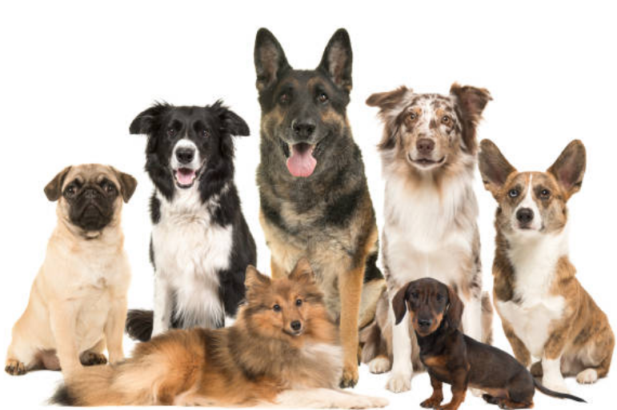
The Prototype View vs. The Classical View
The Classical View
Concepts are mentally represented as definitions.
Every object is either strictly in or not in the category.
Assumes no distinction between category members.
Problems
Impossible to come up with a concrete definition of a category with necessary and sufficient features.
A member may not be clearly in or out of a category.
Notes:
Problem: If we give dog a simple definition of having four legs, bark, have fur and sleep. There are furless dogs, dogs that have lost a leg or two. Can not distinguish dogs from other animals. Can not come up with a unified set of definition that would conveniently include all dogs and exclude non-dogs.

Slide 3
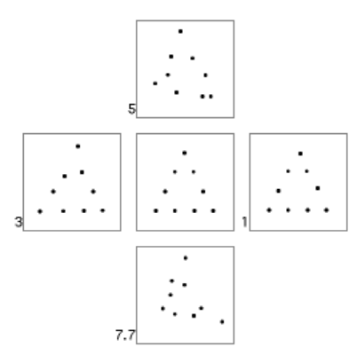
The Prototype View vs. The Classical View
The Prototype View
Best example theory: every category can be represented by a single, best prototype.
Summary representation: the prototypical representation is assumed to be a summary representation that corresponds to some “central tendency.”
A triangle (center image) is clearly the
prototype of the category of distorted
dot images.
Posner & Keele (1968)
Notes:
The prototype view argues that there is some prototype that is a unified representation of the category.

Slide 4
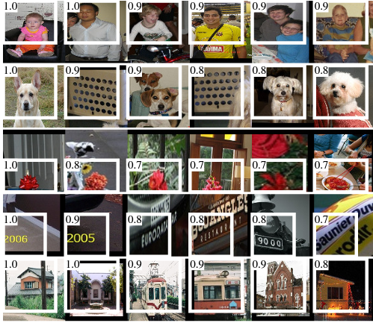
The Prototype View
Summary representation Best example
Learned Image Templates
Maximum Neuron Activation
Girshick et al.(2014)
Notes:
One example to the summary representation could be learned image templates from a linear classifier. These visualization of the weights can be viewed as a prototypical representation of the classes.
One example to the best example could be the images input that attains the maximum neuron activation. They are the single best prototypes according to the best example theory.

Slide 5
The Prototype View Cont.
The best example approach is often regarded as flawed.
No ideal example can encompass all the variabilities of a category.
Shares the same pitfalls as the classical view.
Summary representation
Family-resemblance view (Rosch & Mervis): features that are usually found in the category members are of different importance in representation.
(A weapon may or may not be made of metal. But the feature of a weapon “doing harm” is highly weighted.)
Notes:
The best example theory is often deemed to be unwarranted. The idea that a single prototype could represent a whole category is questionable. There is no ideal example that can encompass all the variabilities.

Slide 6
The Prototype View Cont.
Family-resemblance view
It is difficult to deal with continuous dimensions that do not have set feature values.
(How to define the lethality of a weapon?)
Categorize new items (Smith & Osherson):
Calculates the similarity of the item to the feature list. A common feature is assigned high “scores,” where a dissimilar or missing feature is assigned low “scores.”
A categorization criterion classifies new items into categories based on some critical values threshold.
Notes:
Continue to the family-resemblance view, one problem is that it is difficult to deal with continuous dimensions.
Under this framework, one way to categorize new items is to calculate the similarity of the item to the feature list.

Slide 7
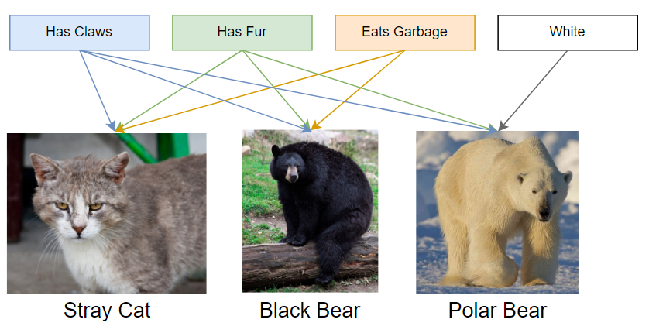
The Prototype View Cont.
Feature combinations (Rosch & Mervios, Smith & Medin, Hampton)
Keeps track of how often features occurred in category members.
A polar bear would have the
combinatorial features of “has
claws,” “has fur,” “white,”
“claws and fur,” “claws and white,”
“fur and white,” “claws and fur and
white.” The combinatorial complexity
scales polynomially – combinatorial
explosion.
Notes:
An additional methods for categorization under the prototype view framework is feature combination.

Slide 8
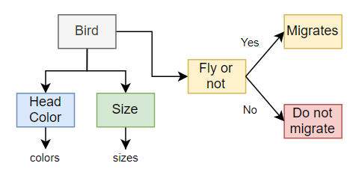
The Prototype View Cont.
Schemata (Cohen & Murphy, Smith & Osherson)
Unstructured feature list does not represent relations between features.
A schemata is a structured representation that divides up the features and their associated weights.
A hierarchical structure of features puts
constraints on entries (head colors field
cannot include sizes) and on relations (a
bird that does not fly cannot migrate).
Notes:
Lastly, one development tied to prototype view is the schemata representation of concepts.

Slide 9
The Exemplar View
The Exemplar View (Medin & Schaffer)
People do not have a representation that somehow encompasses an entire concept; instead, a person’s concept is the specific set that the person remembers.
The most typical items are the ones that are highly similar to many category members.
(A German shepherd is extremely similar to dogs and is not similar
to other animals. But a chihuahua is less typical because it is more
similar to maybe guinea pig.)
A contrastive model that learns representation from similarities to previously learned category.

Slide 10
The Exemplar View
A contrastive model that learns representation from similarities to previously learned category.
The prototype view argues that a person learns a general, robust representation from observations.
vs
The exemplar view argues that, after some initial category learning (seeing alpacas for the first time in a zoo), a person learns a representation is relative to previously learned categories.
Notes:
A person initially learns a basic abstraction of category of alpaca after seeing it for the first time in a zoon. The person then learns a representation that is relative to previous learned categories. The representation of alpaca is tailored based on, for example, how an alpaca is similar to dogs, horse or goats.

Slide 11
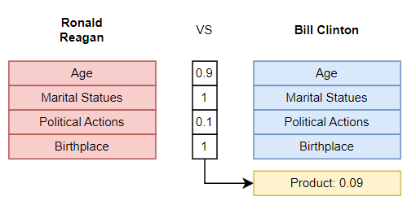
The Exemplar View
Similarity calculation according to the context model (Medin & Schaffer)
Medin and Schaffer proposed a multiplicative function of matching and mismatching features for similarities.
* 1 = Trivial
* 0 = Important
Notes:
One key aspect of an elaborate exemplar model is how to identify similar exemplars.
For each feature, you would compute a similarity score between the features to decide how matching or mismatching they

Slide 12
The Exemplar View
Similarity calculation according to the context model (Medin & Schaffer)
To compare an item against exemplars, similarities scores (products) are added up for each exemplar in a category.
For example, if you have 100 exemplars of dogs in your memory, you would add up the similarities of an observed animal to those 100 dogs.
The category with the most similarities to the observed item would “win” the contest.
The multiplicative nature of this similarity measure suggests that it is better to be very similar to a few items, and it is unhelpful to be somewhat similar to many items.

Slide 13
The Knowledge Approach
The knowledge Approach
Concepts are part of our general knowledge about the world. We do not learn concepts in isolation from everything else.
Concepts are influenced by what we already know, and a new concept will affect subsequent predictions.
A baby goose is dissimilar to a mother goose, both visually and biologically. A similarity-based model may not correctly categorize a baby goose without external, prior knowledge (babies are smaller and often stick close to their parents).

Slide 14
Discussion
Goal-derived categories @f1, @f8
Goal-derived categories appears to resolve the limitations of the prototype views and the exemplar views. Categories are defined in terms of how their members fulfills some desired goals (e.g., birthday presents).
“Prior-knowledge” can be multimodal. We may not distinguish baby goose and mother goose visually without using biology properties (baby and mother).
Views (classical, prototype, exemplar, etc.) discussed in the paper don’t tell the whole story @f2, @f7
Which of the discussed approach, or a combination of them, is more prevalent in computer vision research?
A simple linear classifier learns a template (prototype), and uses similarity (exemplar) to predict future items.
Exemplar views vs World view@f3
Do models trained using human annotations have general knowledge of certain world views, or do they simply obtain isolated tasked-specific information?

