Slide 1
Hand Movements: A Window into Haptic Object Recognition
By Susan Lederman and Roberta Klatzky
Published 1987 in Cognitive Psychology, Vol. 19 Iss. 3
Presented by Adam Li
Discussion by Maxwell Li
Notes:
View original slides at https://docs.google.com/presentation/d/1B9EXJhzM2bPKVOgSwb02GVuT8gP7gdTVqbBk_XKfE9Y/edit

Slide 2
Agenda
Intro and What is Haptics?
Exploratory Procedures
Experiment 1: Instructed Haptic Exploration
Experiment 2: Constrained Haptic Exploration
Paper Summary and Discussion
Piazza Discussion
Appendix

Slide 3
Authors
Susan Lederman
Roberta Klatzky
Canadian Experimental Psychologist
Professor at Queen’s University
Done research on
  Texture perception
  Haptic processing
Helped add tactile features to canadian banknotes for accessibility
Professor of Psychology at Carnegie Mellon University
Has done work in
  Navigational aids
  Haptic interfaces
  Exploratory robotics
Specializes in human perception and cognition

Slide 4
Haptics
Haptics is the study of touch and perception through such physical feeling
The haptic system has historically performed poorly in research
  2D raise displays
  3D nonsense shapes
Author’s prior work demonstrates efficient recognition of common objects
Why the discrepancy?
Notes:
Haptics is the study of touch and perception through such physical feeling
Prior research had repeatedly shown the haptic system to be poor at perceiving spatial layout and structure
However, this was specifically with 2-dimensional raised displays and 3d nonsense shapes
In contrast, the authors previously demonstrate that real and common 3-d object could be recognized quickly and efficiently through haptic exploration

Slide 5
Haptics, in a Different Light
Haptics is composed of two subsystems
  Sensory subsystem
  Motor subsystem
Perhaps poor performance is because of restricted motor subsystem?
Perhaps the motor subsystem enhances the sensory subsystem?
Notes:
If we instead view the hand as a composition of two subsystems, the sensory subsystem and the motor subsystem, this discrepancy starts to make sense
Sensory composed of cutaneous, thermal, and kinesthetic sensors
Motor composed of actively grasp and manipulate objects.
Empirical evidence and observations seems to support the idea that the hand “piggybacks” off of the motor subsystem

Slide 6
If the hand can take advantage of its motor competencies to facilitate its perceptual and cognitive functions, hand movements should vary with the sensory input and with the type of information desired.
If the hand can take advantage of its motor competencies to facilitate its perceptual and cognitive functions,
Notes:
Once the authors considered manipulation, and with the empirical evidence that the addition of this manipulation system serves to enhance the sensory system, they come to the following empirical hypothesis.
If the hand…

Slide 7
Agenda
Intro and What is Haptics?
Exploratory Procedures
Experiment 1: Instructed Haptic Exploration
Experiment 2: Constrained Haptic Exploration
Paper Summary and Discussion
Piazza Discussion
Appendix

Slide 8
Haptic Exploration
Authors postulate common stereotyped patterns, “Exploratory Procedures”
Exploratory Procedure | Knowledge Gain
Lateral Motion | Texture
Pressure | Hardness
Static Contact | Temperature
Unsupported Holding | Weight
Enclosure | Volume, Global Shape
Contour Following | Volume, Exact Shape
Function Test | Specific Function
Part Motion Test | Part Motion
Substance-related
Structure-related
Function-related
Notes:
The authors aim to show that in combination with the motor subsystem which provides manipulation, the hand can improve its perceptual and cognitive functions to gather more information.
They attempt to describe what can be observed during haptic “apprehension,” by which they mean the task of assessing and understanding object properties and how they combine.
For a basic unit of haptic observation, the authors define “Exploratory Procedures,” which are stereotyped movement patterns executed independently of the effector or hand configuration, but containing some invariant property.
They postulated eight types of these movement patterns, and link them a variety of object-based knowledge parameters - Substance-related parameters, structure-related parameters, and function-related parameters.

Slide 9
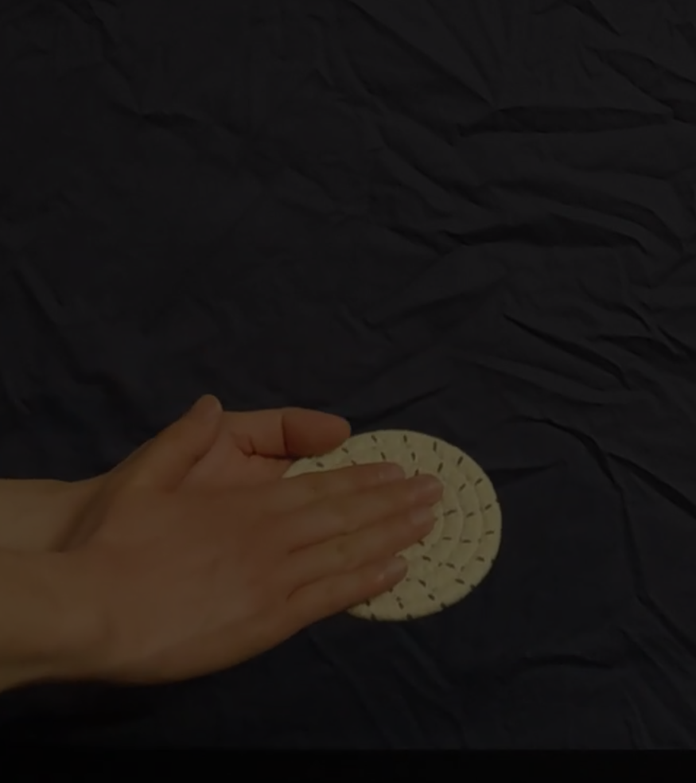
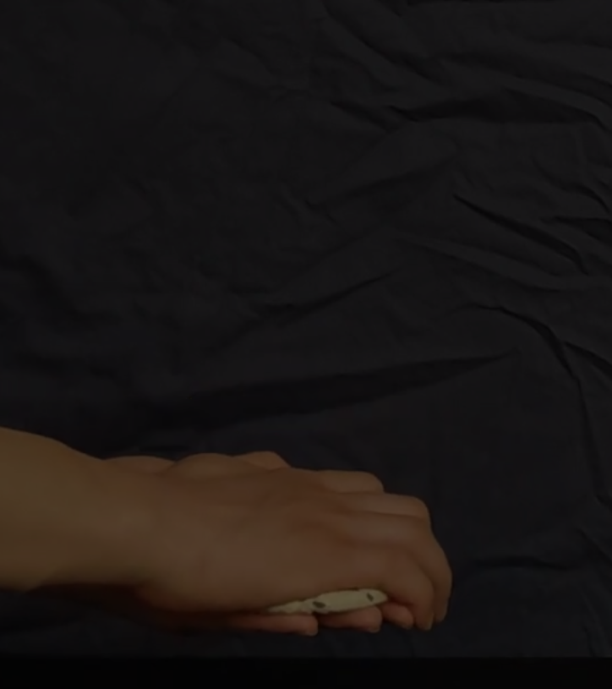

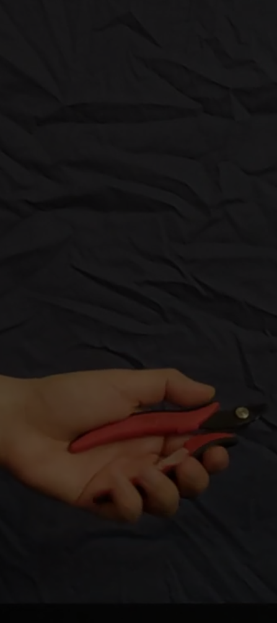
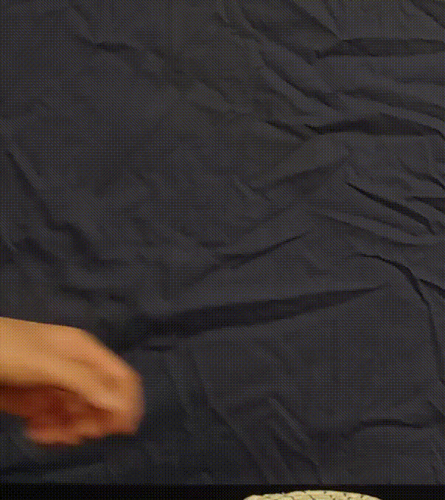
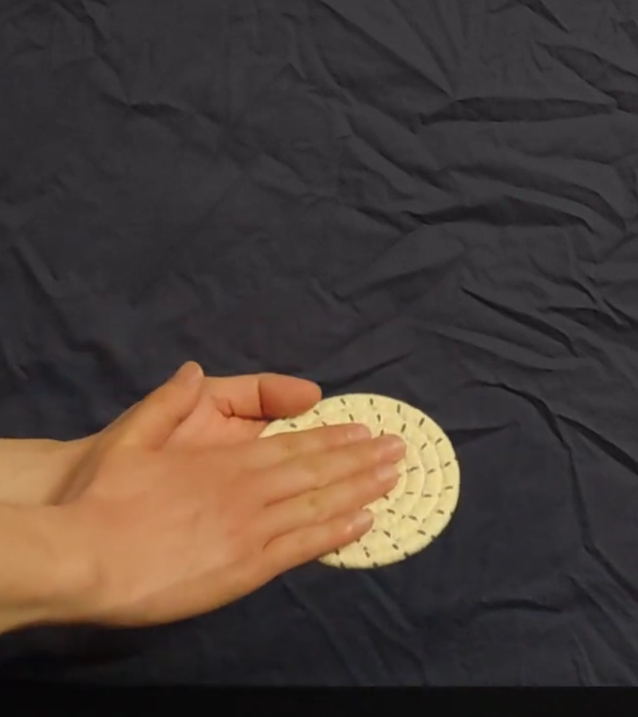
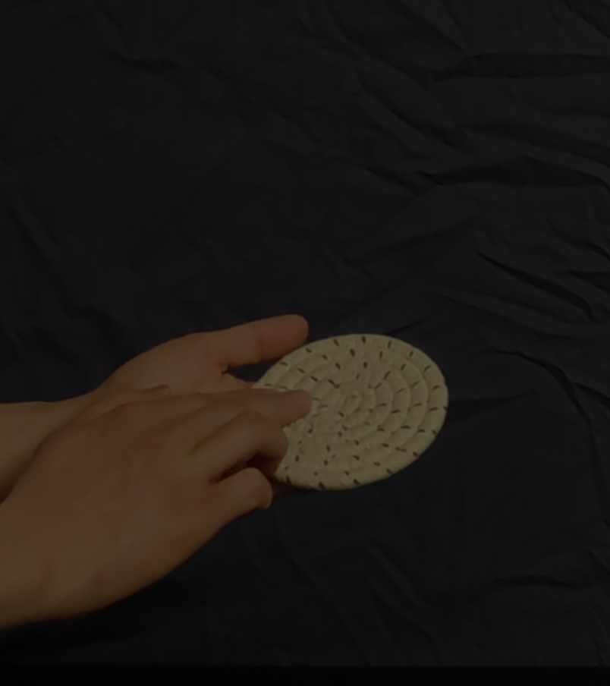
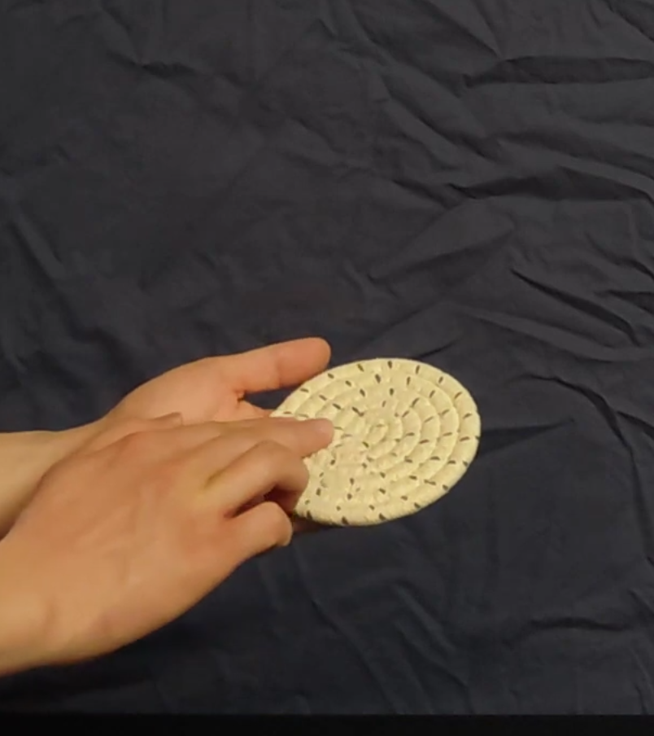
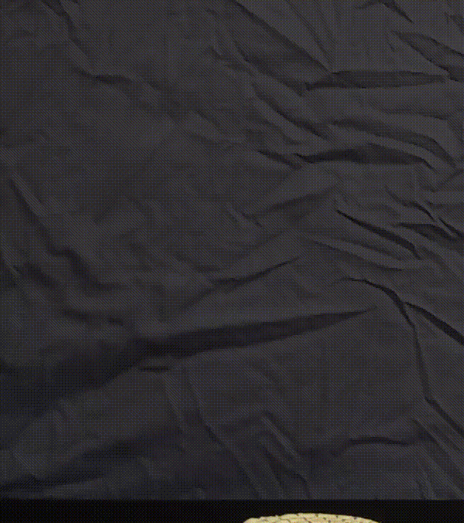
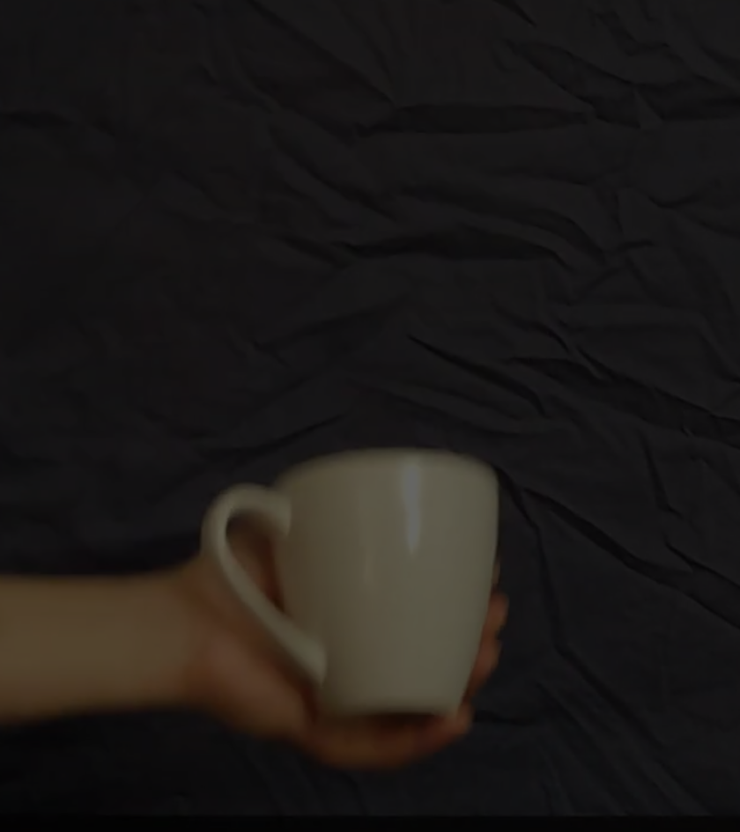
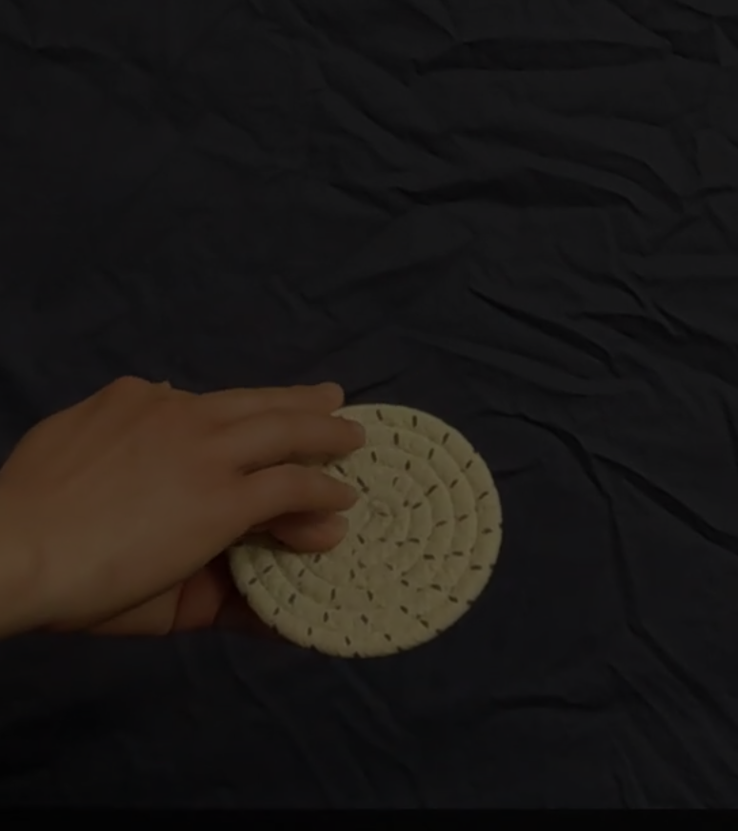
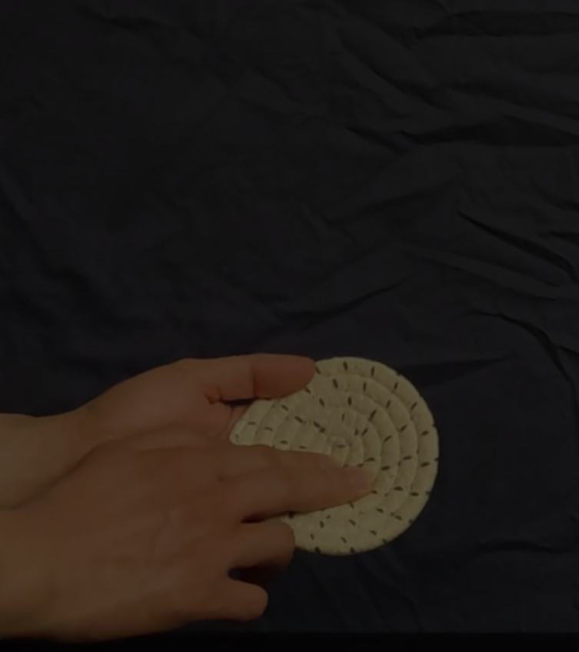
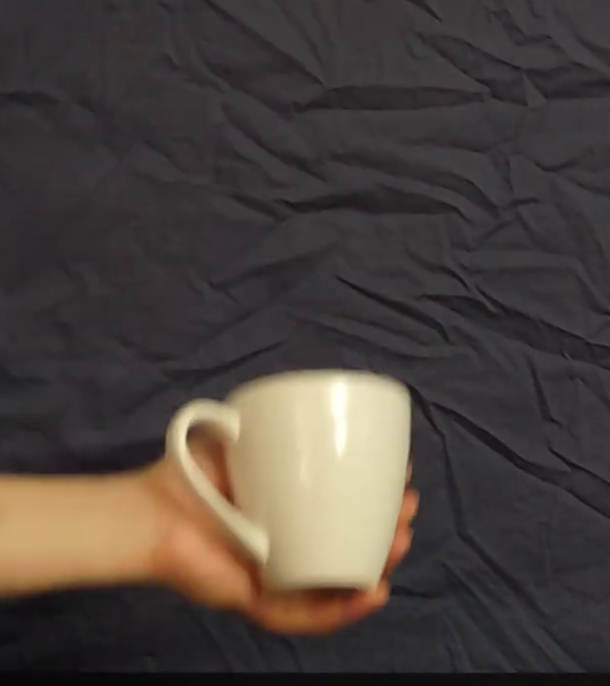
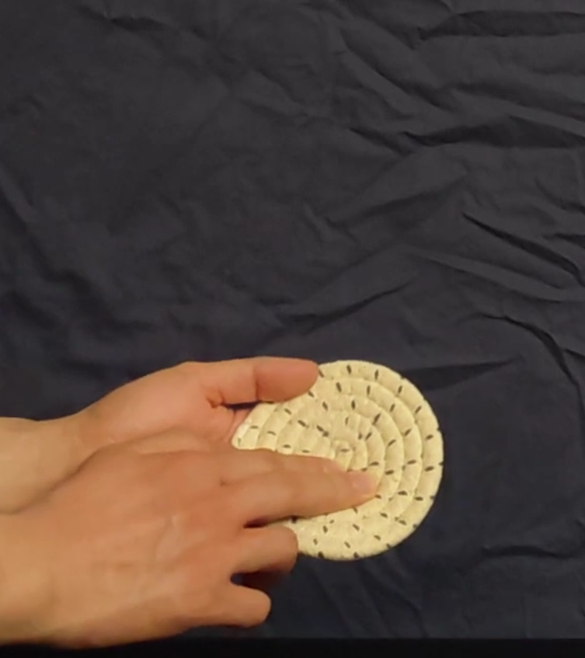
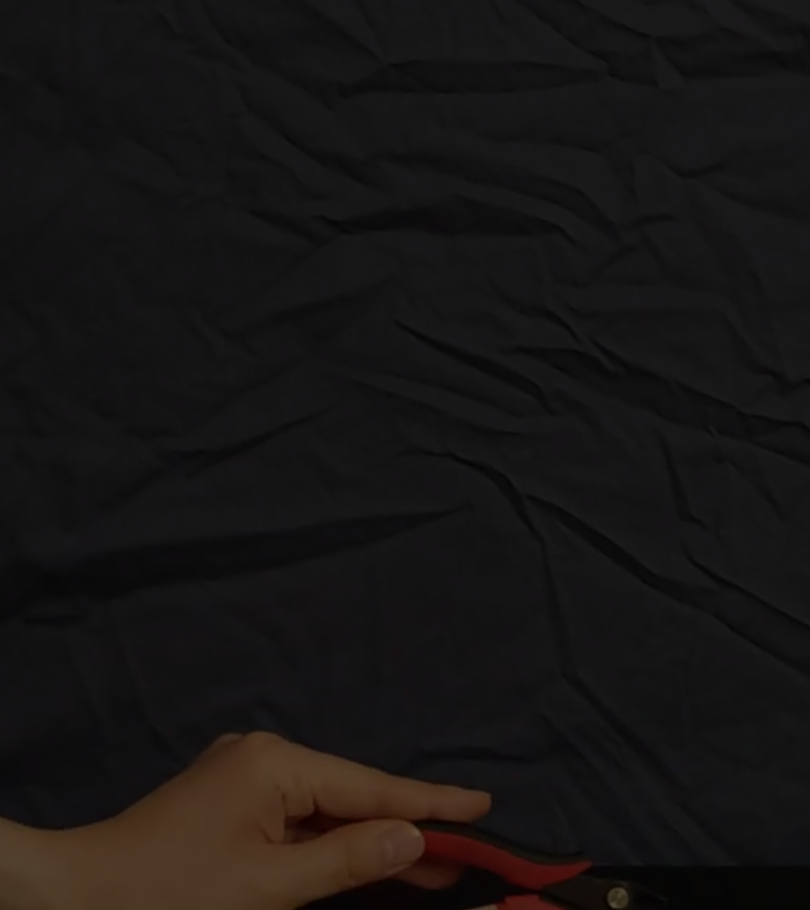

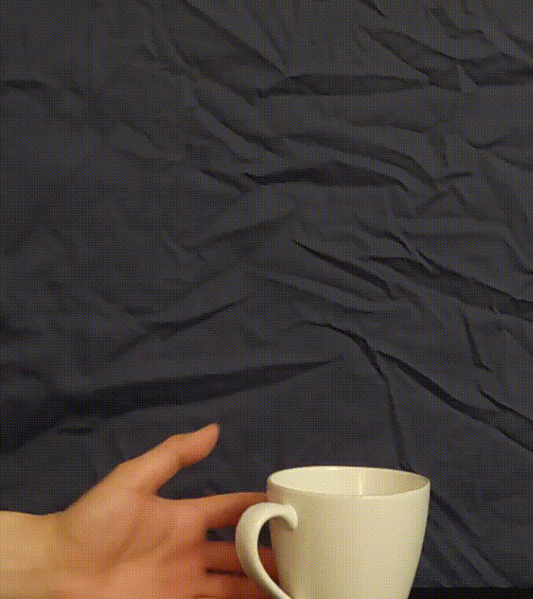

Slide 10
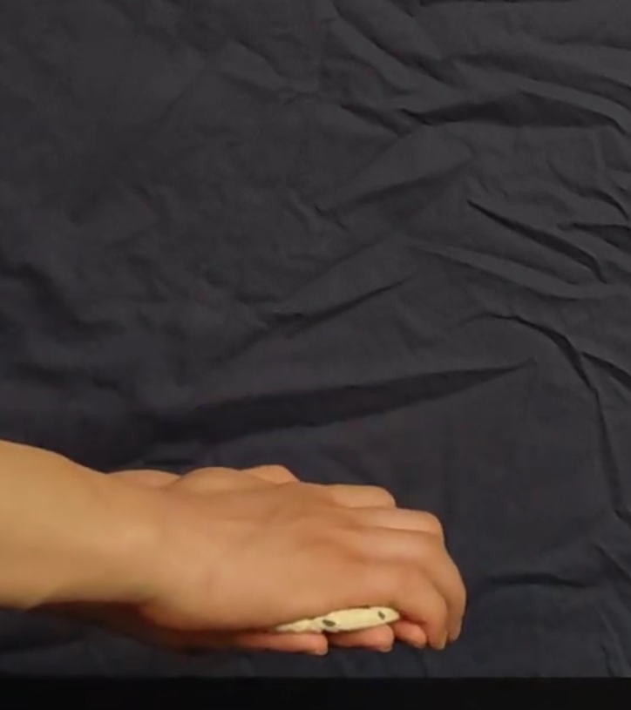
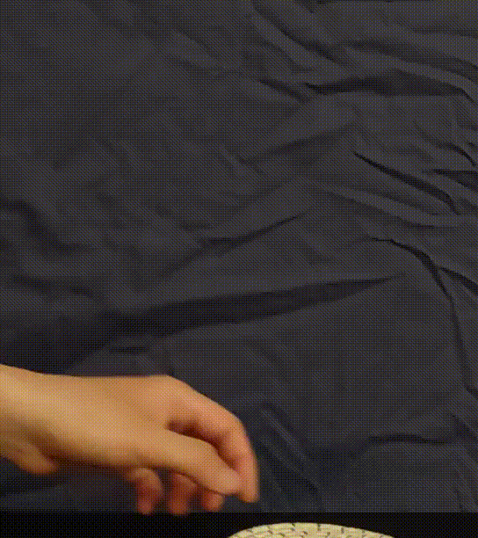
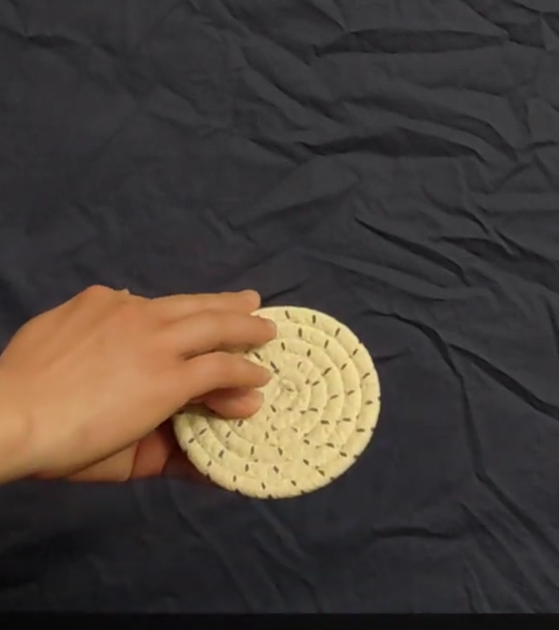
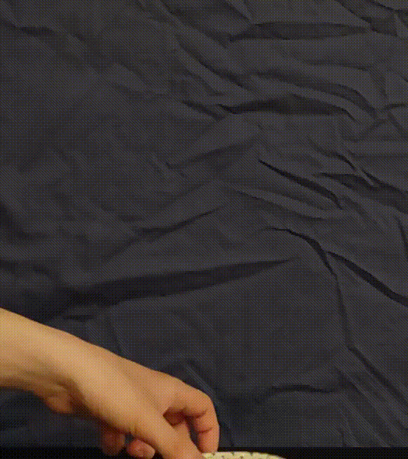

Slide 11
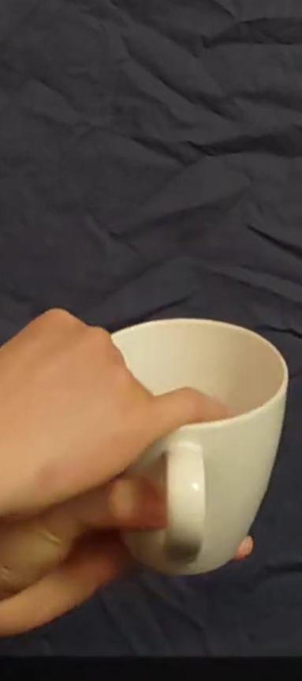

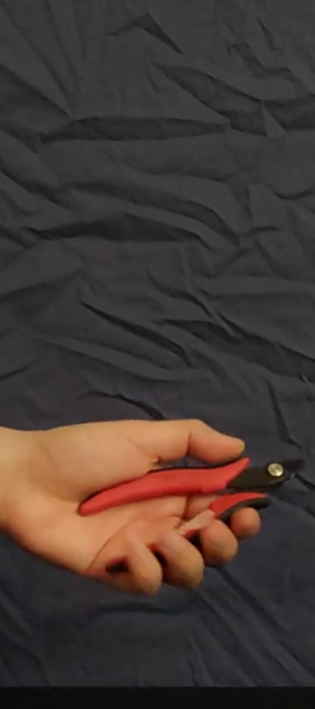

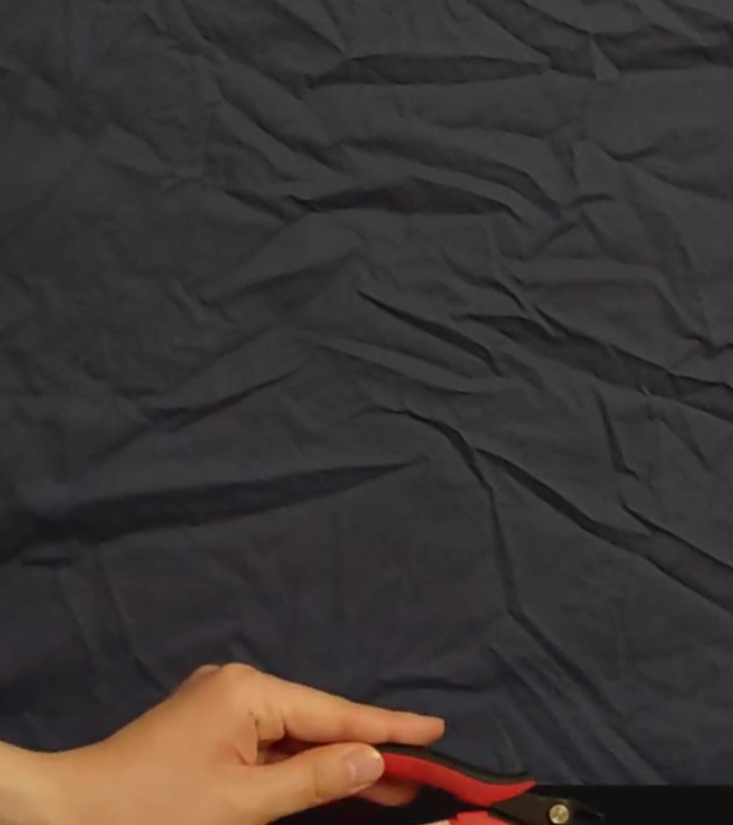


Slide 12
Notes:
The authors were not the first to explore haptics with abstract descriptions like these either. However, these “elementary movements” were intended to be somewhat broad and capture the hand movement specifically during object recognition and understanding. While the authors could have added more procedures, they chose to exclude object-specific movements like pencil sharpening and focus on more generally observable movements. This way, it could remain relatively unambiguous and easy to identify, with functionally similar movements being grouped together.

Slide 13
Agenda
Intro and What is Haptics?
Exploratory Procedures
Experiment 1: Instructed Haptic Exploration
Experiment 2: Constrained Haptic Exploration
Paper Summary and Discussion
Piazza Discussion
Appendix

Slide 14
Experiment 1 Setup
18 volunteers as subjects
36 sets of objects
  1 standard object
  3 comparison objects, 1 of which is best match
Blindfolded and given an instructed dimension to explore
Time limits for exploration set by a few pilot trials
Recorded experiments reviewed and hand movements classified
Notes:
The goal of experiment 1 was to see if there were consistent elementary motions like these exploratory procedures that could be identified in an object exploration or recognition task.
18 volunteers with 36 sets of objects
Each set composed of 1 standard object and 3 comparison objects, one of which is a best match across one of the 9 knowledge properties previously mentioned.
Texture, Hardness, Temperature, Weight, Volume, Global Shape, Exact Shape, Part Motion, and Function.
Subjects blindfolded and given a dimension to explore along with a time limit
blindfolded subjects matched objects on an instructed dimension and their hand movements were classified into exploratory procedures
Subjects blindfolded and given a dimension to explore along with a time limit
blindfolded subjects matched objects on an instructed dimension and their hand movements were classified into exploratory procedures

Slide 15
Experiment 1 Results
Dimension Instruction | Observed Exploratory Procedure Duration (s)
 | Lateral Motion | Pressure | Static Contact | Unsupported Holding | Enclosure | Contour Following | Part Motion / Function
Texture | 3.46 | 0.18 | 0.00 | 0.00 | 0.07 | 0.82 | -
Hardness | 0.66 | 2.24 | 0.01 | 0.05 | 0.03 | 0.52 | -
Temperature | 0.02 | 0.13 | 0.06 | 0.00 | 2.00 | 0.58 | -
Weight | 0.10 | 0.08 | 0.00 | 2.12 | 0.28 | 0.55 | -
Volume | 0.20 | 0.01 | 0.04 | 0.07 | 2.61 | 2.15 | -
Global Shape | 0.32 | 0.13 | 0.00 | 0.00 | 1.00 | 4.30 | -
Exact Shape | 0.35 | 0.00 | 0.00 | 0.03 | 1.92 | 11.20 | -
Part Motion | 0.00 | 0.06 | 0.03 | 0.00 | 0.43 | 2.13 | 3.26
Function | 0.24 | 0.18 | 0.08 | 0.00 | 0.26 | 2.42 | 3.50
Mean EP Time | 0.59 | 0.33 | 0.02 | 0.25 | 0.96 | 2.74 | 3.38
Notes:
A volunteer was brought on to measure the duration of exploratory procedures during the matching task
The resulting average duration for each procedure for a given instructed dimension are thus tabulated.
In purple we see the
“this latter departure from predictions points out a problem with the raw duration analysis; it does not take into account the fact that different EPs inherently take different times to execute. Accordingly, Table 4b presents the duration data in the form of z scores computed over columns, which adjust for this difference.”

Slide 16
Experiment 1 Results
Dimension Instruction | Observed Exploratory Procedure Duration (s)
 | Lateral Motion | Pressure | Static Contact | Unsupported Holding | Enclosure | Contour Following | Part Motion / Function
Texture | 3.46 | 0.18 | 0.00 | 0.00 | 0.07 | 0.82 | -
Hardness | 0.66 | 2.24 | 0.01 | 0.05 | 0.03 | 0.52 | -
Temperature | 0.02 | 0.13 | 0.06 | 0.00 | 2.00 | 0.58 | -
Weight | 0.10 | 0.08 | 0.00 | 2.12 | 0.28 | 0.55 | -
Volume | 0.20 | 0.01 | 0.04 | 0.07 | 2.61 | 2.15 | -
Global Shape | 0.32 | 0.13 | 0.00 | 0.00 | 1.00 | 4.30 | -
Exact Shape | 0.35 | 0.00 | 0.00 | 0.03 | 1.92 | 11.20 | -
Part Motion | 0.00 | 0.06 | 0.03 | 0.00 | 0.43 | 2.13 | 3.26
Function | 0.24 | 0.18 | 0.08 | 0.00 | 0.26 | 2.42 | 3.50
Mean EP Time | 0.59 | 0.33 | 0.02 | 0.25 | 0.96 | 2.74 | 3.38
Notes:
A volunteer was brought on to measure the duration of exploratory procedures during the matching task
The resulting average duration for each procedure for a given instructed dimension are thus tabulated.
In purple we see the relative time per column. This can then be compared to the expected optimal knowledge gain EP’s, except for one problem.
This does not take into account the fact that different EPs inherently take different times to execute, and so can’t be compared row-wise.
So the authors thus calculated z scores over the columns and perform the comparison. Accordingly, Table 4b presents the duration data in the form of z scores computed over columns, which adjust for this difference.”

Slide 17
Experiment 1 Results
Dimension Instruction | Observed Exploratory Procedure Duration (s)
 | Lateral Motion | Pressure | Static Contact | Unsupported Holding | Enclosure | Contour Following | Part Motion / Function
Texture | 3.46 | 0.18 | 0.00 | 0.00 | 0.07 | 0.82 | -
Hardness | 0.66 | 2.24 | 0.01 | 0.05 | 0.03 | 0.42 | -
Temperature | 0.02 | 0.13 | 0.06 | 0.00 | 2.00 | 0.58 | -
Weight | 0.10 | 0.08 | 0.00 | 2.12 | 0.28 | 0.55 | -
Volume | 0.20 | 0.01 | 0.04 | 0.07 | 2.61 | 2.15 | -
Global Shape | 0.32 | 0.13 | 0.00 | 0.00 | 1.00 | 4.30 | -
Exact Shape | 0.35 | 0.00 | 0.00 | 0.03 | 1.92 | 11.20 | -
Part Motion | 0.00 | 0.06 | 0.03 | 0.00 | 0.43 | 2.13 | 3.26
Function | 0.24 | 0.18 | 0.08 | 0.00 | 0.26 | 2.42 | 3.50
Mean EP Time | 0.59 | 0.33 | 0.02 | 0.25 | 0.96 | 2.74 | 3.38
Dimension Instruction | Observed Exploratory Procedure Duration (s)
 | Lateral Motion | Pressure | Static Contact | Unsupported Holding | Enclosure | Contour Following | Part Motion / Function
Texture | 3.46 | 0.18 | 0.00 | 0.00 | 0.07 | 0.82 | -
Hardness | 0.66 | 2.24 | 0.01 | 0.05 | 0.03 | 0.42 | -
Temperature | 0.02 | 0.13 | 0.06 | 0.00 | 2.00 | 0.58 | -
Weight | 0.10 | 0.08 | 0.00 | 2.12 | 0.28 | 0.55 | -
Volume | 0.20 | 0.01 | 0.04 | 0.07 | 2.61 | 2.15 | -
Global Shape | 0.32 | 0.13 | 0.00 | 0.00 | 1.00 | 4.30 | -
Exact Shape | 0.35 | 0.00 | 0.00 | 0.03 | 1.92 | 11.20 | -
Part Motion | 0.00 | 0.06 | 0.03 | 0.00 | 0.43 | 2.13 | 3.26
Function | 0.24 | 0.18 | 0.08 | 0.00 | 0.26 | 2.42 | 3.50
Mean EP Time | 0.59 | 0.33 | 0.02 | 0.25 | 0.96 | 2.74 | 3.38
Notes:
So the authors thus calculated z scores over the columns, which I used to obtain this following color coding, and perform the comparison.
If we highlight the highest z-score color per row, we then also obtain the best performing EP for each task according to experiment 1.
Note, only 11 observers used to get final data, after verifying consistency with a split reliability test. This was done because of the time it took to analyze the data.
Also concern with reliability check of the first scorers results with second scorer as one of the experimenters is a concern. Specifically, how this second scorer changed some of the scoring guidelines after the fact (making it moving goalposts). Regardless, there was high agreement between the two.
Despite flaws, clearly demonstrates links for further exploration and thus exp 2

Slide 18
Agenda
Intro and What is Haptics?
Exploratory Procedures
Experiment 1: Instructed Haptic Exploration
Experiment 2: Constrained Haptic Exploration
Paper Summary and Discussion
Piazza Discussion
Appendix

Slide 19
Experiment 2 points
Exploration constraints added to Experiment 1
48 volunteers
Subset of the same 36 object sets
Unlike before, hand movements were limited
Only 6 EP’s and 7 knowledge dimensions -> 42 trials
Time limits based on the times from Experiment 1
Performance assessed to find links between EP’s and knowledge goals
Notes:
Goal was to identify the links between exploratory procedures and knowledge goals, so added constraints to experiment 1
48 volunteers with same 36 sets of objects.
Subjects blindfolded and instructed to match, except they were limited ways to move their hands
Only 6 EP’s and 7 dimensions used as the part movement and function were hard to differentiate and explain without revealing information. Total of 42 trials
Time limits based on the times found in Experiment 1
blindfolded subjects were asked to perform a specific constrained exploratory procedure and performance on specific matching tasks was assessed to identify the links between exploratory procedures and knowledge goals.

Slide 20
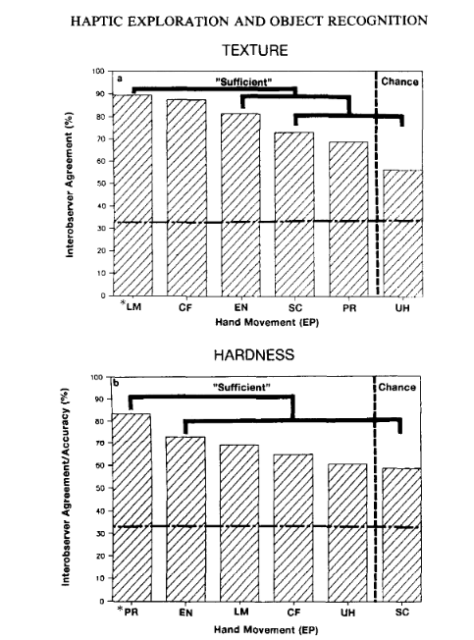
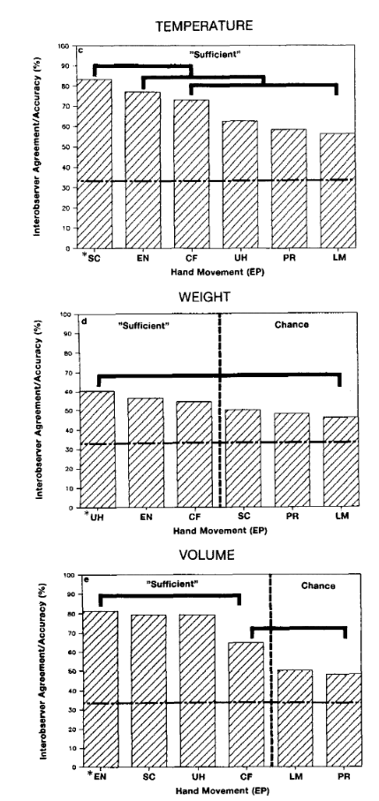
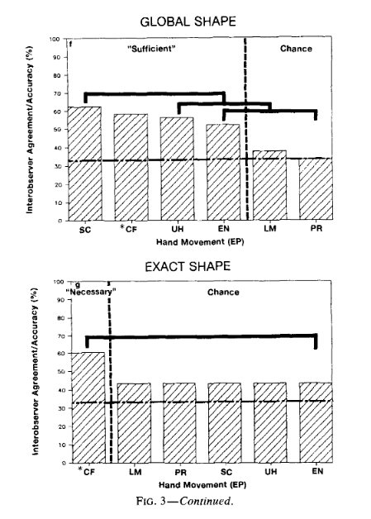
Experiment 2 Histogram Results
Notes:
Effect of EP duration - variable and thus no further analysis
Accuracy - see following graphs
Necessary EP’s - contour following, necessary to exact shape
Sufficient EP’s - 1-6 for each instruction, refer to graph
Optimal EP’s - For all except global shape, the expected from exp 1 was the optimal one
EP specialization - a measure of how good one ep is in its specific condition over all others

Slide 21
Experiment 2 Results
Dimension Requested | Exploratory Procedure Constraint
 | Lateral Motion | Pressure | Static Contact | Unsupported Holding | Enclosure | Contour Following
Texture | •
Hardness |  | •
Temperature |  |  | •
Weight |  |  |  | •
Volume |  |  |  |  | •
Global Shape |  |  | •
Exact Shape |  |  |  |  |  | ⦿
EP Specialization Score | 2.06 | 2.79 | 1.56 | 1.95 | 0.62 | 1.92
Notes:
Effect of EP duration - variable and thus no further analysis
Accuracy - see following graphs
Necessary EP’s - contour following, necessary to exact shape
Sufficient EP’s - 1-6 for each instruction, refer to graph
Optimal EP’s - For all except global shape, the expected from exp 1 was the optimal one for exp2
EP specialization - a measure of how good one ep is in its specific condition over all others

Slide 22
EP Optimality Based on Experiments 1 and 2
Dimension Requested | Exploratory Procedure Constraint
 | Lateral Motion | Pressure | Static Contact | Unsupported Holding | Enclosure | Contour Following
Texture | •
Hardness |  | •
Temperature |  |  | •
Weight |  |  |  | •
Volume |  |  | •
Global Shape |  |  | •
Exact Shape |  |  |  |  |  | ⦿
Duration (s) | 3 | 2 | 2 | 2 | 3 | 11
EP Specialization Score | 2.06 | 2.79 | 1.56 | 1.95 | 0.62 | 1.92
Notes:
They also combine the results of the two experiments to create a combined metric of EP optimality, shown above.
Indices of optimality here should be taken as indicating a lower bound, and hence why an exploratory procedure like static contact is considered better over enclosure for the volume dimension.

Slide 23
Agenda
Intro and What is Haptics?
Exploratory Procedures
Experiment 1: Instructed Haptic Exploration
Experiment 2: Constrained Haptic Exploration
Paper Summary and Discussion
Piazza Discussion
Appendix

Slide 24
Notes:
In this paper, the authors sought to answer the question of haptic object recognition.
Since a haptic glance is usually confined to a single object and usually not completely accessible to the haptic sensory system, motion is required to learn about the complete object.
The authors defined these 8 exploratory procedures to identify the connection between hand motions and desired knowledge gain of the task.

Slide 25
EP Optimality Based on Experiments 1 and 2
Dimension Requested | Exploratory Procedure Constraint
 | Lateral Motion | Pressure | Static Contact | Unsupported Holding | Enclosure | Contour Following
Texture | •
Hardness |  | •
Temperature |  |  | •
Weight |  |  |  | •
Volume |  |  | •
Global Shape |  |  | •
Exact Shape |  |  |  |  |  | ⦿
Duration (s) | 3 | 2 | 2 | 2 | 3 | 11
EP Specialization Score | 2.06 | 2.79 | 1.56 | 1.95 | 0.62 | 1.92
Notes:
They then create two experiments and combine the results of them to create this metric of EP optimality, shown above.
And given the above table of necessary, sufficient, and optimal exploratory procedures, they also demonstrate that not just any movement suffices for a given dimension either.
They additionally offered the taxonomy of exploratory procedures for purposeful hand movements and demonstrate it’s linkage with specific knowledge dimensions of objects.
That linkage also provides a hierarchical approach to obtaining data, one where for some completely unfamiliar object, a general EP like enclosure may first be performed to help dictate what EP may follow.
With these experiments, they successfully demonstrate that the hand is an intelligent device which uses motor capabilities to greatly extend its sensory function.

Slide 26
Agenda
Intro and What is Haptics?
Exploratory Procedures
Experiment 1: Instructed Haptic Exploration
Experiment 2: Constrained Haptic Exploration
Paper Summary and Discussion
Piazza Discussion
Appendix

Slide 27
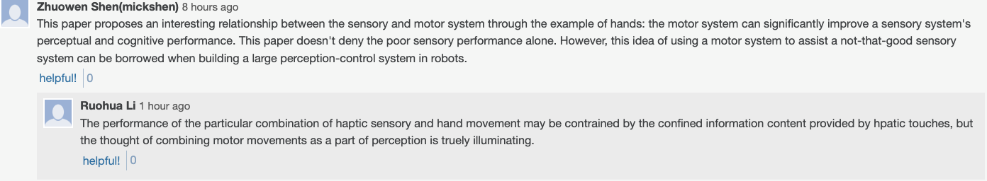
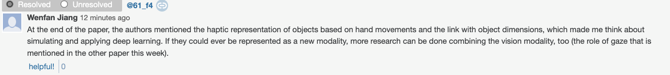
Multi-Modal Aspect of Haptic Information & Perception
Notes:
For the discussion I saw there were some interesting posts regarding the multi modal aspects of integrating hand movements as a way to enrich data for deep learning models. Having haptic representations could allow for richer data which could lead the way to better results for conventional deep learning.

Slide 28
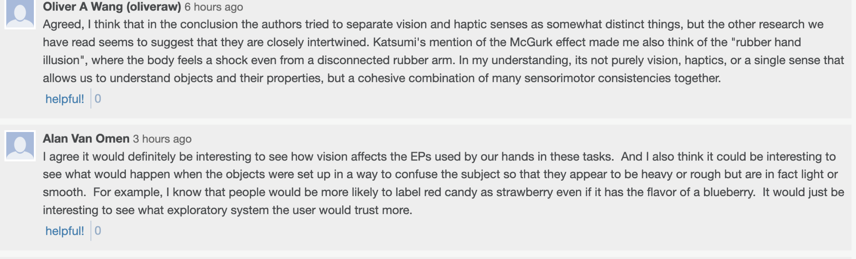
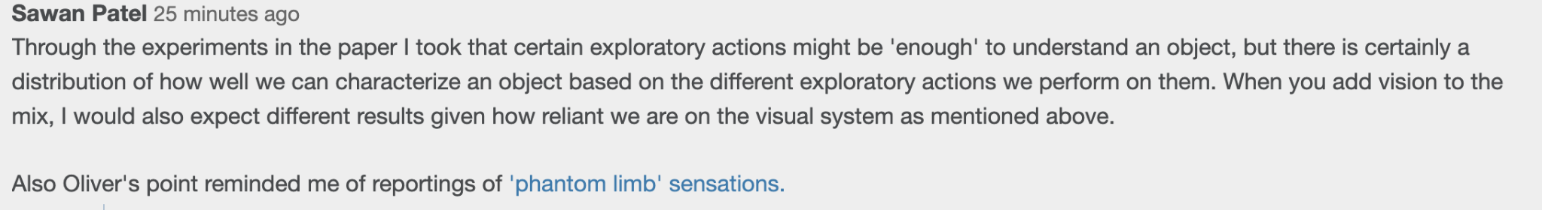
Separation of Haptics and Vision
Notes:
The authors separated vision and haptic feedback as two completely separate systems. Some of the papers that we have gone through more recently would suggest that perception takes into account many systems at the same time. Would vision effect the exploratory procedures that the authors went through?

Slide 29
Agenda
Intro and What is Haptics?
Exploratory Procedures
Experiment 1: Instructed Haptic Exploration
Experiment 2: Constrained Haptic Exploration
Paper Summary and Discussion
Piazza Discussion
Appendix

Slide 30
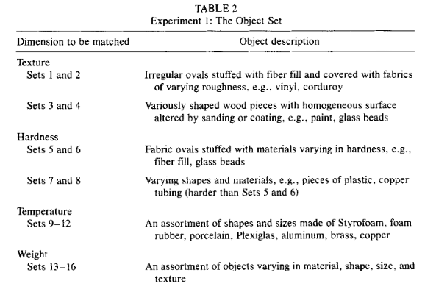
Appendix A: The Object Set for Experiment 1

Slide 31
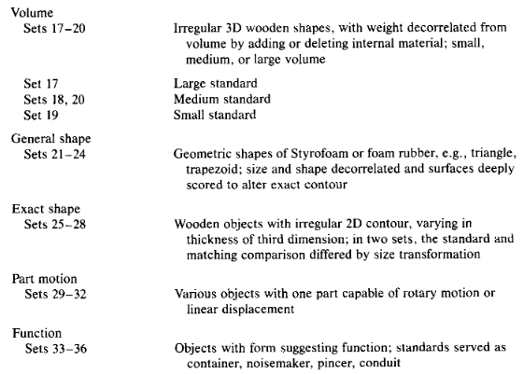
Appendix A: The Object Set for Experiment 1 (cont.)

Slide 32
Appendix B: Experiment 1 Dimension Times
Dimension | Time Given (s) | Description
Texture | 7
Hardness | 8
Temperature | 6 | How relatively warm or cool the objects feel
Weight | 6
Volume | 7 | Three-dimensional size
General shape | 10 | The regularly shaped container into which the object would best fit with a minimum of empty space independent of size
Exact shape | 20 | Precise local variation in contour, ignoring size transformations
Part motion | 10 | Rotary vs translational motion
Function | 16 | The purpose for which the object may be used

Slide 33
Appendix C: Z-Score Table for Experiment 1
Dimension Instruction | Observed Exploratory Procedure Column-normalized Z-score
 | Lateral Motion | Pressure | Static Contact | Unsupported Holding | Enclosure | Contour Following | Part Motion / Function
Texture | 2.78 | -0.22 | -0.89 | -0.38 | -0.96 | -0.60 | -
Hardness | 0.06 | 2.82 | -0.46 | -0.30 | -1.00 | -0.69 | -
Temperature | -0.56 | -0.31 | 1.43 | -0.38 | 1.13 | -0.67 | -
Weight | -0.48 | -0.38 | -0.89 | 2.83 | -0.73 | -0.68 | -
Volume | -0.38 | -0.48 | 0.61 | -0.28 | 1.80 | -0.18 | -
Global Shape | -0.27 | -0.30 | -0.89 | -0.38 | 0.05 | 0.48 | -
Exact Shape | -0.24 | -0.49 | -0.89 | -0.34 | 1.05 | 2.63 | -
Part Motion | -0.58 | -0.41 | 0.11 | -0.38 | -0.57 | -0.19 | +
Function | -0.34 | -0.23 | 1.79 | -0.38 | -0.76 | -0.10 | +

Slide 34
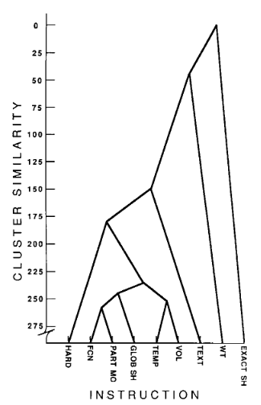
Appendix D: Relative Time Complexity of Tasks Exp 1

Slide 35
Appendix E: Precise EP Directions for Experiment 2
Precise descriptions of the six EPs to be used in exploration were provided. Each EP was referred to by name throughout the experiment. For “lateral motion,” the middle finger was placed on some homogeneous part of the object’s surface, and observers rubbed the surface in a quick back and forth motion. For “pressure,” the middle finger was placed on the object, and observers pushed directly into the object’s surface, alternately pushing and relaxing. For “static contact,” the entire palm of the observer’s preferred hand was placed gently against the object, where it relaxed without moulding to the object’s contours. For “unsupported holding,” the object was placed in the observer’s hand, which rested palm up on the table. He or she lifted the hand off the table and hefted the object up and down, cupping the hand a little to prevent the object from rolling, but without molding. For “enclosure,” observers rested one hand palm up on the table, with the wrist on the table edge. When an object was placed in this hand, observers closed their fingers around its edges, using the other hand as well if desired. Finally, for “contour following,” the middle finger was placed on an edge of the object resting on the table. Observers were to follow along its contours, using as many fingers of either/both hands as they wished. For each EP instruction, observers were told not to use any of the other forms of exploratory motions which had been explained. Movement was monitored by the experimenter.

Slide 36
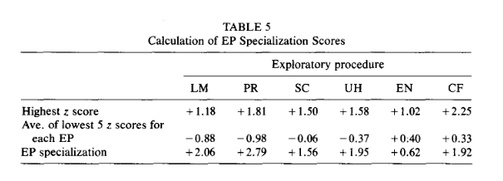
Appendix F: Calculation of EP Specialization Scores

Slide 37
Organization (notes, not the actual intro slide)
Haptics in perception (Two systems, sensory subsystem and motor subsystem)
What are EP’s
  The 8 EP’s
Two Experiments
  Instructed Haptic Exploration (blindfolded subjects matched objects on an instructed dimension and their hand movements were classified into exploratory procedures)
    Illustrated Demo
    Conclusions (distinctive and predictable EP’s)
  Constrained Haptic Exploration (blindfolded subjects were asked to perform a specific constrained exploratory procedure and performance on specific matching tasks was assessed to identify the links between exploratory procedures and knowledge goals.)
    Illustrated Demo
    Conclusions (Necessary EP’s, Sufficient EP’s, Optimal EP’s. EP specialization)
Discussion from paper (probably integrate to the above)
Class Discussion

Slide 39
Notes:
https://www.youtube.com/watch?v=k_fTkwuhBrM

Slide 40
