Slide 1
PRINCIPLES OF CATEGORIZATION
A summary of
Eleanor Rosch, 1978
by
Chenhui Zhao | chuizhao@umich.edu
Youren Zhang | yourenz@umich.edu

Slide 2
“Human categorization should NOT be considered the arbitrary product of historical accident or of whim but RATHER the result of psychological principles of categorization, which are subject to investigation.”
Youren Zhang | Chenhui Zhao

Slide 3
TWO PRINCIPLES
1. Cognitive Economy
The task of category systems is to provide maximum information with the least cognitive effort.
To categorize a stimulus means to consider it for purposes
Maximum information: predict as many properties as possible from knowing any one property
Least cognitive effort: not to differentiate one stimulus from others when that differentiation is irrelevant to the purposes at hand
Youren Zhang | Chenhui Zhao

Slide 4


TWO PRINCIPLES
2. Perceived World Structure
The perceived world is NOT an unstructured total set of equiprobable co-occurring attributes Rather, the material objects of the world are perceived to possess high correlational structure.
Combinations of what we perceive as the attributes of real objects do not occur uniformly
The attributes of perceived world are species-specific and influenced by perceptual factors and social environment
Youren Zhang | Chenhui Zhao

Slide 5
TWO DIMENSIONS OF CATEGORY SYSTEMS
Level of Inclusiveness
Living Thing
Nonliving Thing
Animal
Machinery
Mammal
Vehicle
Dog
Car
Collie
Ford
Segmentation
Youren Zhang | Chenhui Zhao

Slide 6
IMPLICATION OF TWO PRINCIPLES
Cognitive Economy & Perceived World Structure
Two Principles
+
+
Vertical Dimension
Horizontal Dimension
Basic-level Objects
Prototypes
Youren Zhang | Chenhui Zhao

Slide 7
VERTICAL: BASIC-LEVEL OBJECTS
Terminology
Taxonomy: a system by which categories are related to one another by means of class inclusion
Category: a number objects that are considered equivalent
Taxonomy
Category
Youren Zhang | Chenhui Zhao

Slide 8
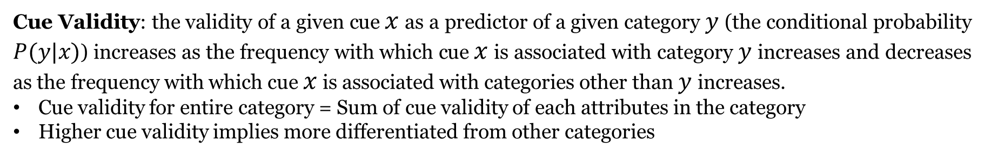
VERTICAL: BASIC-LEVEL OBJECTS
Metrics
Cue Validity: the validity of a given cue $x$ as a predictor of a given category $y$ (the conditional probability $P(y|x)$) increases as the frequency with which cue $x$ is associated with category $y$ increases and decreases as the frequency with which cue $x$ is associated with categories other than $y$ increases.
Cue validity for entire category = Sum of cue validity of each attributes in the category
Higher cue validity implies more differentiated from other categories
Category Resemblance (by Tversky): the weighted sum of the measures of all the common features within a category minus the sum of .the measures of all the distinctive features.
Does not weight the effect of contrast categories as much as does the cue validity.
Youren Zhang | Chenhui Zhao

Slide 9
VERTICAL: BASIC-LEVEL OBJECTS
Working Assumptions
Information of perceptual and functional attributes are discontinuous in perceived world
Basic cuts in categorization are made at these discontinuities
Vehicle
Furniture
Superordinate Level:
Few common attributes
Car
Chair
Basic Level:
At the level that maximize cue validity and category resemblance
…………
…………
Subordinate Level:
Bundles of common, predictable attributes and functions
Youren Zhang | Chenhui Zhao

Slide 10

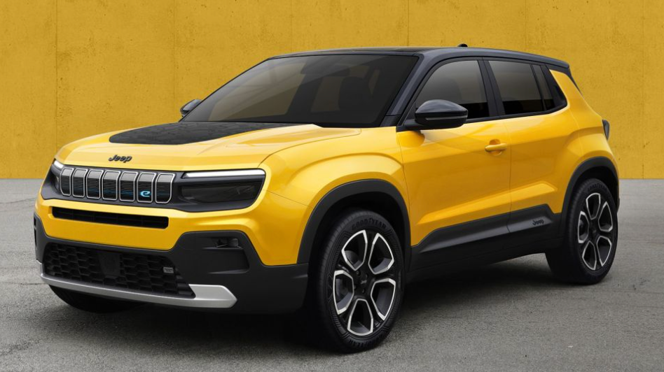
VERTICAL: BASIC-LEVEL OBJECTS
Four investigations provided converging operational definitions of the basic level of abstraction
Common Attributes
  There are more common attributes in basic level than in super- and subordinate level
Common Motor Movements
  Basic objects have most motor sequences in common
Similarity in Shape
  The similarity in shape was measured by the IoU of two outlines of objects
  The objects from basic level have greatest IoU
  Gain(Super -> Basic) > Gain(Basic -> sub)
Identifiability of averaged shapes
  The averaged shape of objects from basic level is recognizable
Youren Zhang | Chenhui Zhao

Slide 11
VERTICAL: BASIC-LEVEL OBJECTS
Implication for Other Fields
Imagery
  It is possible to form a mental image isomorphic to the appearance of members of class as whole.
Perception
  objects maybe recognized as members of their basic category, and that only with the aid of additional processing can they be identified as members of their superordinate or subordinate category.
Development
  Basic objects should be the first categorizations of concrete objects made by children.
Language
  Expect the most useful and, thus, most used name for an item to be the basic-level name.
  In the evolution of languages, one would expect names to evolve first for basic level objects, spreading both upward and downward as taxonomies increased in depth.
  It was the basic-level categories that were most often coded by single signs and super- and subordinate categories that were likely to be missing for sign language of the deaf.
Youren Zhang | Chenhui Zhao

Slide 12

HORIZONTAL: PROTOTYPES
Argument: Most, if not all, categories do not have clear-cut boundaries, basic object categories follow clusters of perceived attributes.
Cognitive economy dictates that categories tend to be viewed as being as separate from each other and as clear-cut as possible. Categorical judgments become a problem only if one is concerned with boundaries.
Youren Zhang | Chenhui Zhao

Slide 13
HORIZONTAL: PROTOTYPES
By prototypes of categories we have generally meant the clearest cases in the category.
Youren Zhang | Chenhui Zhao

Slide 14


HORIZONTAL: PROTOTYPES
Two Confusions
The notion of prototypes has tended to become reified as though it represent a specific category
The empirical findings about prototypicality have been confused with theories of processing - that is, there has been a failure to distinguish the structure of categories from theories concerning the use of that structure in processing
Bird
Robin
Penguin
Youren Zhang | Chenhui Zhao

Slide 15
HORIZONTAL: PROTOTYPES
Formation of Prototypes
The formation of prototypes should also maximize cue validity and category resemblance
The more prototypical a member is rated, the more/fewer attributes it has on common with members of the same/contracting categories.
Prototypical category members have been found to represent the means of attributes that have a metric (e.g., size).
In short, prototypes appear to be just those members of a category that most reflect the redundancy structure of the category as a whole.
Youren Zhang | Chenhui Zhao

Slide 16
HORIZONTAL: PROTOTYPES
Effects of Prototypicality on Psychological Dependent Variables
The prototypicality of items within a category can be shown to affect virtually all of the major dependent variables used as measures in psychological research.
Speed of Processing (Reaction time): recognizing responses is faster for the items that have been rated more prototypical.
Order of Development in Children: the children had learned the category membership of the prototypical members earlier than that of other members.
Order and Probability of Item Output: most prototypical items were the first and most frequently produced items when subjects were asked to list the members of the category.
Effects of Advance Information on Performance: degree of prototypicality determines whether advance information about the category name facilitates or inhibits responses in a matching task. (More on following slides)
Youren Zhang | Chenhui Zhao

Slide 17
HORIZONTAL: PROTOTYPES
Effects of Advance Information on Performance: Hedges, Substitutability into Sentences, Superordination in ASL (American Sign Language)
Hedges: qualifying terms such as "almost" and "virtually."
Bird
A robin is a technically bird
A penguin is technically a bird
Youren Zhang | Chenhui Zhao

Slide 18

HORIZONTAL: PROTOTYPES
Effects of Advance Information on Performance: Hedges, Substitutability into Sentences, Superordination in ASL (American Sign Language)
Substitutability into Sentences: prototypicality ratings for members of superordinate categories predicts the extent to which the member term is substitutable for the superordinate word in sentences.
“There are some birds perching on the telephone
wires outside.”
Youren Zhang | Chenhui Zhao

Slide 19
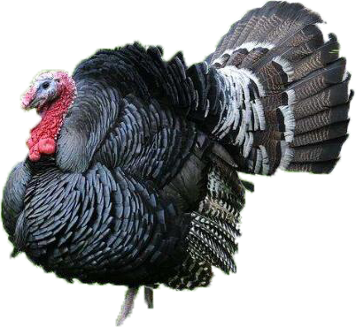
HORIZONTAL: PROTOTYPES
Effects of Advance Information on Performance: Hedges, Substitutability into Sentences, Superordination in ASL (American Sign Language)
Substitutability into Sentences: prototypicality ratings for members of superordinate categories predicts the extent to which the member term is substitutable for the superordinate word in sentences.
“There are some turkeys perching on the telephone
wires outside.”
Youren Zhang | Chenhui Zhao

Slide 20
HORIZONTAL: PROTOTYPES
Effects of Advance Information on Performance: Hedges, Substitutability into Sentences, Superordination in ASL (American Sign Language)
Superordination in ASL: when superordinates in ASL are generated by means of a partial fixed list of category members, those members are the more prototypical items in the category..
In summary, evidence has been presented that prototypes of categories are related to the major dependent variables with which psychological processes are typically measured.
Youren Zhang | Chenhui Zhao

Slide 21
HORIZONTAL: PROTOTYPES
Discussion of the role of prototypes: prototypes themselves do not constitute any particular model of processes, representations, or learning.
To speak of a prototype at all is simply a convenient grammatical fiction; what is really referred to are judgments of degree of prototypicality. There is no single entity that is the prototype.
Prototypes do not constitute any particular processing model for categories. Instead, what prototypicality contribute to processing notions is a constraint - process models should not be inconsistent with the known facts about prototypes
Prototypes do not constitute a theory of representation of categories. As with processing models, the facts about prototypes can only constrain, but do not determine, models of representation.
Prototypes do not constitute any particular theory of category learning. Learning of prototypicality could be represented in terms of other forms.
Youren Zhang | Chenhui Zhao

Slide 22
TWO PROBLEMATIC ISSUES
1. The Nature of Perceived Attributes
Some attributes, such as “seat” for the object “chair,” appeared to have names that is meaningless prior to knowledge of the object as chair;
Some attributes such as “large” for the object “piano” seemed to have meaning only in relation to categorization of the object in terms of a superordinate category - piano is large for furniture but small for other kinds of objects such as buildings;
Some attributes such as “you eat on it” for the object “table” were functional attributes that seemed to require knowledge about humans, their activities, and the real world in order to be understood.
Although the author argues the attributes are defined such as to make the system appear as logical and economical as possible. There is no place to analyze a particular category system, what is the unit with which to start analysis?
Youren Zhang | Chenhui Zhao

Slide 23
TWO PROBLEMATIC ISSUES
2. The Role of Context in Basic-Level Objects and Prototypes.
Both basic levels and prototypes are theories about context itself.
Does this mean that our findings in regard to basic levels and prototypes are relevant only to the artificial situation of the laboratory is which a context is not specified? The author argues that in the absence of a specified context, subjects assume what they consider the normal context or situation for occurrence of that object.
To make such claims about categories appears to demand an analysis of the actual events in daily life in which objects occur.
Youren Zhang | Chenhui Zhao

Slide 24
THE ROLE OF OBJECTS IN EVENTS
The Unit of The Events
Experiment: students in a seminar on events were asked to choose a particular evening on which to list the events that they remembered of that day
Result: There was considerable agreement on the kinds of units into which a day should be broken units such as making coffee, taking a shower, and going to statistics class. No one used much smaller units nor larger units. Furthermore, the units that were listed did not change in size or type with their recency or remoteness in time to the writing.
This implies a good candidate for the basic level of abstraction for events is the type of unit into which the students broke their days.
From the perspective of prototypes, it appears to be those category members judged the more prototypical that have attributes that enable them to fit into the typical and agreed upon script elements.
Youren Zhang | Chenhui Zhao

Slide 25
DISCUSSION
Notes:
Hello everyone, my name is Youren Zhang, my topic for today’s presentation is about Swin-Transformer, a CNN network in transformer’s clothing.

Slide 26
DISCUSSION
Cognitive economy and current computer vision models
30_f2
When modeling this concept with computer vision or other categorization tasks, how can we ensure it is only learning "enough" and not categorizing too much? It seems that if humans tell the models what to categorize into, they would not be able to outperform humans, but if left untouched, they would learn too much.
30_f6
The ways of categorization connects tightly as the way of perception. As the previous paper indicates, our perception evolved to create a representation of the real world that helps one's survival. We also evolve to pick features that contains most information about the category while minimizing the effort we spent detecting it. However, those features might not be the actual distinction that this animal or object has. The actual feature that distinct it from the rest might not be represented by our sensing system or simply too costly to include. When we see deep learning classification algorithms using feature that does not make sense to us. Does it mean they are wrong or we are wrong?
Youren Zhang | Chenhui Zhao

Slide 27
DISCUSSION
The connection between learning basic-level object and current recognition models
30_f1
The author defined the basic-level abstraction for the vertical dimension of categorization. I found the application of the idea of basic-level abstraction in perceptual and development quite inspiring. The author mentioned that objects might be first recognized as members of their basic category and that only with the aid of additional processing can then be identified as members of their superordinate or subordinate category, together with, basic objects should be the first categorizations of concrete objects made by children. These two applications make me rethink the pretrain model in computer vision. From the aspect of basic-level abstraction, we may think that the model was first pretrained on a large dataset (e.g., ImageNet1K) to learn the representation of the basic-level category. The promising performance of pretrain model on downstream tasks may reflect the generalization from the basic-level to subordinate or superordinate categories.
Youren Zhang | Chenhui Zhao

Slide 28
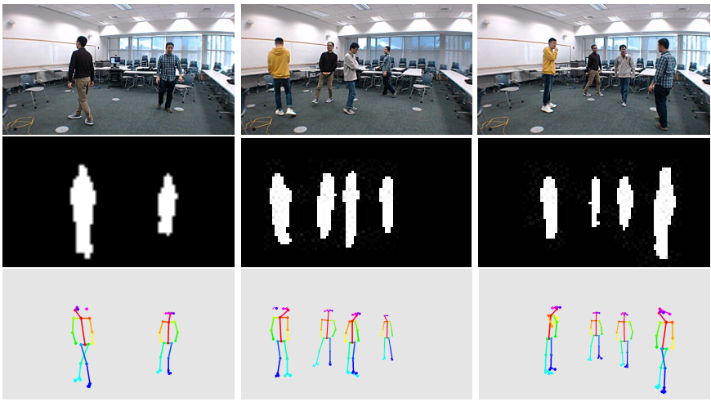
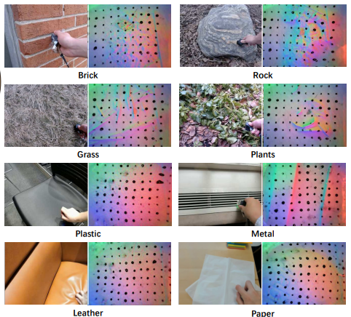
DISCUSSION
30_f8
When performing the action of sitting on a chair, a series of body and muscle movements are usually performed, which are inseparable from the properties of the chair. It is difficult to apply this to current recognition tasks, but when it comes to inseparable properties, I first proposed the CSI measurement, that is, the CSI measure varies from object to object. I also came up with Owen's paper "Touch and Go", which also utilized some inseparable properties.
Youren Zhang | Chenhui Zhao

Slide 29
DISCUSSION
Prototype
For natural language categories, responses of true are faster for the items that have been rated more prototypical.
  Output of a small network or output of the first few network layers in a large network.
Prototypes only constrain but do not specify representation and process models
Context
Different context will affect the basic object and the prototype.
  Gap between biomedical imaging and the general computer vision.
Youren Zhang | Chenhui Zhao

Slide 30
DISCUSSION
Unfortunately, to state the matter in such a way is to provide no clear place at which we can enter the system as analytical scientists.
Youren Zhang | Chenhui Zhao

Slide 31
DISCUSSION
FURTHER QUESTION…
Youren Zhang | Chenhui Zhao

Slide 32
THANKS!

Slide 33
DISCUSSION SUMMARY
Relationship between cognitive economy and modern neural network
  It is hard to relate the cognitive economy directly with the current neural network because the current model's optimal methods are based on gradient descent, and it is hard to determine what the model learned or when the model would learn enough. However, when specifying the problem that the cognitive economy model should ignore those irrelative items, the discussion about the vision transformer comes out. In the vision transformer model, we compute the self-attention between all the patches in an image, no matter whether they are correlative or not. In the contrast, deformable transformers are designed to learn the relationship between each patch and determine which should contribute to self-attention.
Connect the motor movement with current methods
  Motor movement is an operation that will converge to the basic object. In the article, motor movement is described as a kind of property of the basic object but it is hard to apply to the realistic model. There are some other kinds of properties are proposed on the Piazza, which may also converge to the basic object, such as the CSI measurement and the texture. In the class, some students mentioned that voice may also be a kind of property that can converge to the basic object.
Youren Zhang | Chenhui Zhao

